Slide 1

Fundamentals of Information System security
Sec285

Slide 2
introduction
Detailed, and visual summary of what we learned in SEC285

Slide 3
Mod 2
Asymmetric Key Encryption

Slide 4
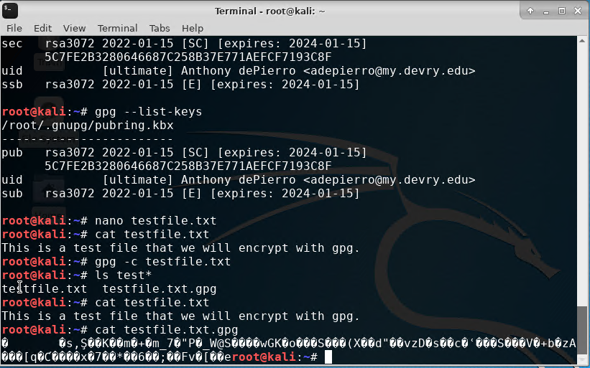
File Encryption
This screenshot shows the following.
Content of the plaintext file
Content of the encrypted file

Slide 5
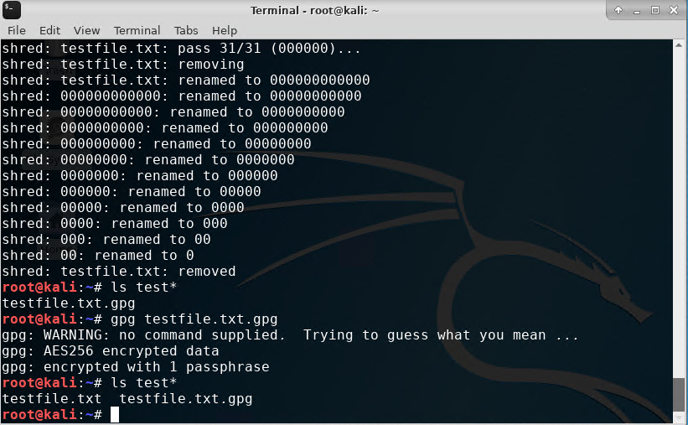
File Decryption
This screenshot shows the following.
The encrypted file being listed by itself
The decrypting process
Both the encrypted file and the original plaintext file being listed

Slide 6
Mod 3
Stateful Firewall

Slide 7
Question
What effect does the sudo iptables --policy INPUT DROP command have on the access to computing resources?
Answer here: The ‘sudo iptables --policy INPUT DROP’ command is a firewall rule that drops all the incoming connections to the computer
References: project guide

Slide 8
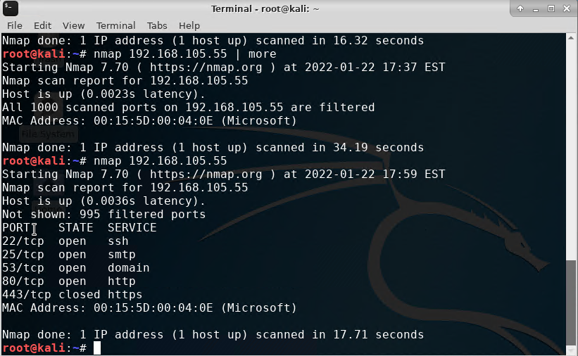
Nmap Scan
This screenshot shows the Nmap scan result of the Linux Server VM.

Slide 9
Mod 4
Bring Your Own Device (BYOD) Security Policy

Slide 10
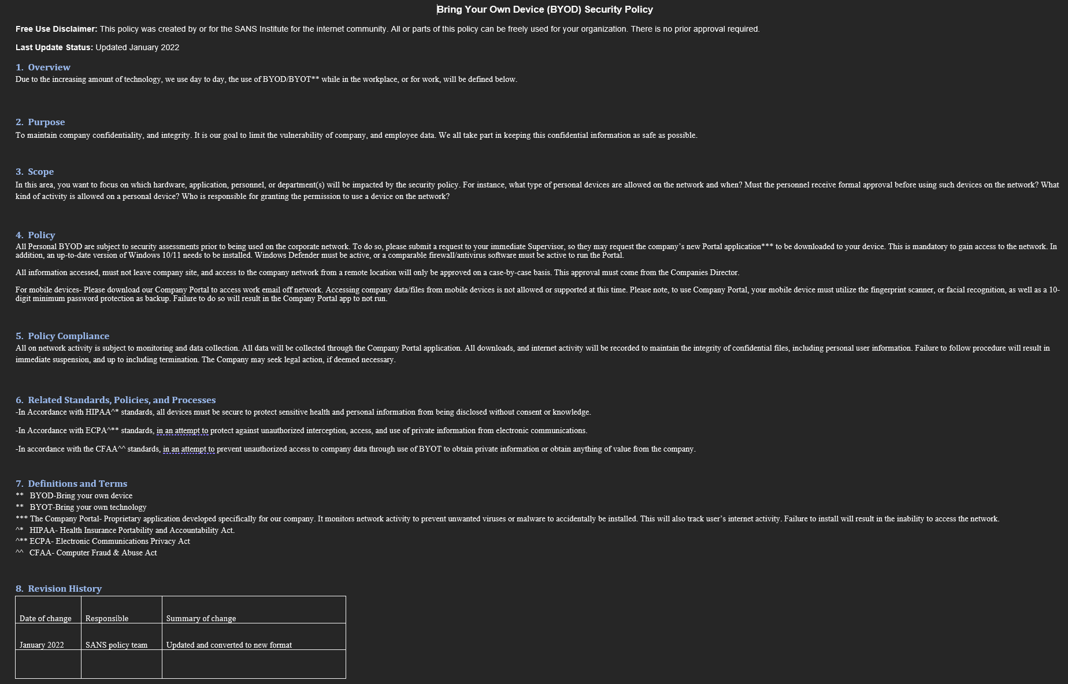

Slide 11
Mod 5
Multifactor Authentication (MFA)

Slide 12
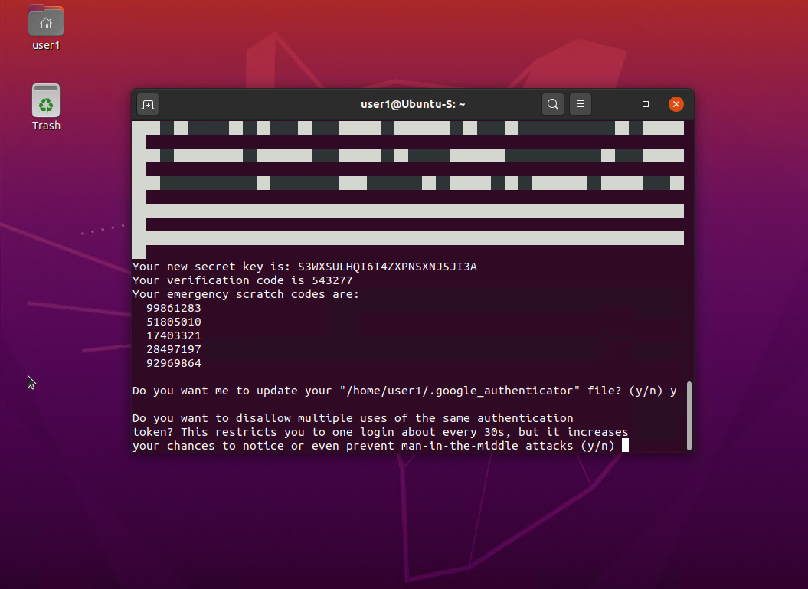
Common-auth Configuration File
This screenshot shows the entry that indicates the use of the Google Authenticator module.

Slide 13
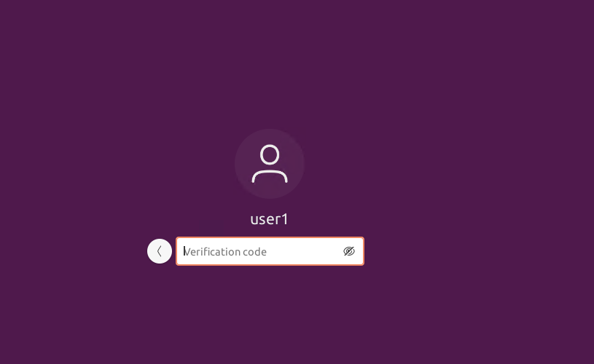
MFA Logon Screen
This screenshot shows the logon screen where a verification code is required.

Slide 14
Mod 6
Vulnerability Assessment

Slide 15
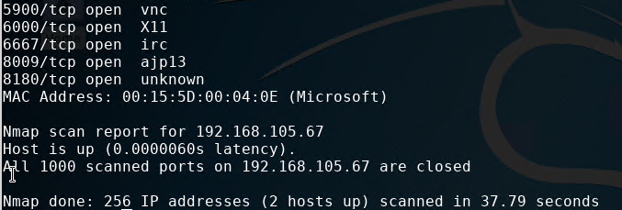
Nmap
This screenshot includes the scan result showing both the Kali and Linux Server VMs.

Slide 16
NetCat
This screenshot includes the scan result showing both the Kali and Linux Server VMs.

Slide 17
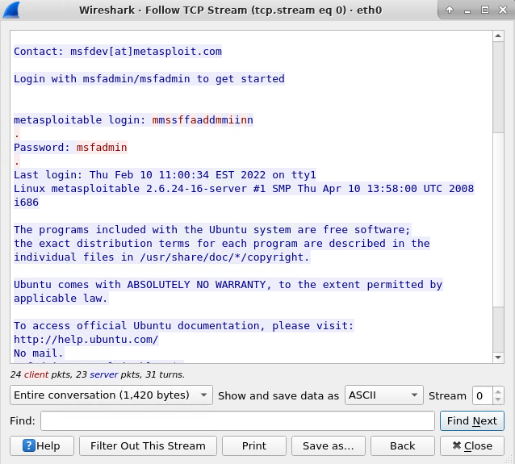
Wireshark
This screenshot includes the Wireshark—Follow TCP Steam window showing the Telnet username and password.

Slide 18
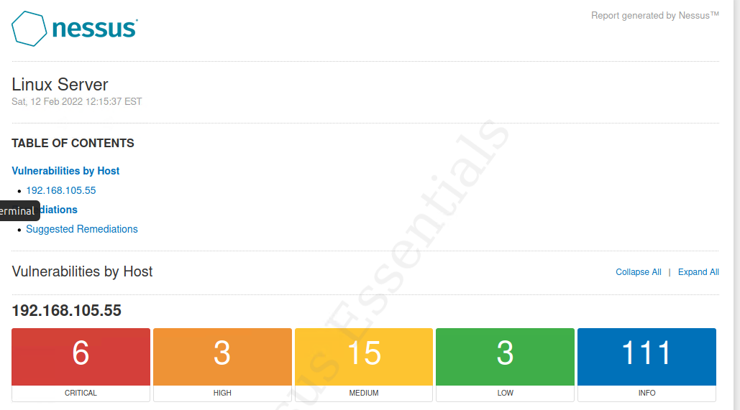
Nessus
This screenshot includes the high-level view of the Nessus vulnerability scan report (showing categories of vulnerability in different colors).

Slide 19
challenges
Connecting to Microsoft Azure
Kali Server not showing the mouse, making me unable to perform tasks unless I restarted.

Slide 20
Career skills
Encryption
Stateful firewall
Creating a Bring Your Own Device Policy
Setting up Multi-Factor Authentication
Performing Vulnerability assessment

Slide 21
conclusion
This project covered the fundamentals of information system security.
Building this project provided hands on practice to the topics covered in this course.

