Slide 1
CEIS 114
Introduction to Digital Devices

Slide 2
Introduction
Option 1- Creating a Multiple Traffic Light Controller with a Cross Walk and an Emergency Buzzer with secured IoT Control via Web

Slide 3
Module 2
Project Plan for IoT Traffic Controller

Slide 4
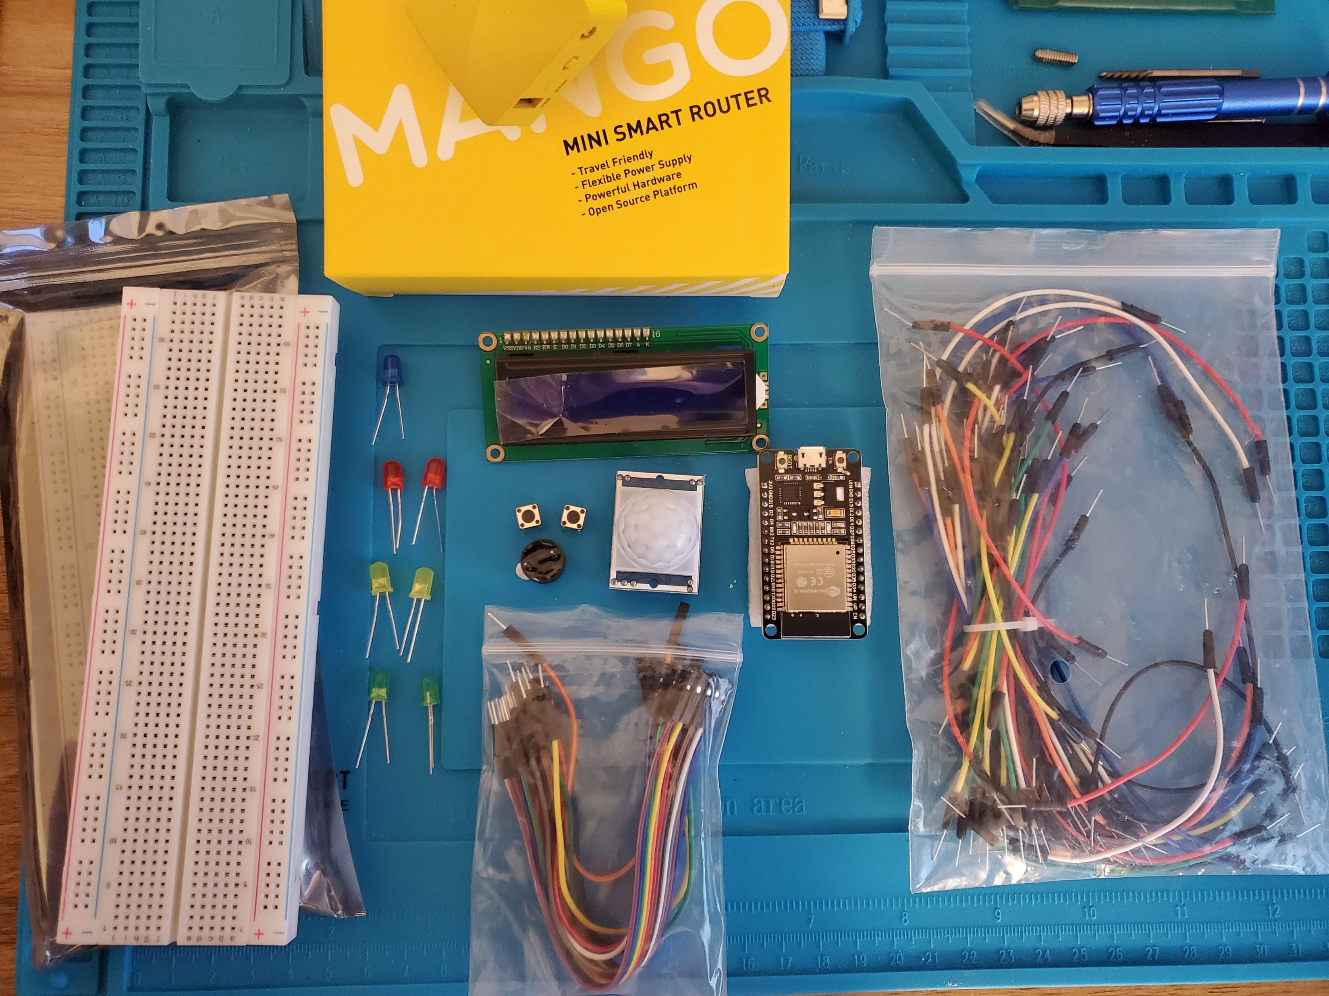
Inventory
ESP 32 Board
Colored LEDs: Red, Yellow, Green, and Blue
220 Ohm Resistors (optional)
Wires
Breadboard(s)
LCD Unit with I2C Adapter
Active Buzzer
Mini Router
Push Button(s)
PIR Motion Sensor

Slide 5
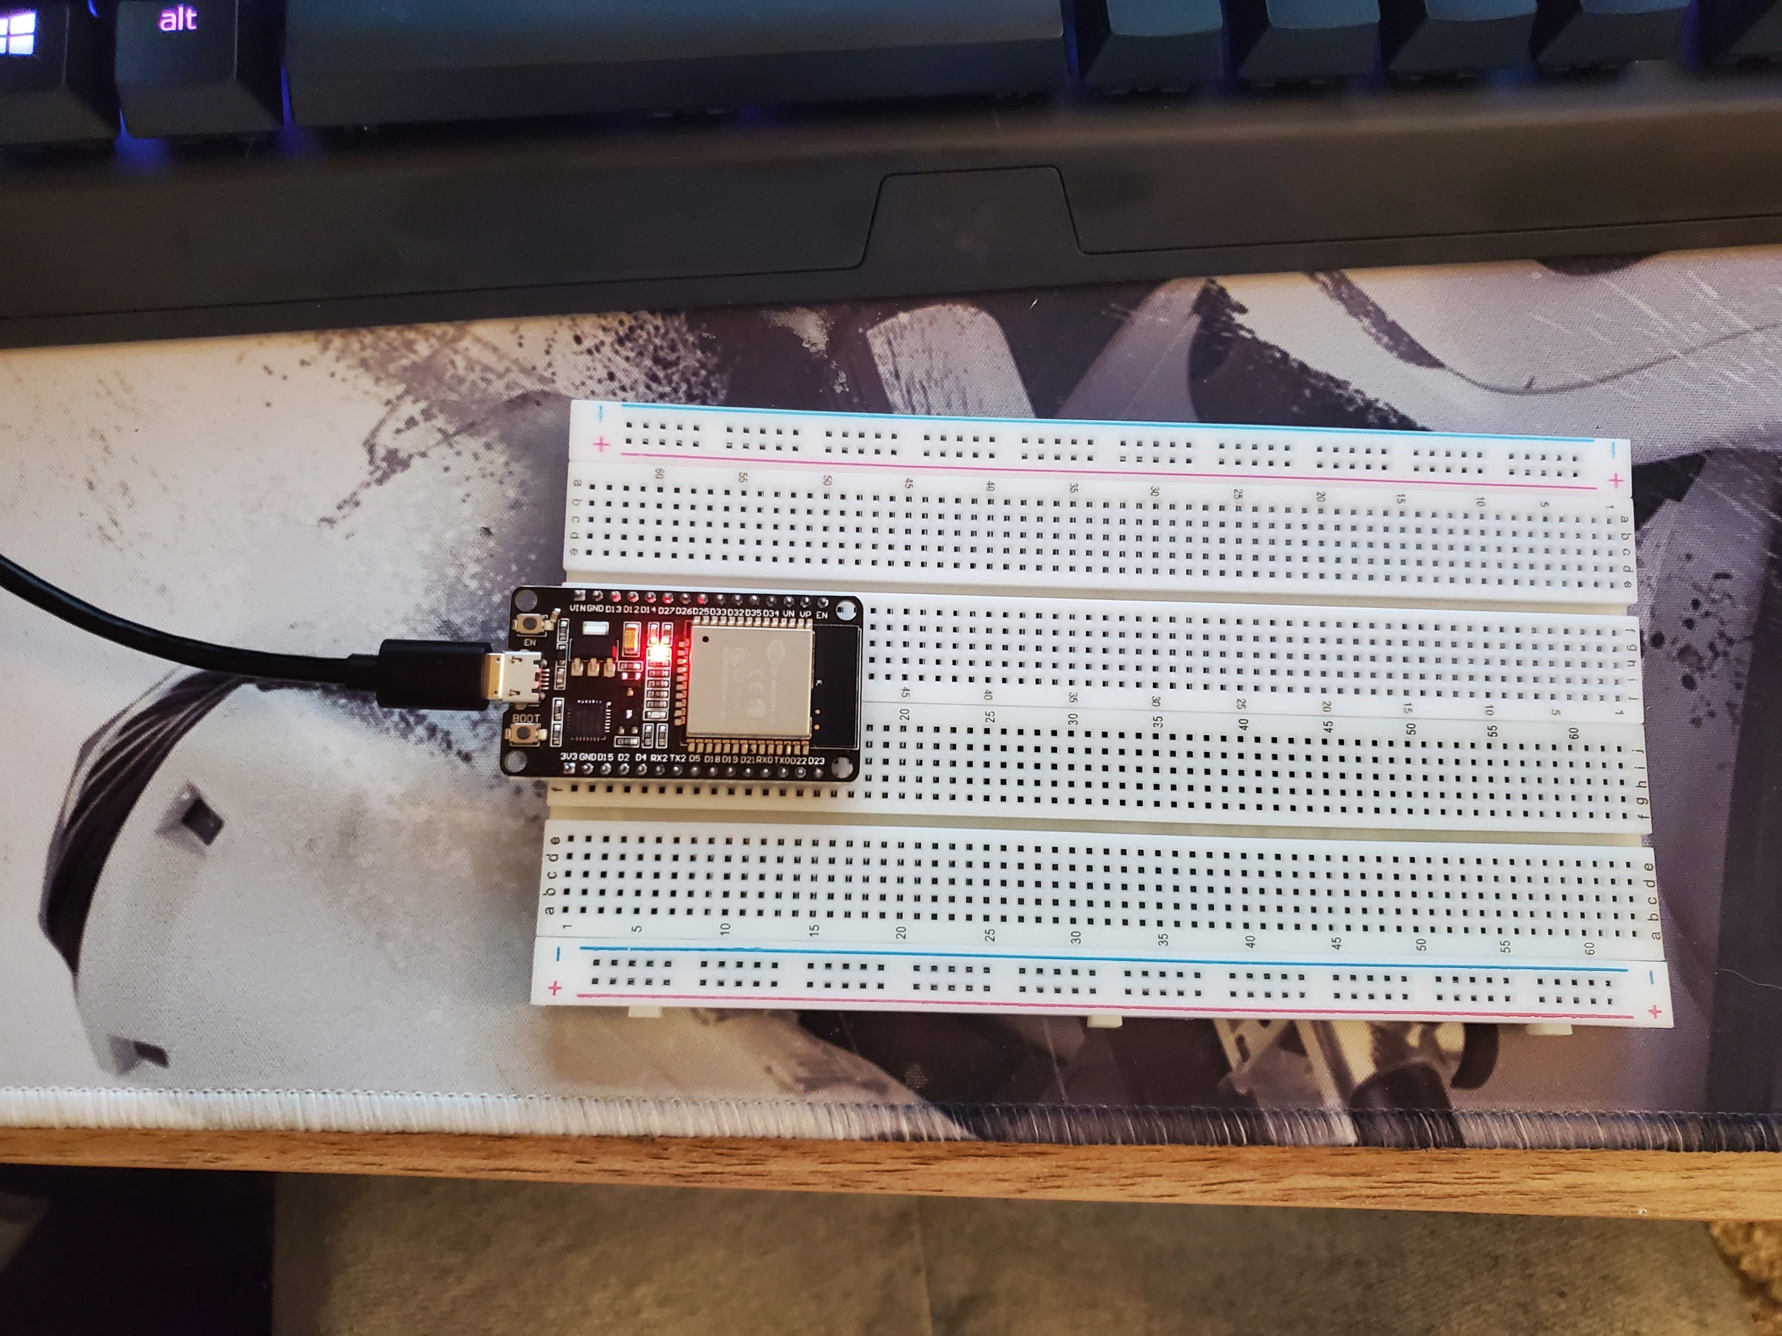
ESP32
Microcontroller mounted and powered ON

Slide 6
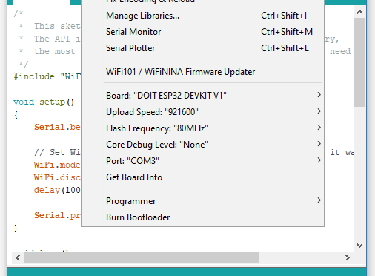
Installation of Arduino IDE
Screenshot of Arduino IDE with Port selected from Tools menu.

Slide 7
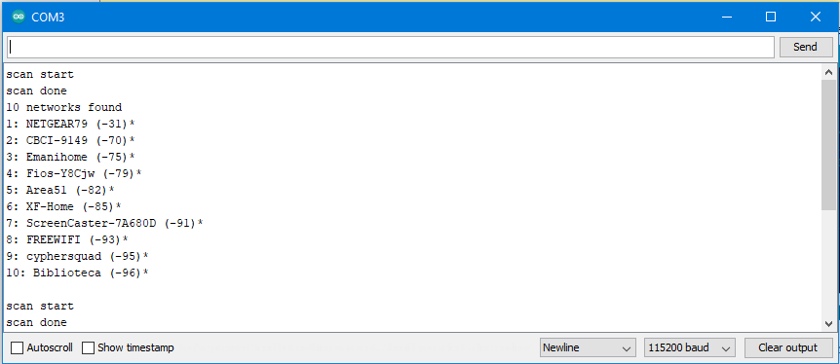
ESP32 Wi-Fi Scan
Screenshot of Serial Monitor in Arduino IDE showing the available networks

Slide 8
Module 3
Creating the Traffic Controller

Slide 9
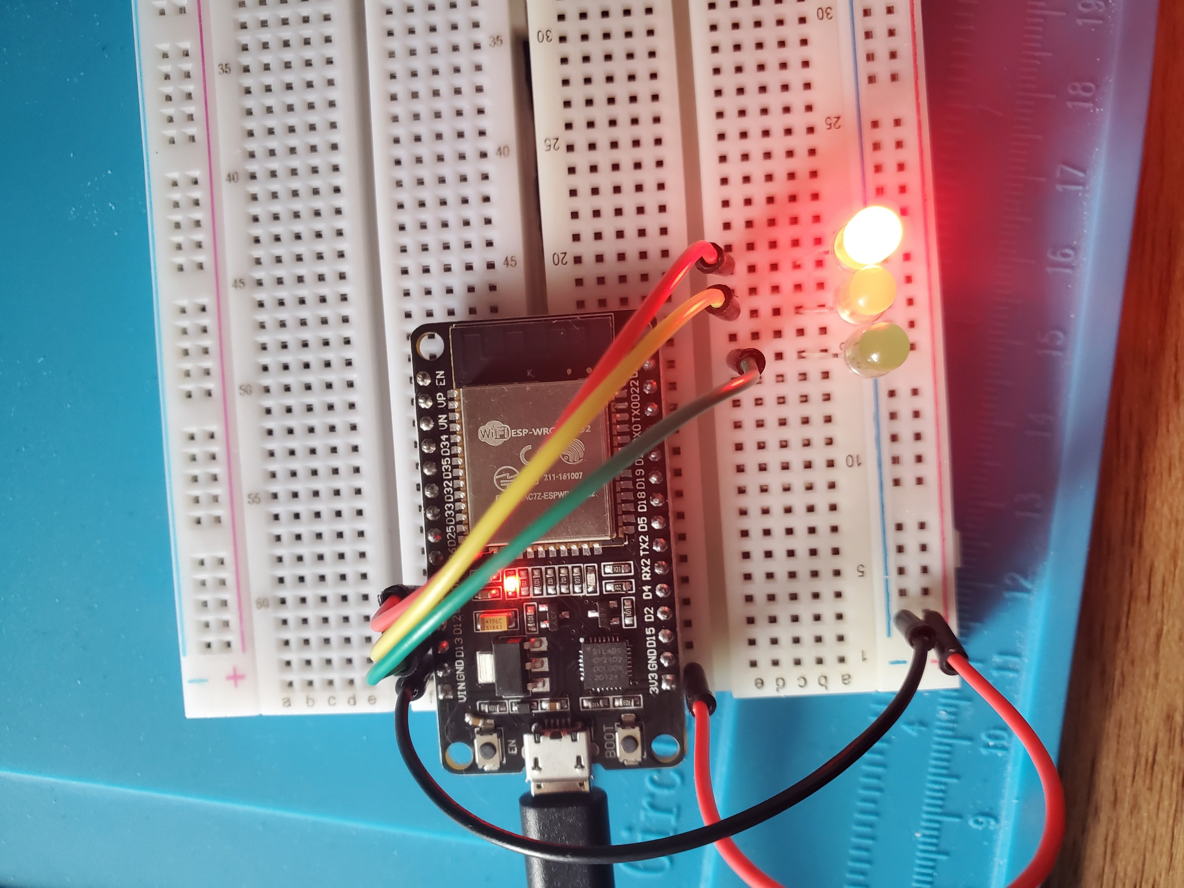
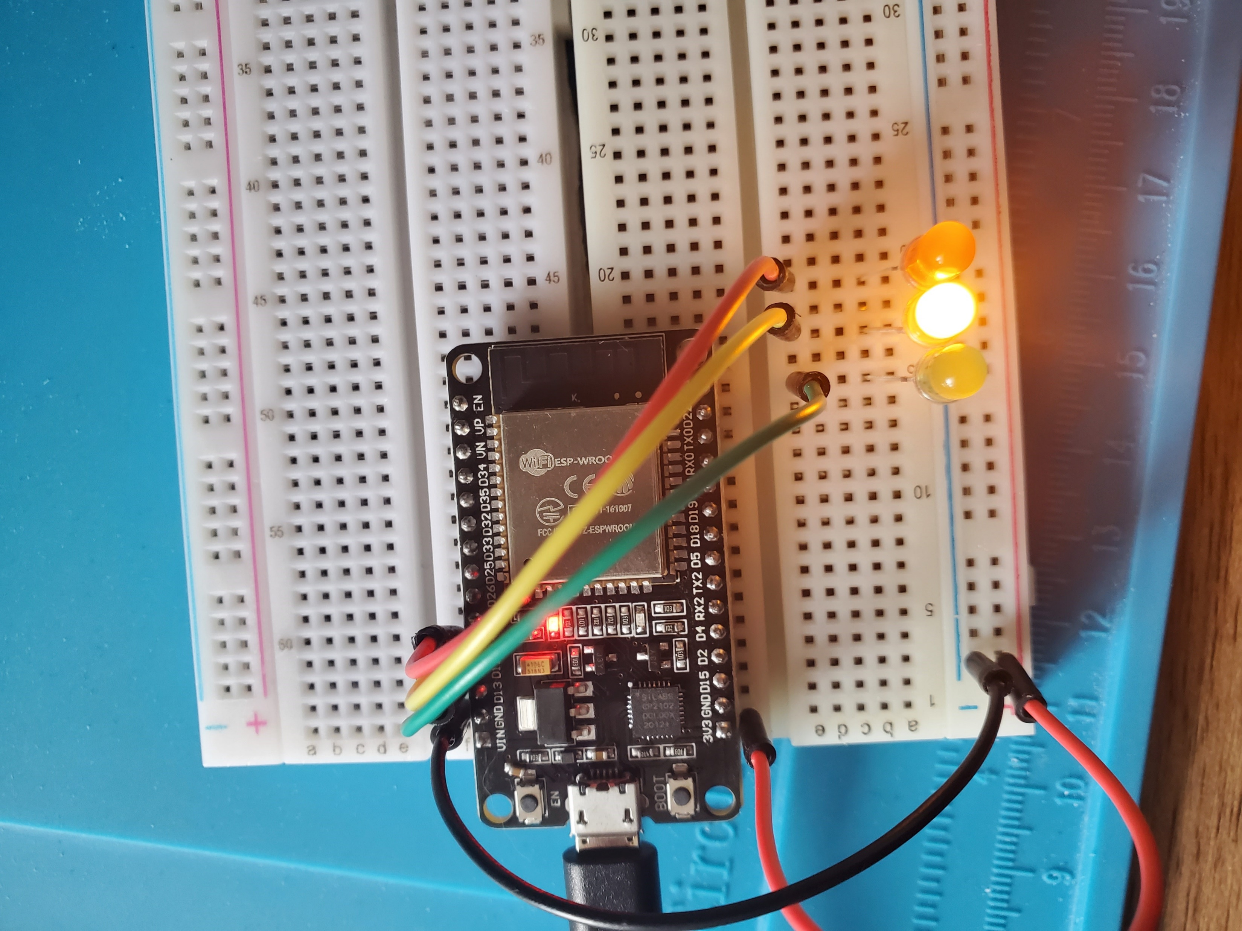
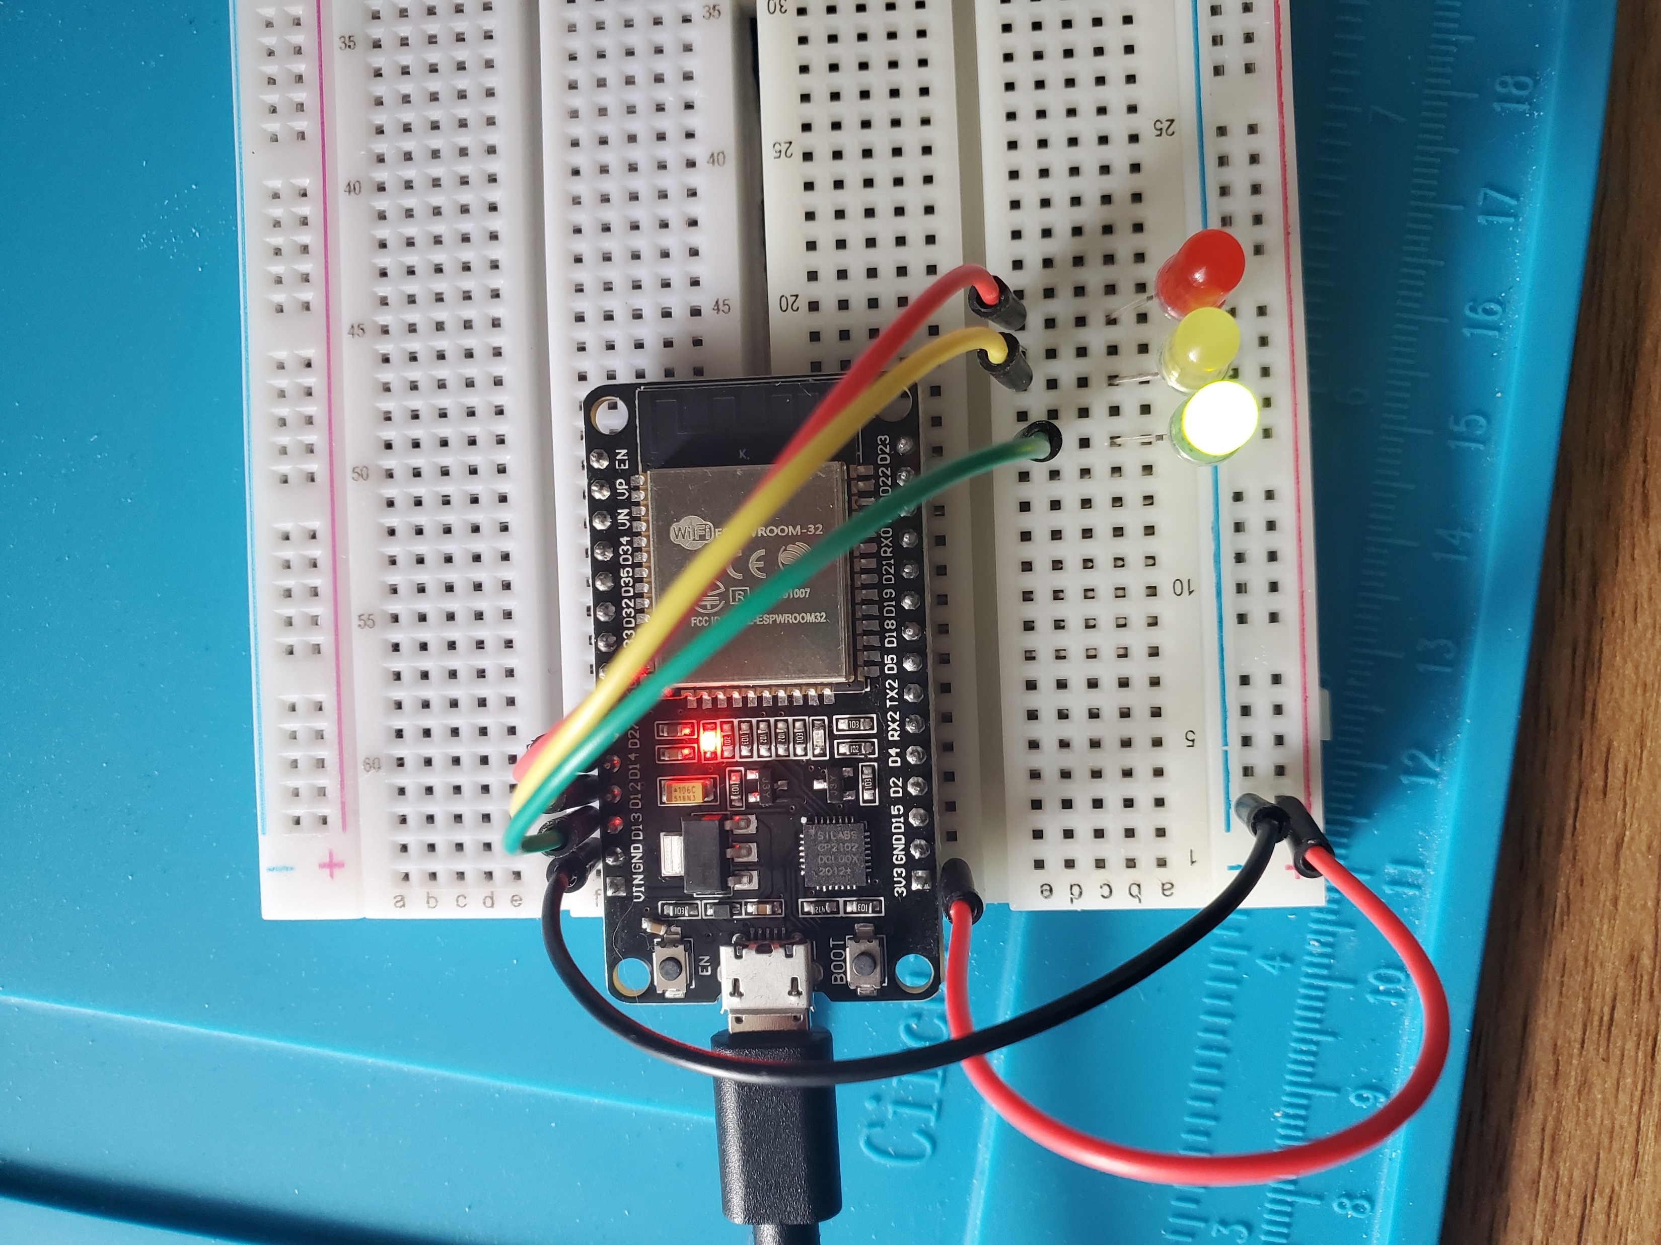
Picture of circuit with working LEDs
ESP 32 Board
Colored LEDs: Red, Yellow and Green
220 Ohm Resistors (optional)
Wires
Breadboard

Slide 10
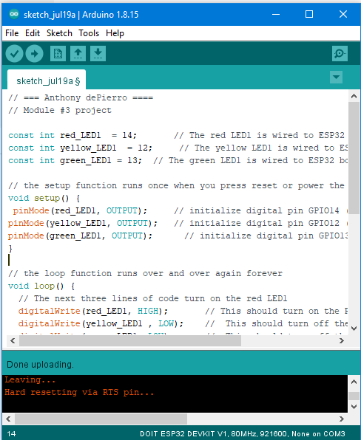
Screenshot of code in Arduino IDE
Screenshot of code in Arduino IDE showing your name in the comment

Slide 11
Module 4
Creating a multiple Traffic Controller

Slide 12
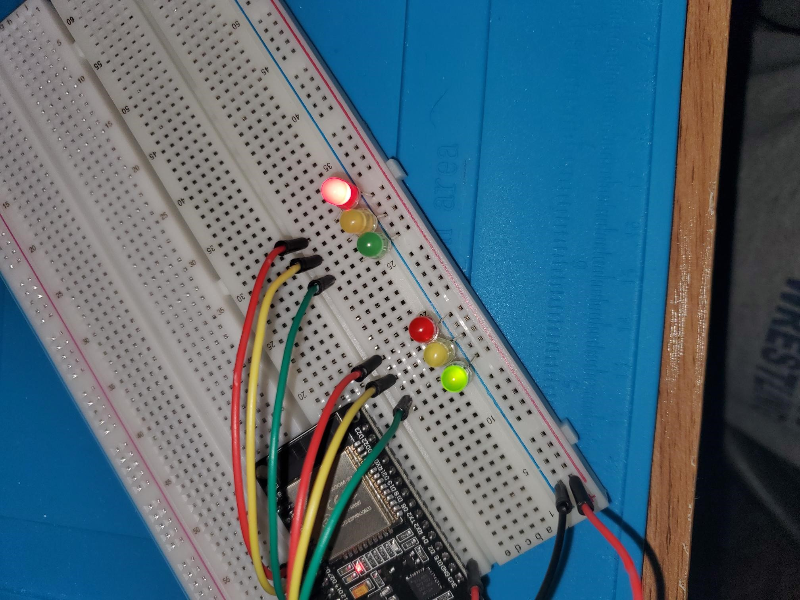
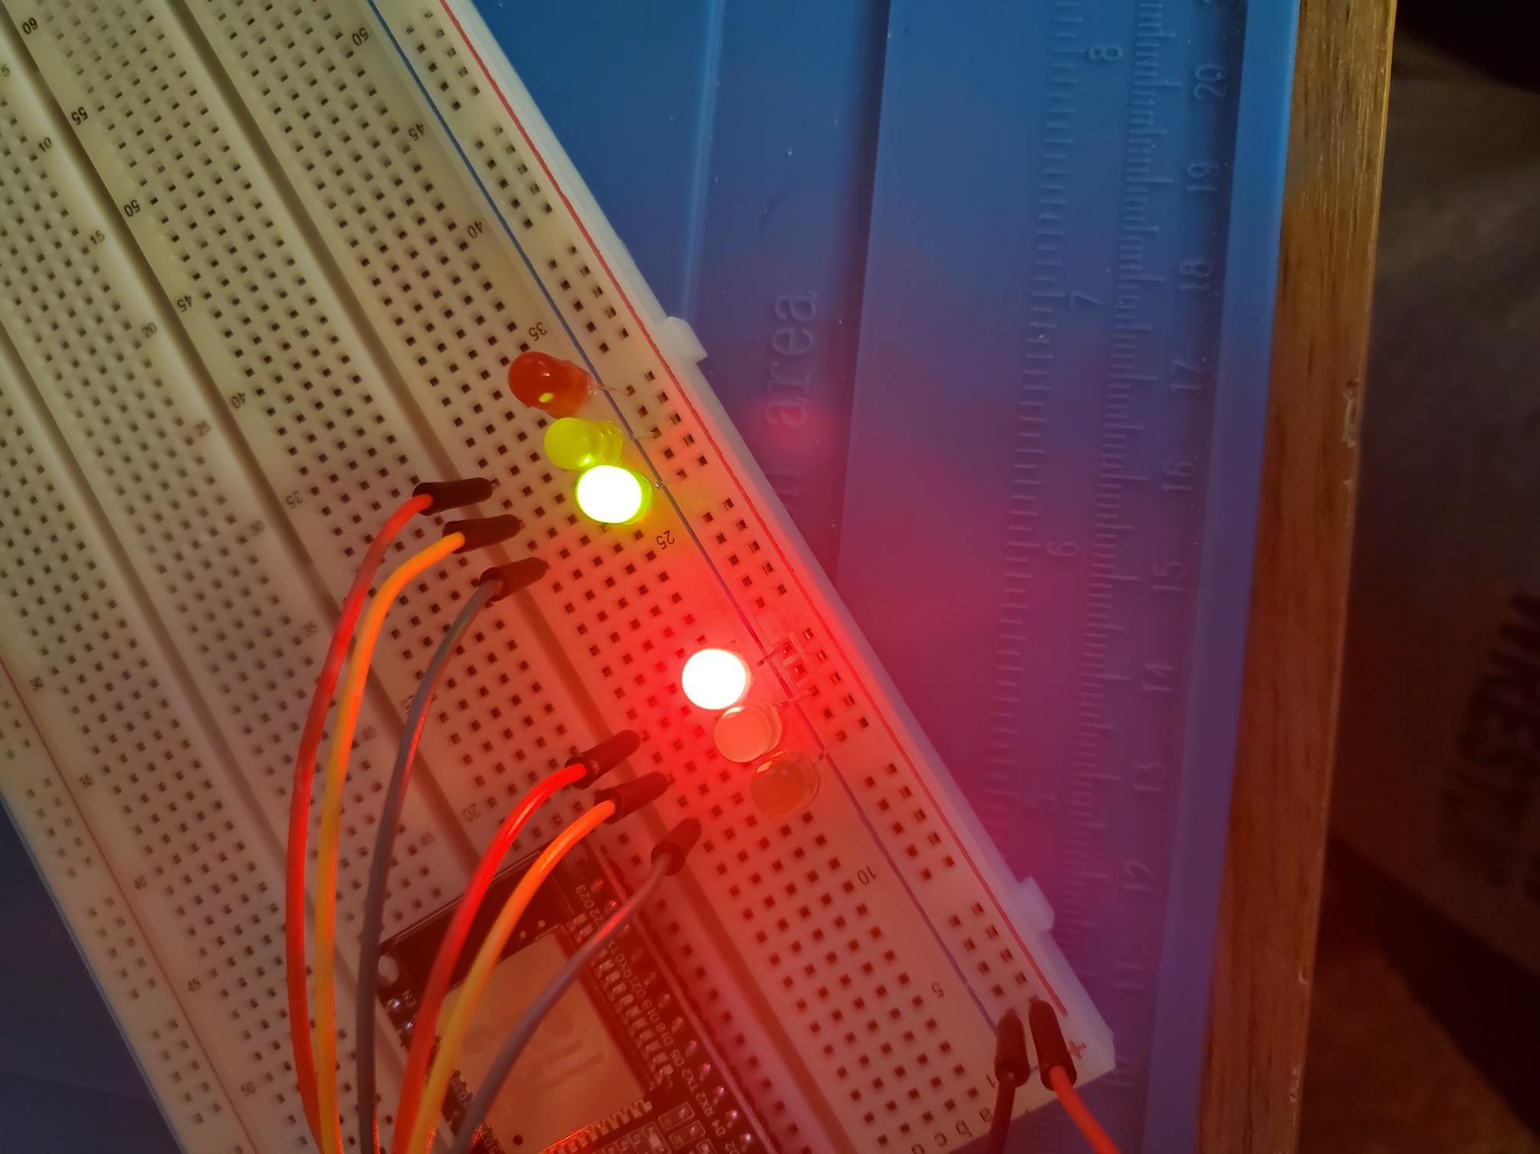
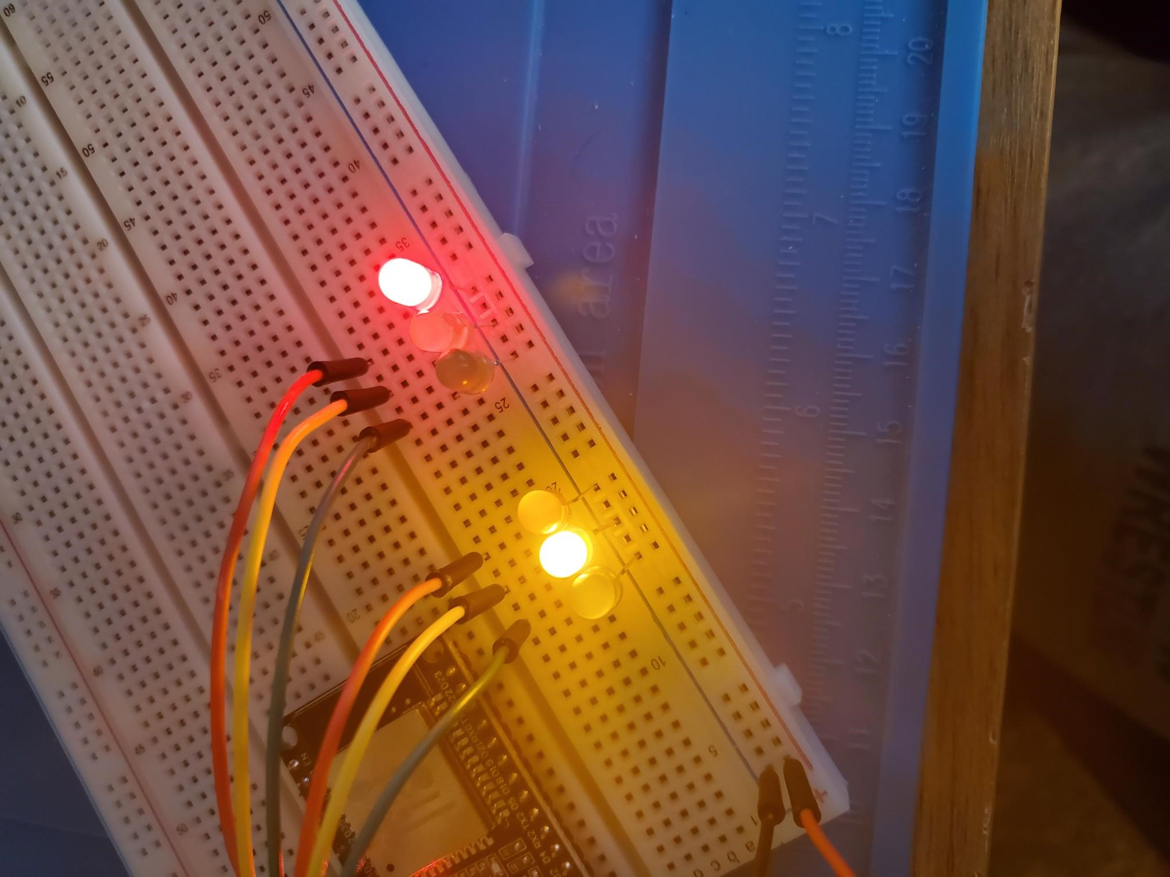
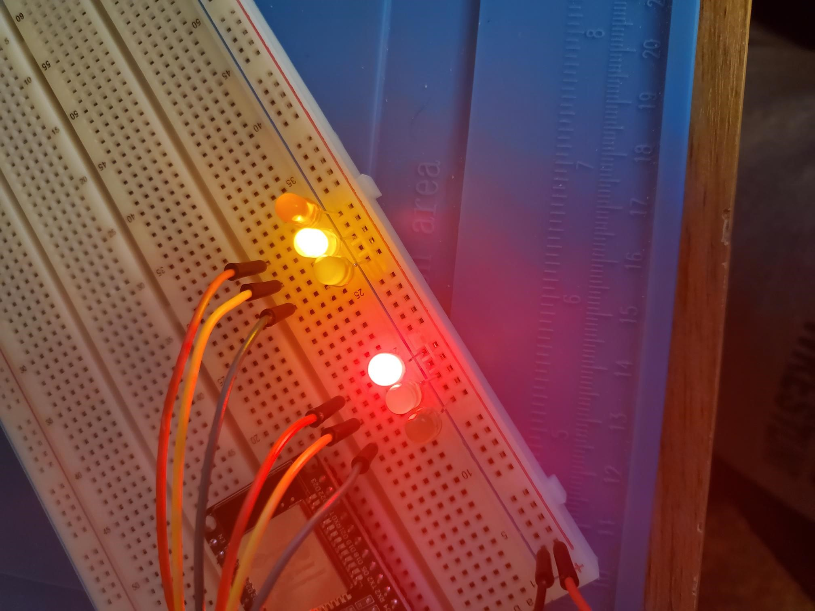
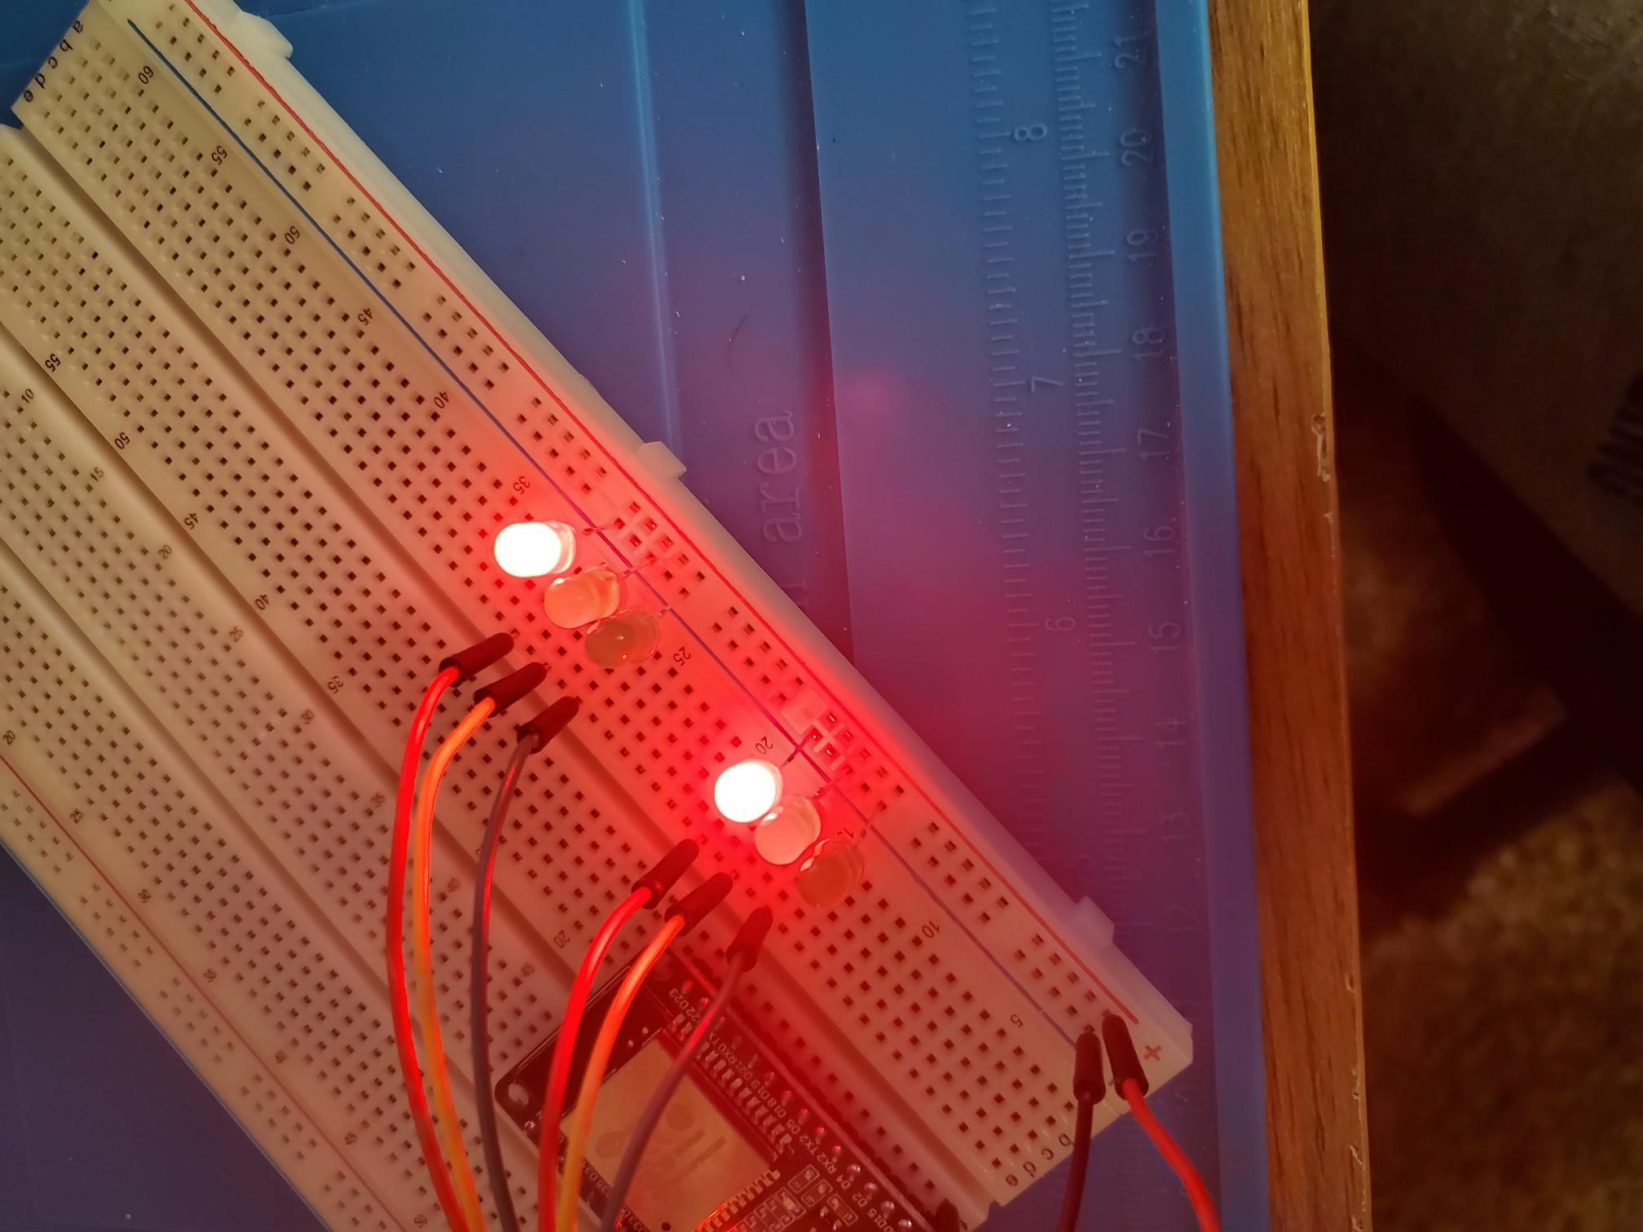
Picture of circuit with working LEDs
ESP 32 Board
Colored LEDs: Red, Yellow and Green (two sets)
220 Ohm Resistors (optional)
Wires
Breadboard

Slide 13
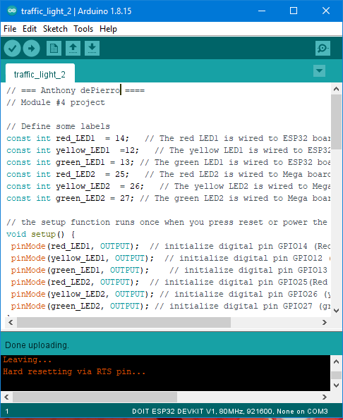
Screenshot of code in Arduino IDE
Screenshot of code in Arduino IDE showing your name in the comment

Slide 14
Module 5
Creating a multiple Traffic Controller with a cross walk

Slide 15
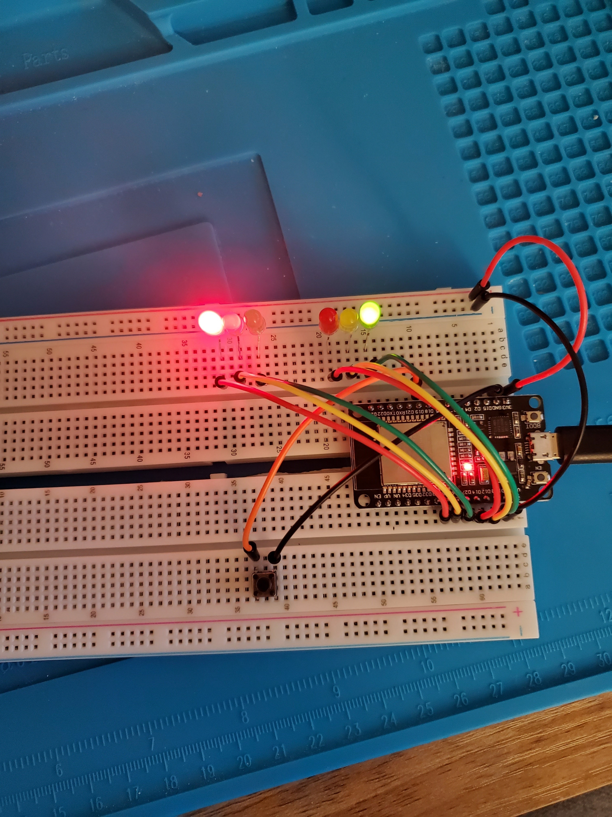
Picture of circuit with working LEDs
ESP 32 Board
Colored LEDs: Red, Yellow and Green (two sets)
220 Ohm Resistors (optional)
Push Button
Wires
Breadboard

Slide 16
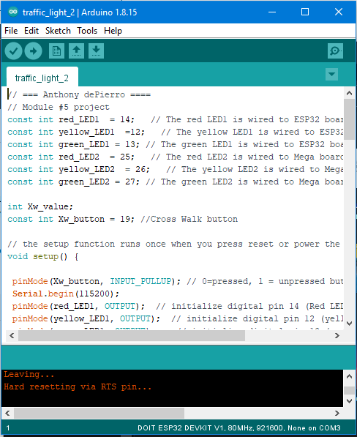
Screenshot of code in Arduino IDE
Screenshot of code in Arduino IDE showing your name in the comment

Slide 17
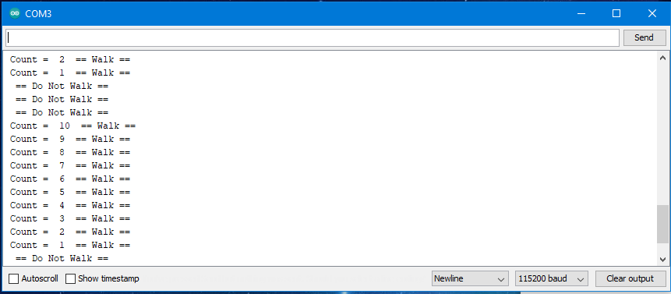
Screenshot of Serial Monitor in Arduino IDE
Screenshot of output in Serial Monitor

Slide 18
Module 6
Creating a Multiple Traffic Light Controller with a Cross Walk and an Emergency Buzzer

Slide 19
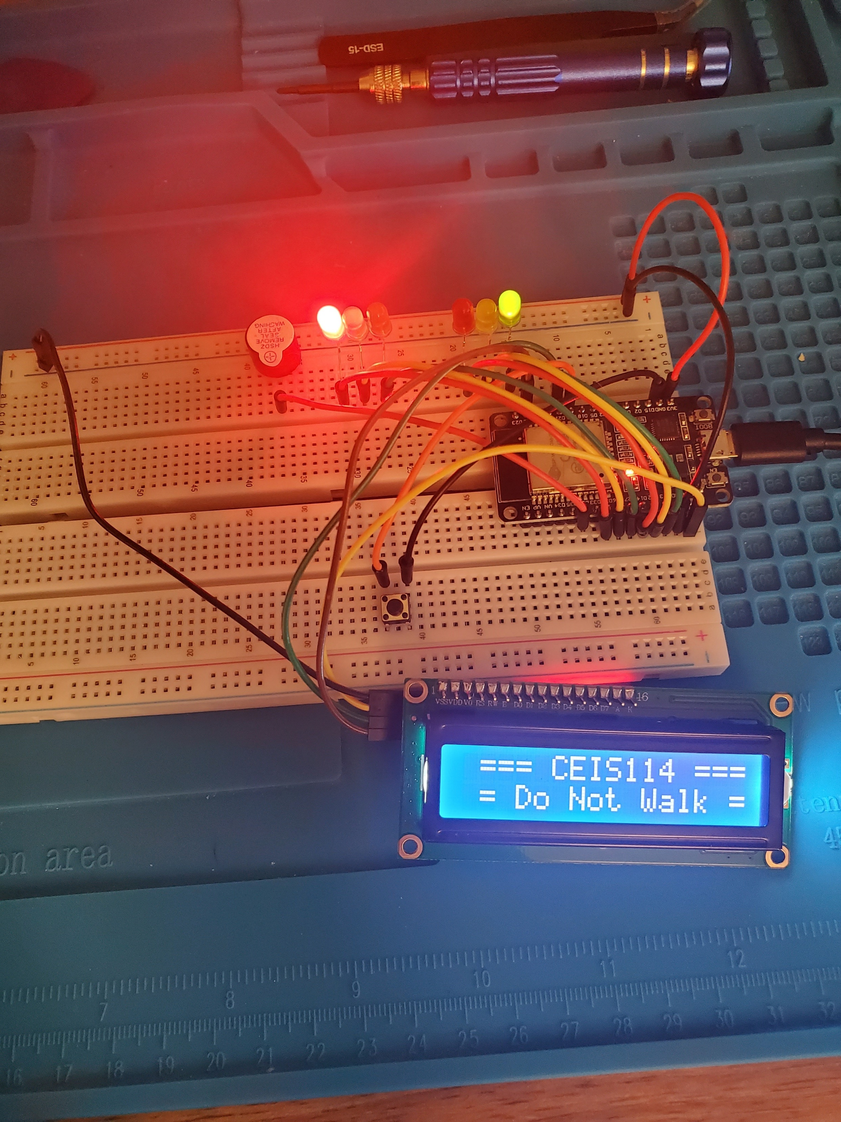
Picture of circuit with working LEDs and LCD display
ESP 32 Board
Colored LEDs: Red, Yellow and Green (two sets)
220 Ohm Resistors (optional)
Push Button
LCD Unit with Message Display
Wires
Breadboard

Slide 20
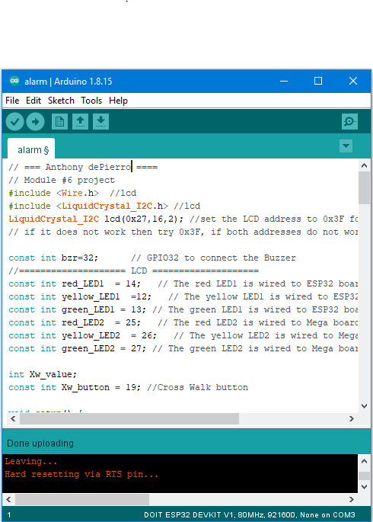
Screenshot of code in Arduino IDE
Screenshot of code in Arduino IDE showing your name in the comment

Slide 21
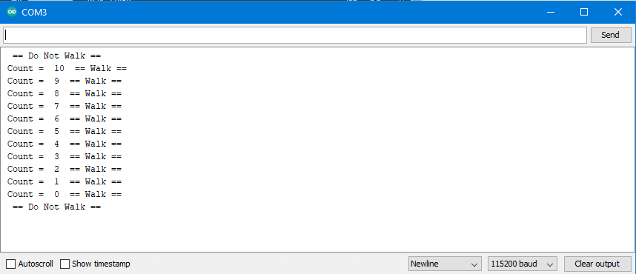
Screenshot of Serial Monitor in Arduino IDE
Screenshot of output in Serial Monitor

Slide 22
Final
Creating a Multiple Traffic Light Controller with a Cross Walk and an Emergency Buzzer

Slide 23
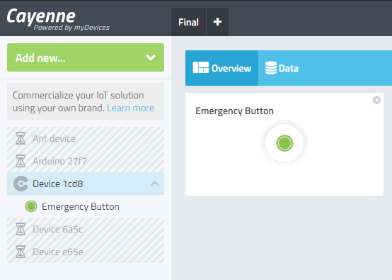
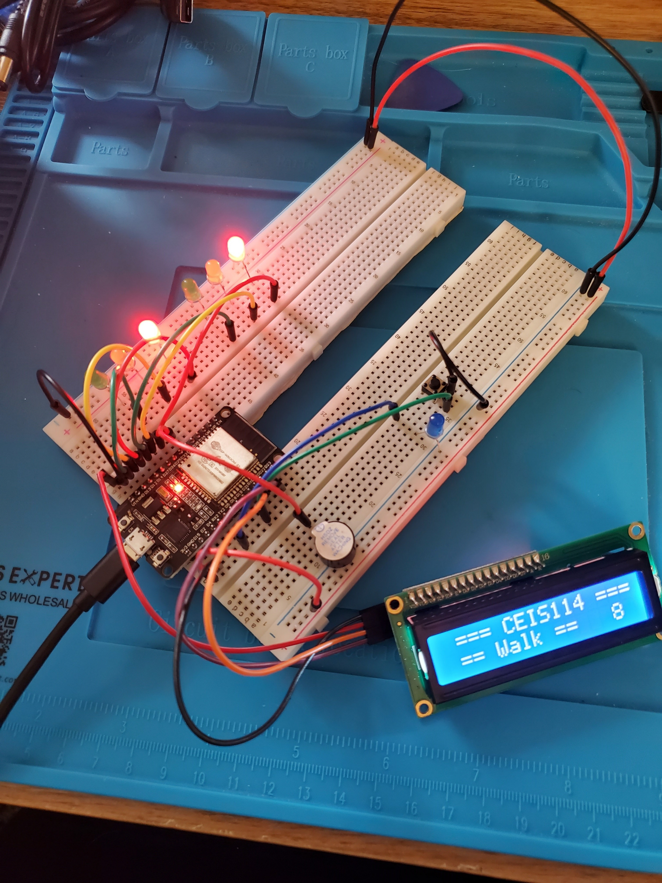
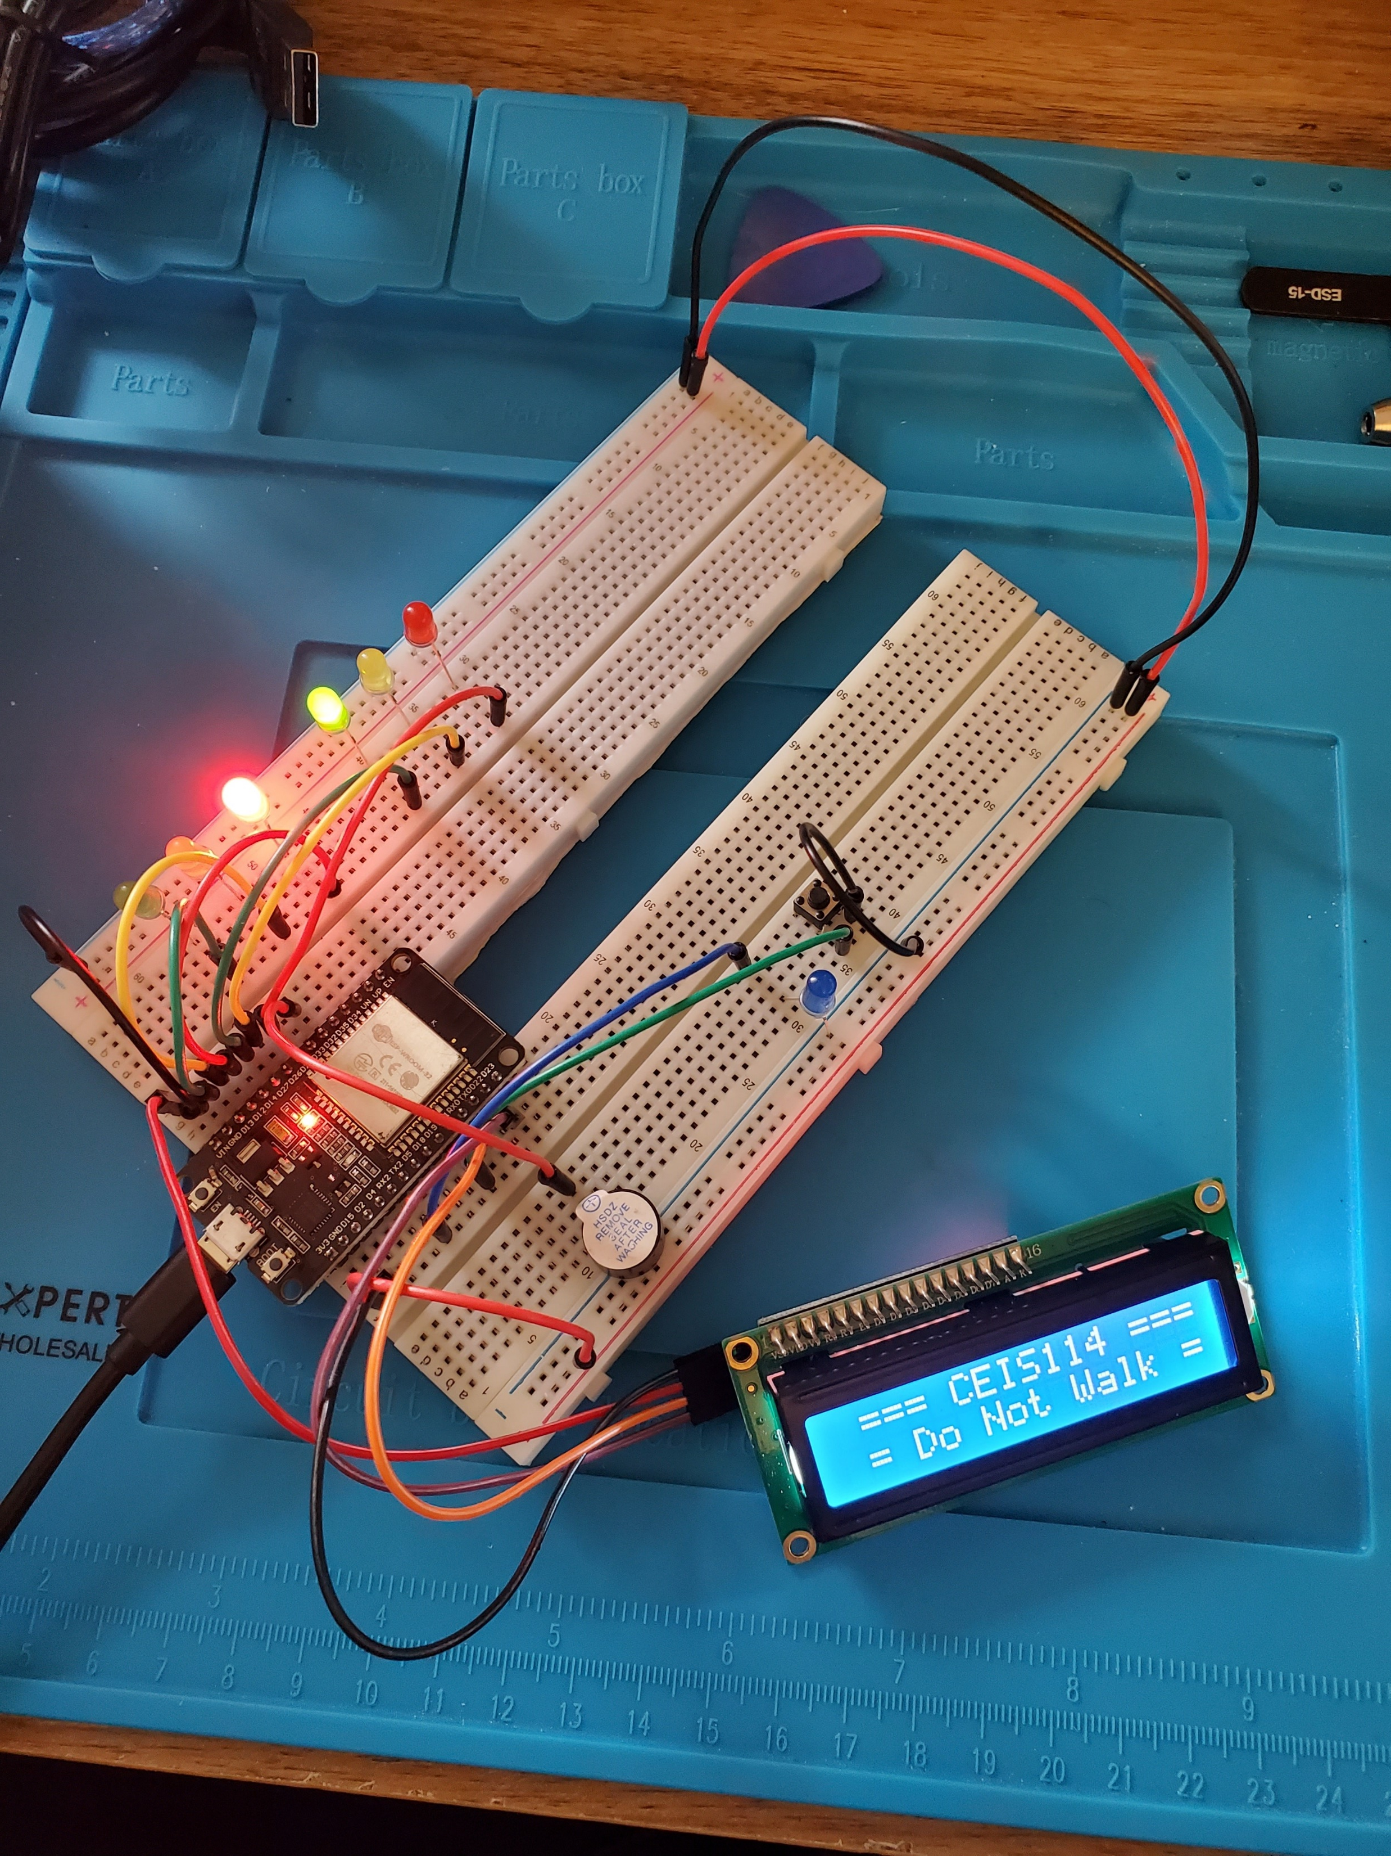
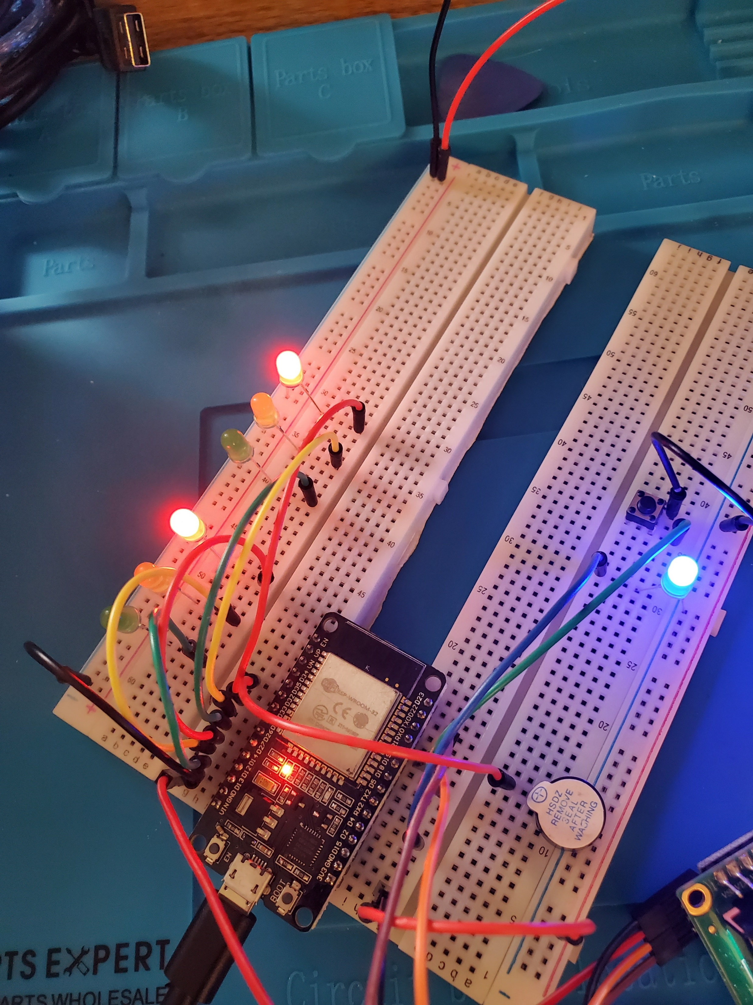
Picture of circuit with working LEDs and LCD display
ESP 32 Board
Colored LEDs: Red, Yellow and Green (two sets)
One Blue LED – Emergency Light
220 Ohm Resistors (optional)
Push Button
LCD Unit
Buzzer
Wires
Breadboard

Slide 24
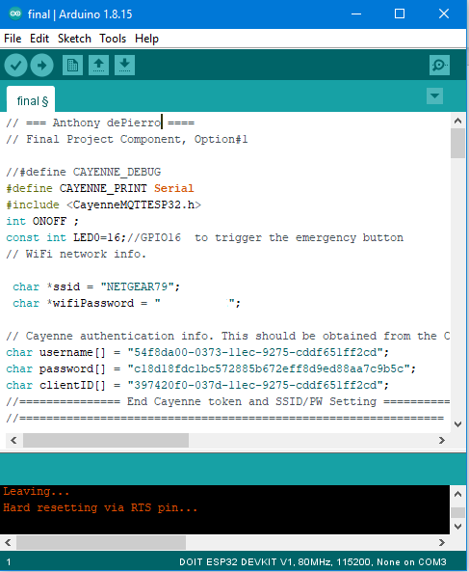
Screenshot of code in Arduino IDE
Screenshot of code in Arduino IDE showing your name in the comment
**Please note**
Password was blurred out due to using my own network. The provided router was moving too slow.

Slide 25
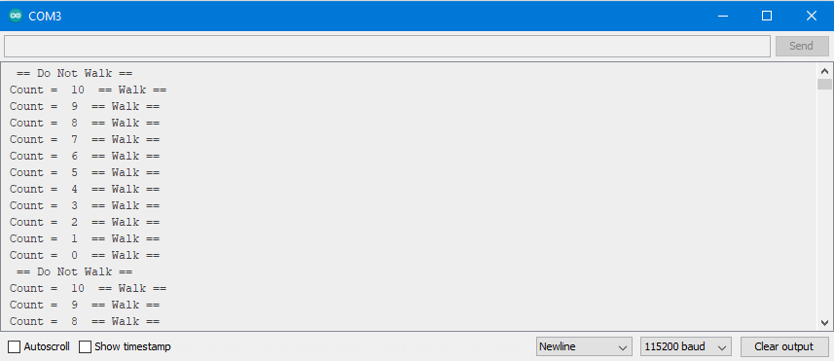
Screenshot of Serial Monitor in Arduino IDE
Screenshot of output in Serial Monitor

Slide 26
Challenges
Getting the ESP32 to connect to my PC
Troubleshooting LCD problems
Issues with Option 2 not working, and switching to option 1
Network troubleshooting Option 1

Slide 27
Career Skills
How to assemble a circuit
Trouble shooting coding
How to sync the ESP32 to a network
How sensors work to provide valuable data to the user

Slide 28
Conclusion
Building this project provided hands on learning opportunity to put into practice the topics covered in the course.
This project covered fundamental topics of digital devices, by building a functioning circuit that simulates real life environments and utilizes connectivity over a network.

