Slide 1
Fundamentals of Information Technology and Networking
NETW191

Slide 2
Introduction
Detailed, and visual summary of what we learned in NETW191.

Slide 3
Mod 2
Preparation and IPv4 Addressing

Slide 4
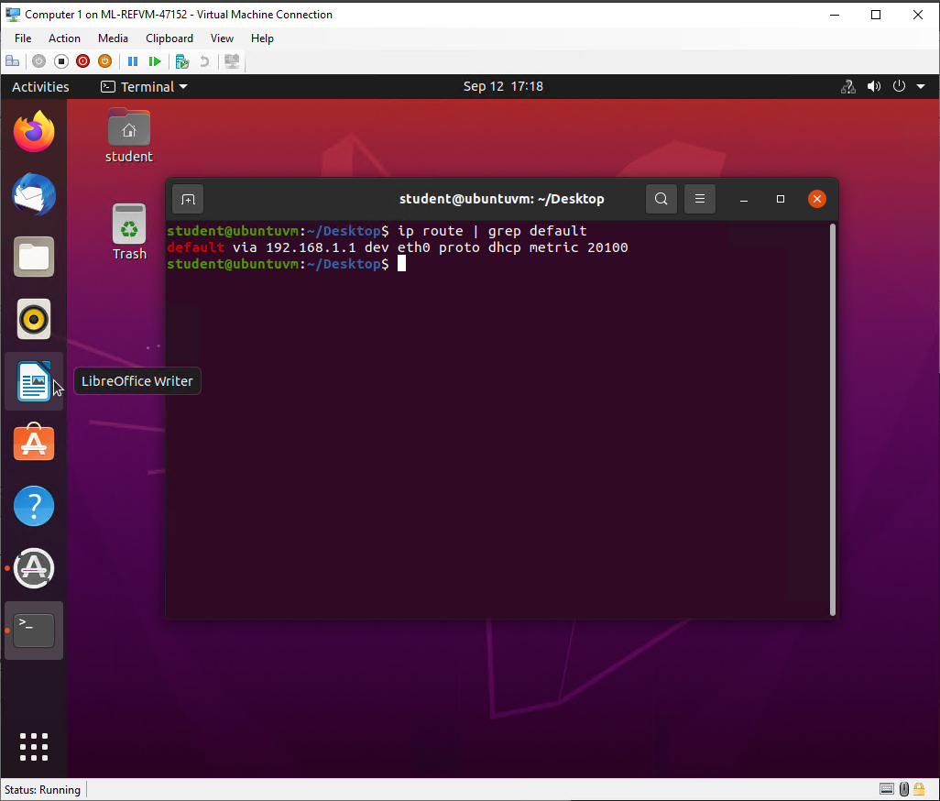
Preparation
This screenshot includes the terminal window that shows the default gateway IP address.

Slide 5
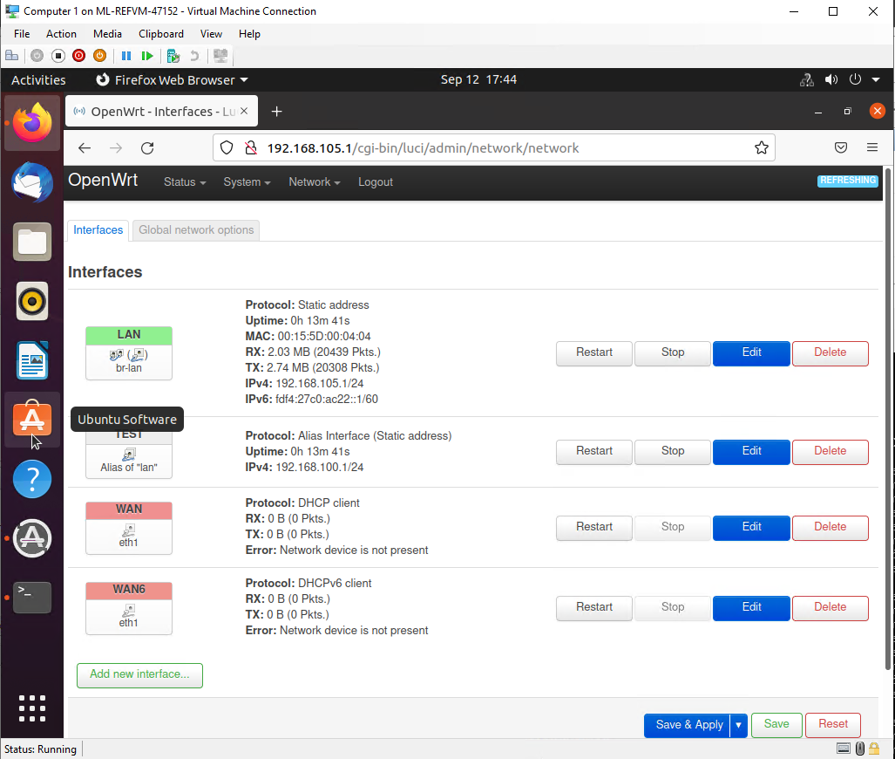
IPv4 Address Assignment
This screenshot includes the Interfaces page that shows the new IPv4 address on the LAN interface.

Slide 6
Mod 3
Connectivity Test

Slide 7
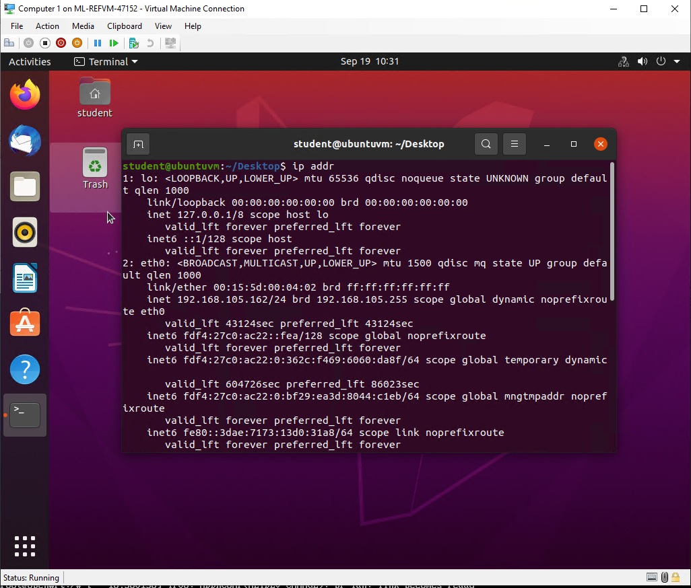
Dynamic IP Address Assignment
This screenshot shows the IPv4 address of the Computer 1 VM.

Slide 8
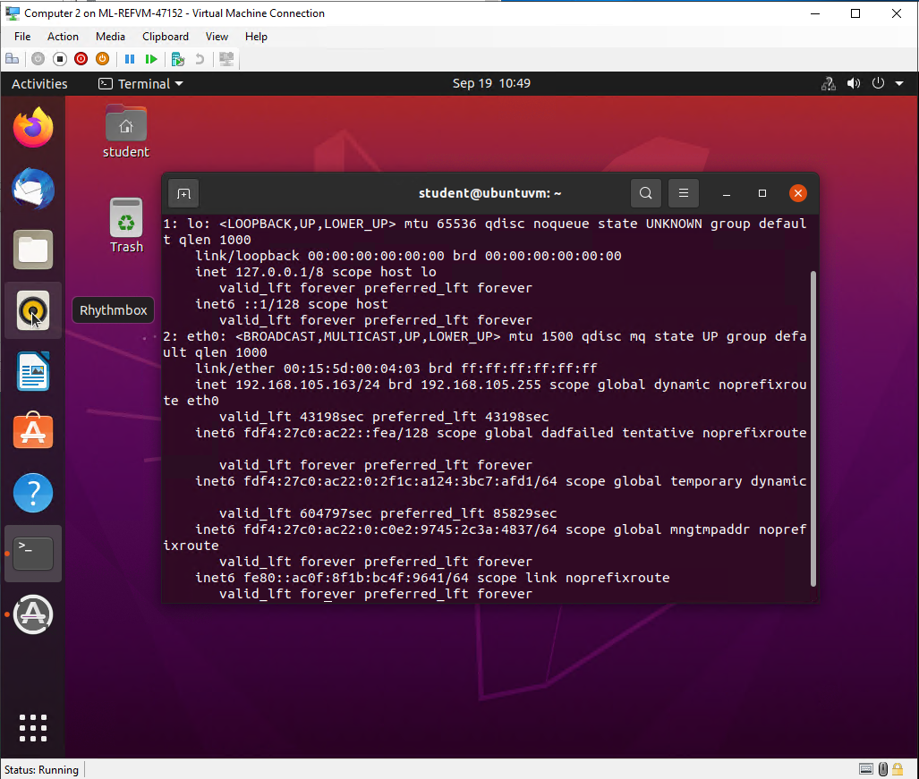
Dynamic IP Address Assignment
This screenshot shows the IPv4 address of the Computer 2 VM.

Slide 9
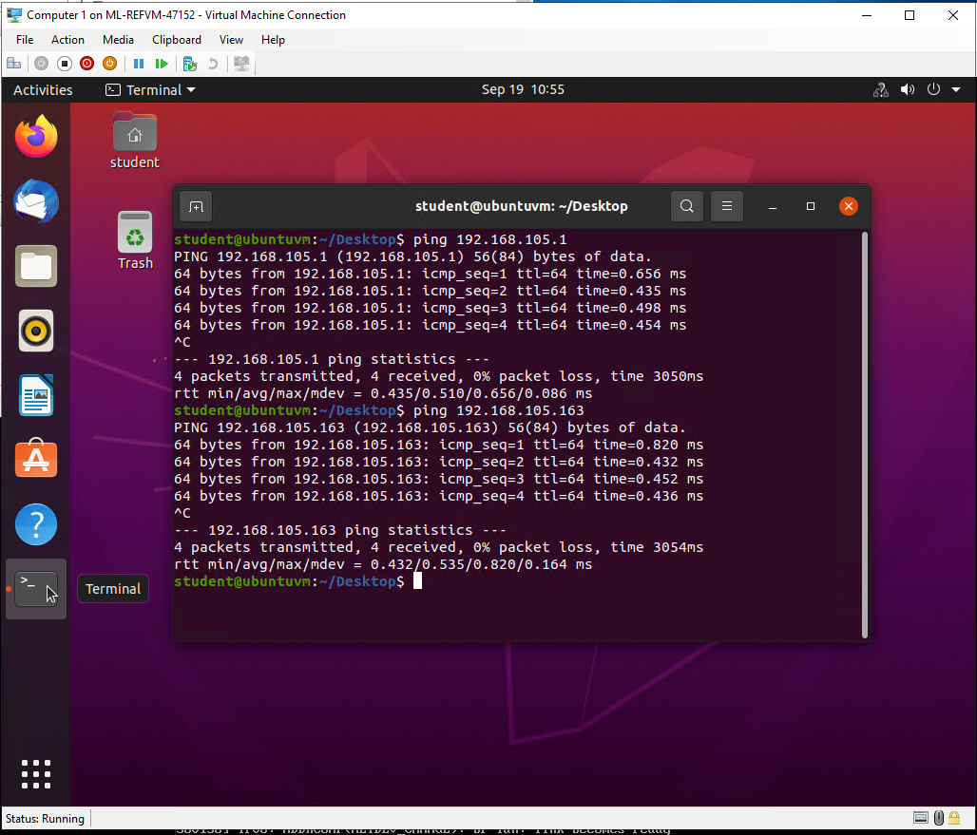
Connectivity Test
This screenshot shows the connectivity tests between the Computer 1 VM and the other two devices (i.e., the SOHO Router VM and Computer 2 VM).

Slide 10
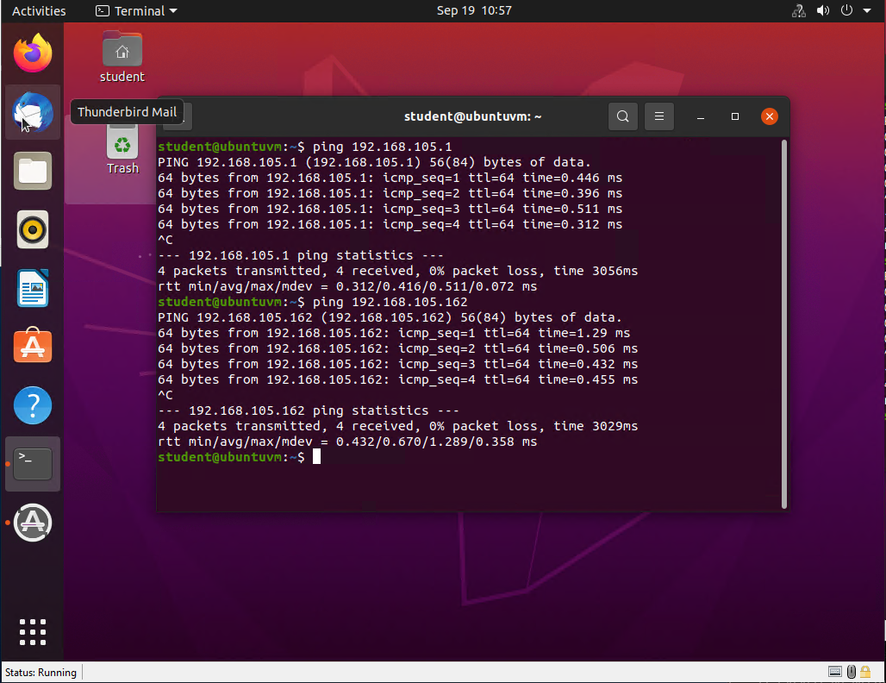
Connectivity Test
This screenshot shows the connectivity tests between the Computer 2 VM and the other two devices (i.e., the SOHO Router VM and Computer 1 VM).

Slide 11
Mod4
IP Subnetting and Loopback interfaces

Slide 12
Subnetting Table
This table includes two /25 subnets, listing the subnet notation, network address, first usable host address, last usable host address, and broadcast address of each subnet.
 | Subnet Notation (x.x.x.x/x) | Network Address (1st IP address) | First usable host address (2nd IP address) | Last useable host address (2nd from the last IP address) | Broadcast Address (the last IP address)
The first subnet | 192.168.5.0 /25 | 192.168.5.0 /25 | 192.168.5.1/25 | 192.168.5.126/25 | 192.168.5.127/25
The second subnet | 192.168.5.128/25 | 192.168.5.128 /25 | 192.168.5.129 /25 | 192.168.5.254 /25 | 192.168.5.255 /25

Slide 13
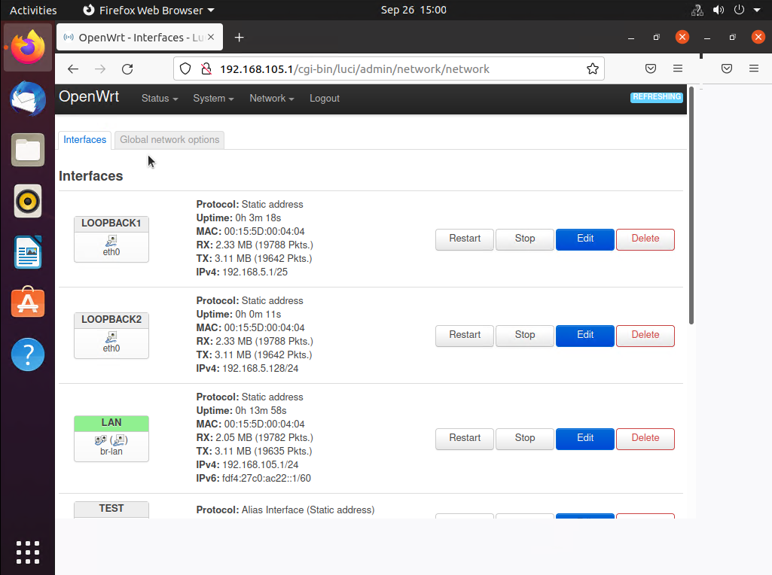
Loopback Interfaces
This screenshot shows both Loopback1 and Loopback2 interfaces and their correct IPv4 addresses.

Slide 14
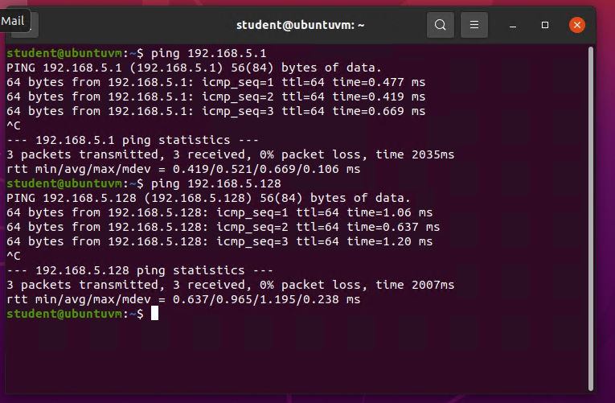
Connectivity Tests
This screenshot shows two successful ping tests from the Computer 1 VM to the Loopback 1 and Loopback 2 interfaces.

Slide 15
Mod5
Network diagram for the VM’s and SOHO router on Visio

Slide 16
Microsoft Visio Network Diagram
This diagram illustrates the interconnection of the Computer 1 VM, the Computer 2 VM, and the SOHO Router VM.

Slide 17
Mod6
SOHO Wireless network Security

Slide 18
SOHO Wireless Network Security
1. What are the factory default username and password of a TP-Link router? Why is it important to change the default username and password of a SOHO router?
Answer: Username: admin password: admin. It is important to change usernames and passwords because generic passwords could possibly be the same on multiple routers, making it a security risk.
2. To protect a SOHO wireless network with a small number of devices, which address management method provides more control, configuring the device IP addresses manually (static IP) or using a DHCP server (dynamic IP)? Why?
Answer: To have the most control, you could manually set up your own ip address, but a dynamic works for most SOHO systems.
3. What does MAC filtering do? If needed, when would you use deny filtering rules and when would you use allow filtering rules? What happens to devices that want to connect, if the “Allow the stations specified by any enabled entries in the list to access” function is enabled but there are no entries in the list?
Answer: MAC Filtering allows you to control the wireless stations accessing the router. You would use the filtering rules when you want to specify which stations can do what on the router. If no entries are on the list, no wireless stations can access the router.

Slide 19
SOHO Wireless Network Security
1. What wireless security settings are displayed on the Wireless Security page? Which one is recommended by the vendor? Why?
Answer: WPA/WPA2-Personal, WPA/WPA2-Enterprise, WEP. It is recommended to enable wireless security and select WPA2-PSK AES encryption.
2. Among the configurations you explored in this module, which one is a true security function? Why?
Answer: Mac address filtering, because you can limit what remote devices can access the router
3. What would you do to protect your wireless network at home? Why?
Answer: I have a Dynamic DNS set up, as well as a VPN built into my router active so I can remote into it, but also have VPNs installed on all of my devices for an added layer of network security.

Slide 20
Challenges
VM and SOHO router would not load during MOD2.
Remembering Linux commands

Slide 21
Career Skills
Setting up a SOHO router and associated network.
Network Security
Setting static IP/ or dynamic IP

Slide 22
Conclusion
This project covered the fundamentals of networking.
Building this project provided hands on practice to the topics covered in this course.

