Slide 1
Fundamentals of Infrastructure Security
SEC290

Slide 2
Introduction
“This course develops infrastructure security implementation skills. Topics include threat intelligence, identification of security vulnerabilities, cloud security, security data analysis, incidence response, risk management, and IT regulatory compliance”.
Ref. Course Syllabus

Slide 3
Intrusion Analysis using Wireshark
Mod 2

Slide 4
Basic attack analysis
Look at captures no. 20 and 22. (You can use the “Go” link at the top of the Wireshark screen to quickly go to a specific capture) Both packets are ICMP traffic but there are subtle differences between them. Compare the time-to-live and data field sizes in the two packets. What differences do you see? The ttl doubles from capture 20 to capture 22.
Do a little Internet research to discover which operating systems use the specific values in their ping commands. What operating system generated the echo request in capture 20? Linux
Review packet no. 37 and beyond, what do you think is taking place here? Someone is trying to connect from 192.168.25.200 to 192.168.25.1
Look at capture 22846. What is suspicious about the flag settings in this packet?
What is the IP address of the host being targeted? 192.168.25.1

Slide 5
Open SSL
Mod 3

Slide 6
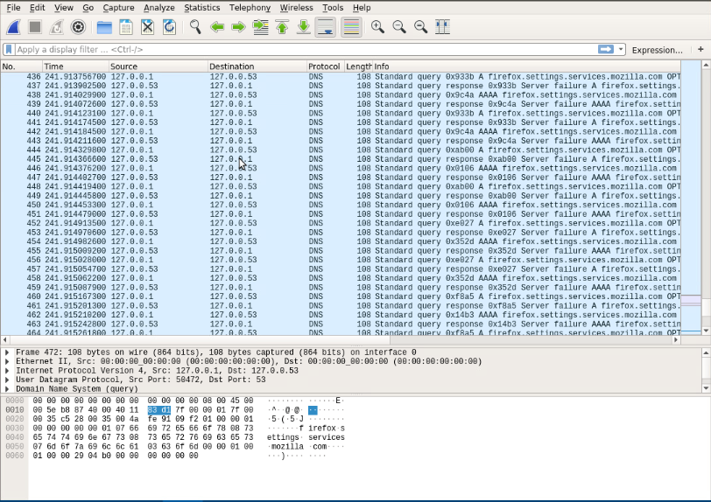
Creating and testing an SSL/TLS file
Screenshot of the output in Step 17.
It shows the GET request in the Info column.

Slide 7
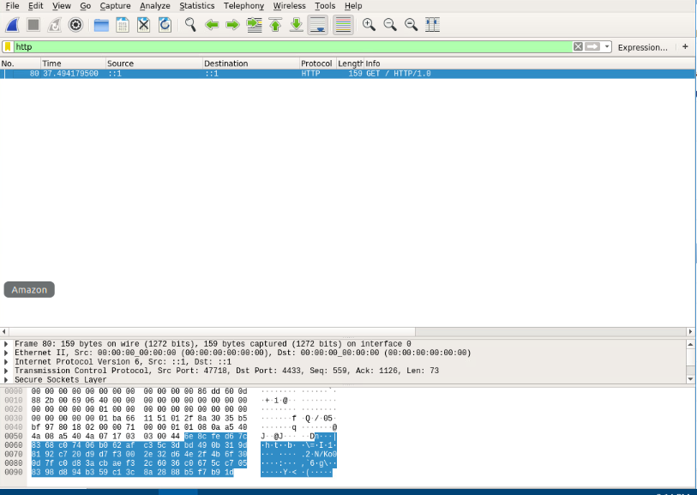
Creating and testing an SSL/TLS file cont’d
Screenshot of the output in Step 20.
It shows the decrypted SSL stream.

Slide 8
Snort
Mod 4

Slide 9
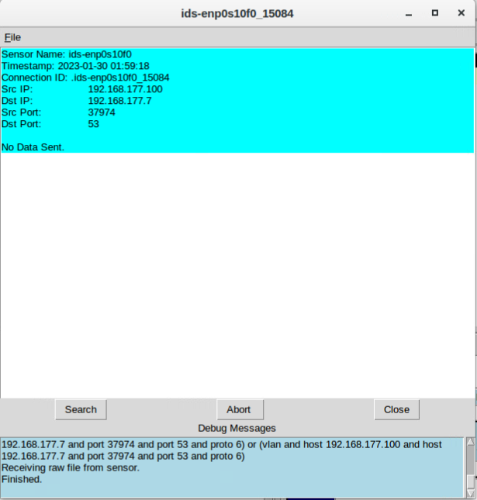
Testing Snort rules
Screenshot of the output in Part 1 Step 8.
It shows the transcript of the XMAS scan alert.

Slide 10
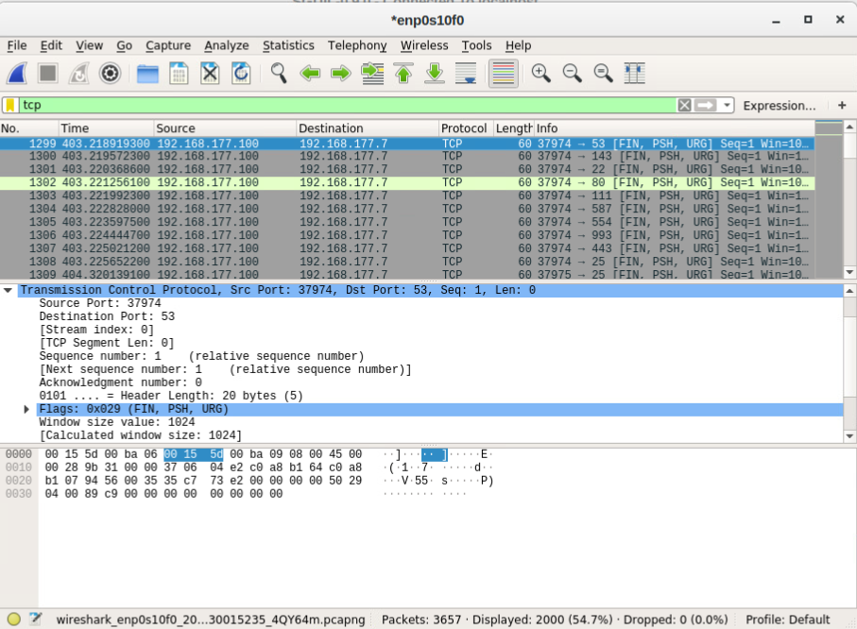
Testing Snort rules cont’d
Screenshot of the output in Part 1 Step 10.
It shows the TCP packets generated by the XMAS scan.

Slide 11
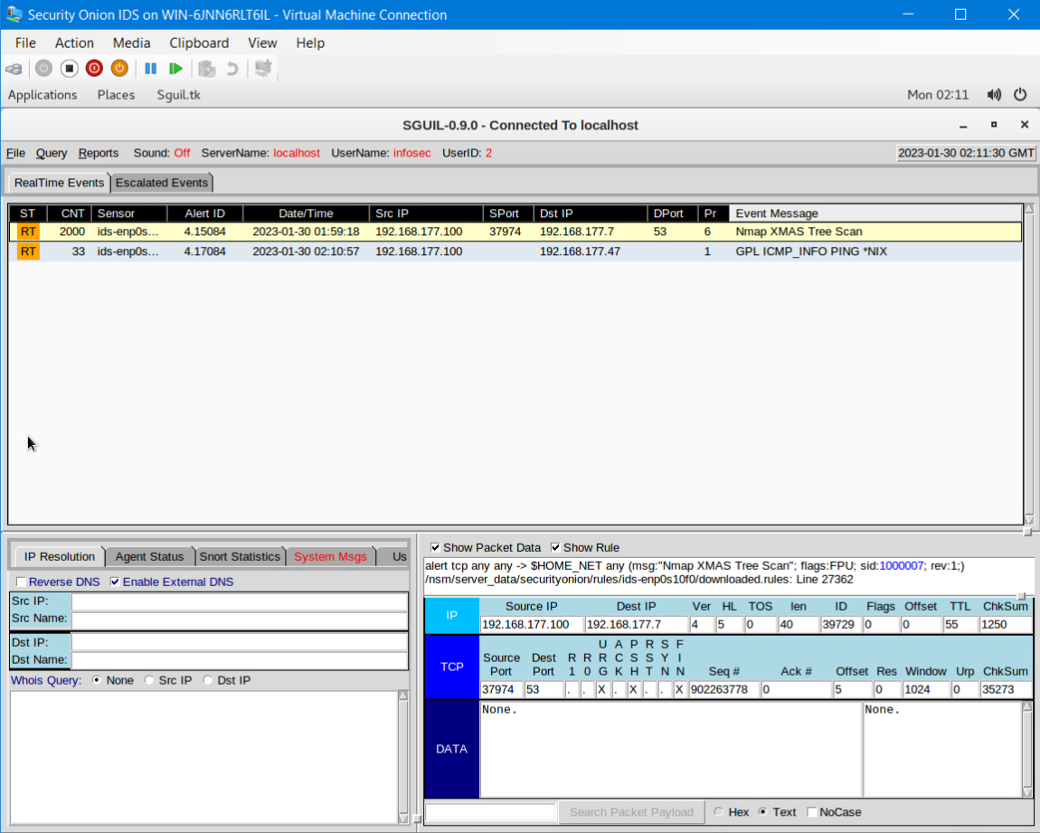
Creating Snort rules
Screenshot of the output in Part 2 Step 5.
It shows the ping activity alert.

Slide 12
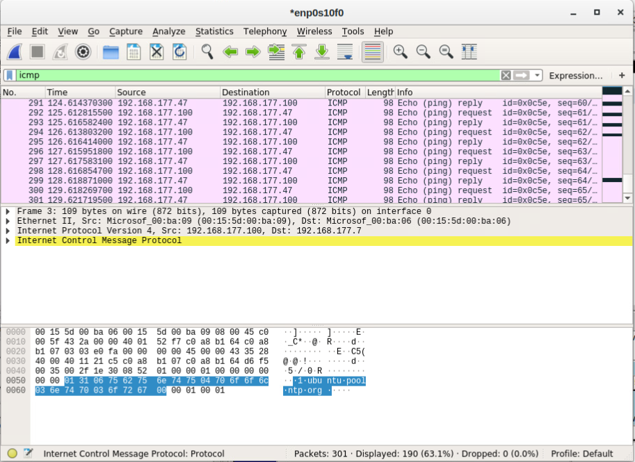
Creating Snort rules cont’d
Screenshot of the output in Part 2 Step 6.
It shows the ICMP packets generated by the ping activity.

Slide 13
Live Memory Analysis
Mod 5

Slide 14
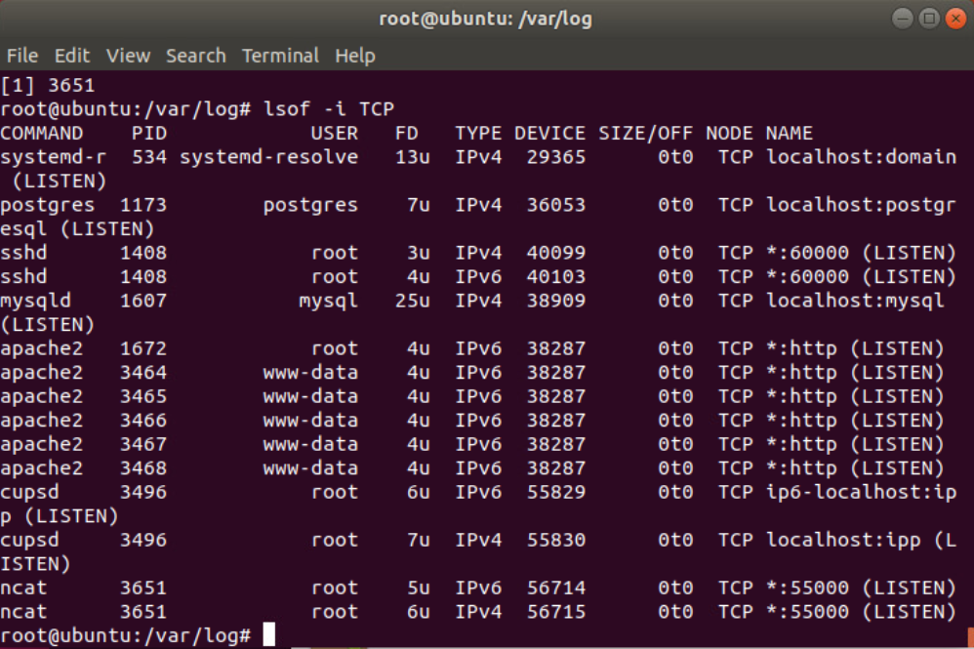
Linux Processes
Screenshot of the output in Part 1, Step 13.
It shows port 55000 open for both IPv4 and IPv6.

Slide 15
Process Hacker
Screenshot of the output in Part 2, Step 5.
It shows the parent of a chosen process.

Slide 16
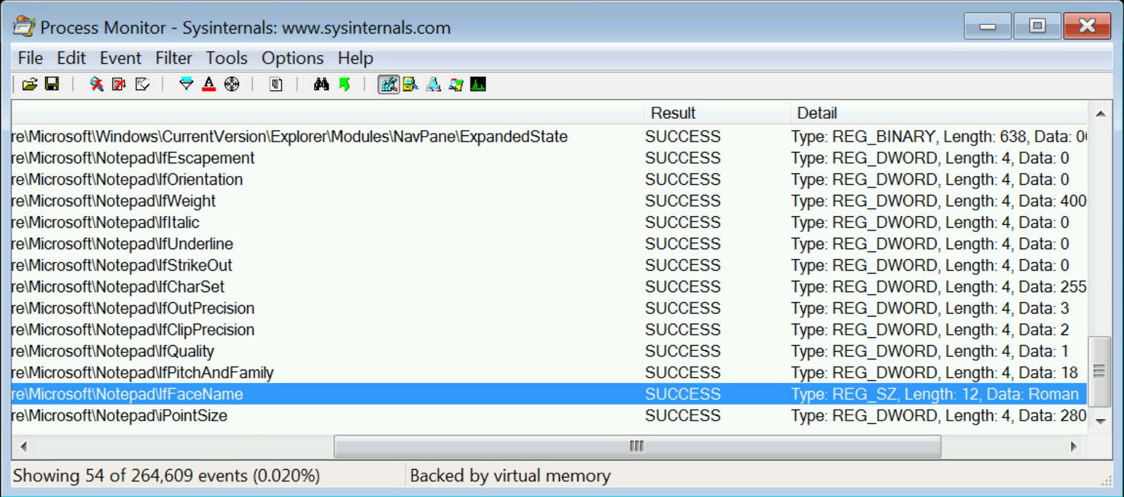
Process Monitor
Screenshot of the output in Part 3, Step 12.
It shows ifFaceName in the Path column and Data: Roman in the Detail column.

Slide 17
Firewall
Mod 6

Slide 18
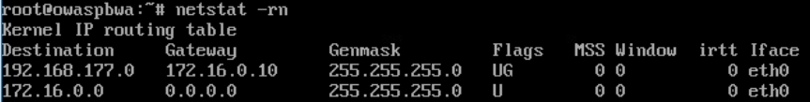
Time-based Access
Screenshot of the output in Part 1 Step 18.
It shows the output of the DMZ Route Table.

Slide 19
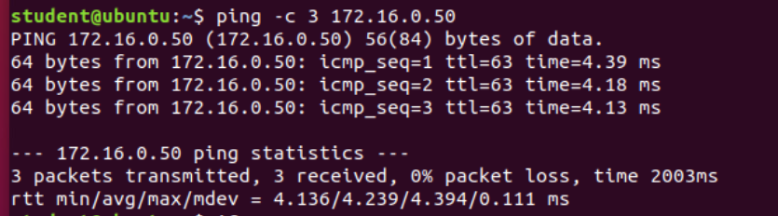
Time-based Access
Screenshot of the output in Part 1 Step 23.
It shows a successful ping from the Ubuntu Web VM and the DMZ VM.

Slide 20
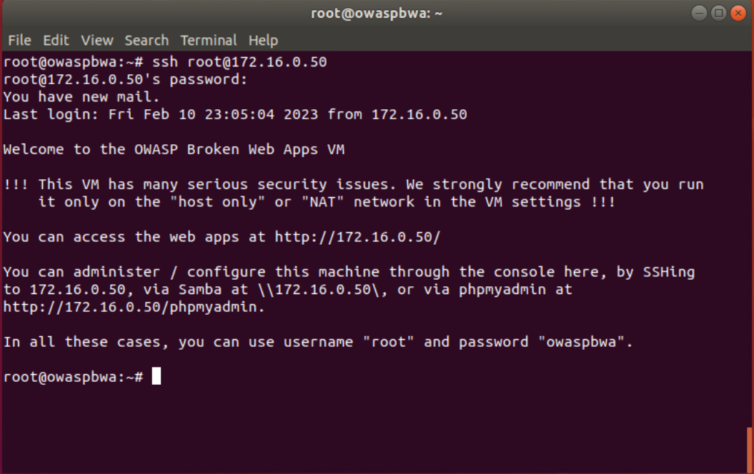
Time-based Access
Screenshot of the output in Part 1 Step 33.
It shows two time-based access rules in the FORWARD chain

Slide 21
Challenges
Difficulty with the labs
Outputs and questions on PowerPoint not lining up
VM occasionally unresponsive

Slide 22
Career Skills
Security Analyzing
PenTesting
Cyber Security Threat defense

Slide 23
Conclusion
I have learned many things from this course, including a better understanding of Infrastructure Security.

