Slide 1
CEIS 110
Intro to programming:
programming with data
Anthony dePierro

Slide 2
Introduction
Uses a cloud based system to gather temperature and humidity data
Data is then analyzed using programming and data analytics

Slide 3
Mod 1- Software Inventory
All necessary software was downloaded and installed
Software used was SQLite Studio, Excel, and Python IDE - Anaconda

Slide 4
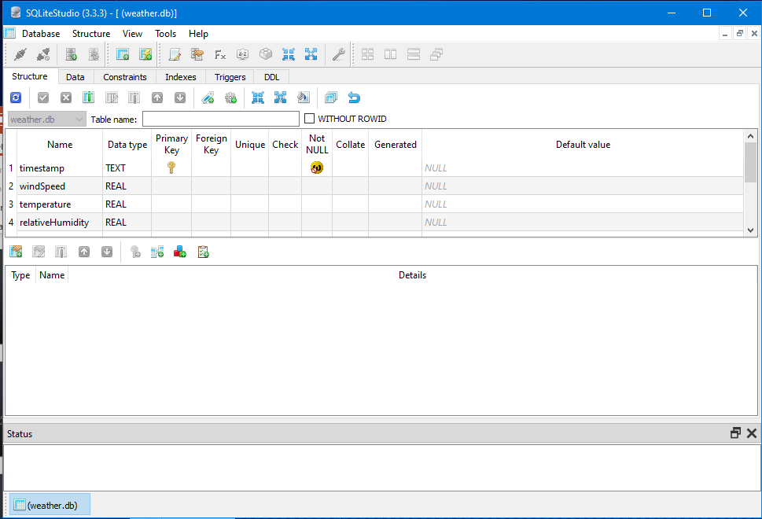
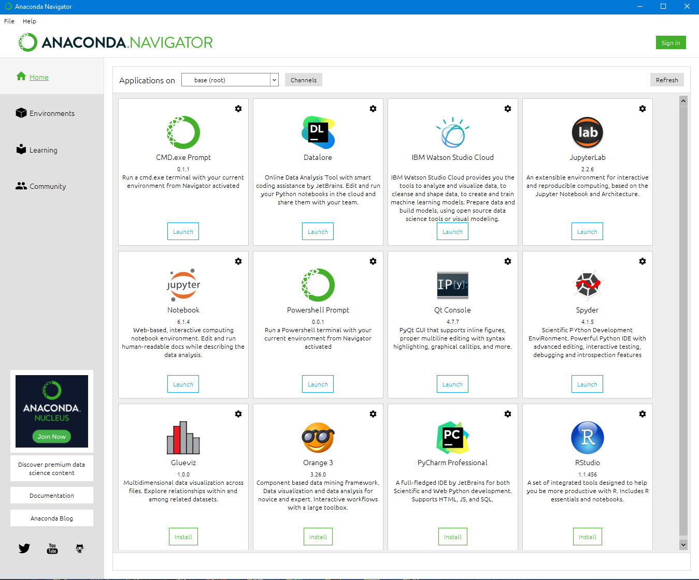
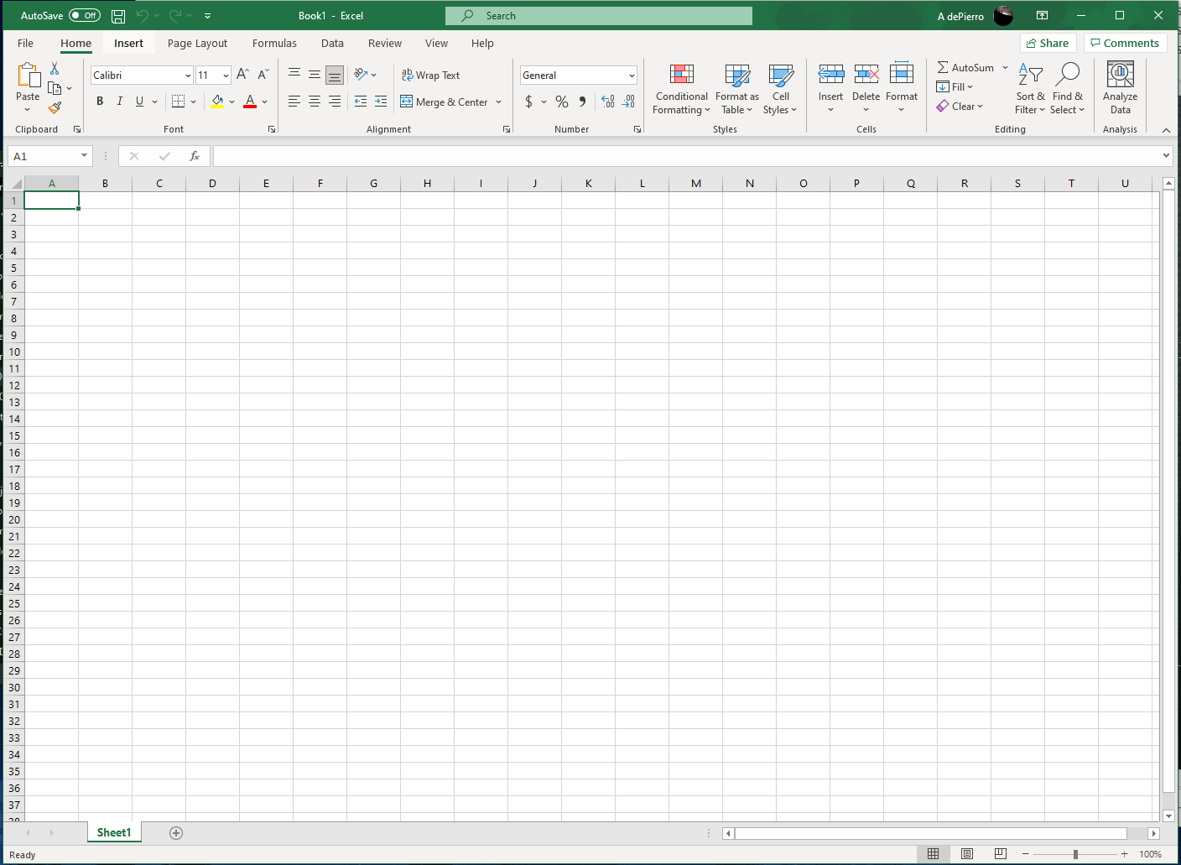
Software

Slide 5
Mod 2- Planning and designing
After installing all necessary software, a plan was created.
A plan was developed utilizing a flowchart

Slide 6
Flowchart purpose
A flowchart is a graphical representation of a process or workflow. It is used to illustrate the process and output of a software development project
Flowcharts can be used as simple naratives

Slide 7
Flowchart

Slide 8
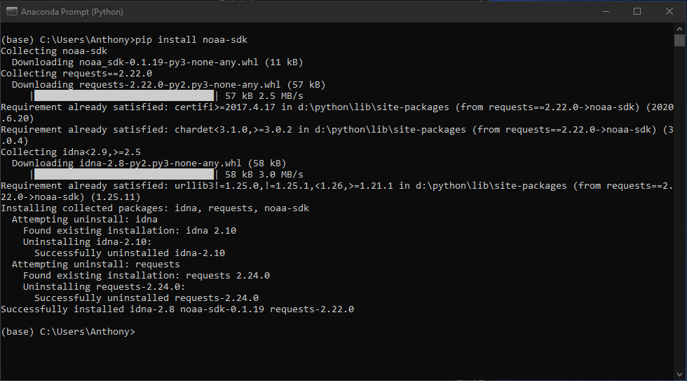
Software Inventory
NOAA-SDK library installed
"Successfully installed noaa-sdk" of pip install command is visible.

Slide 9
Mod 3- Gathering Temperature and Humidity data
After planning and design, the code was developed to download a set of weather observations.
The data was stored on a local database in a table for later analysis.

Slide 10
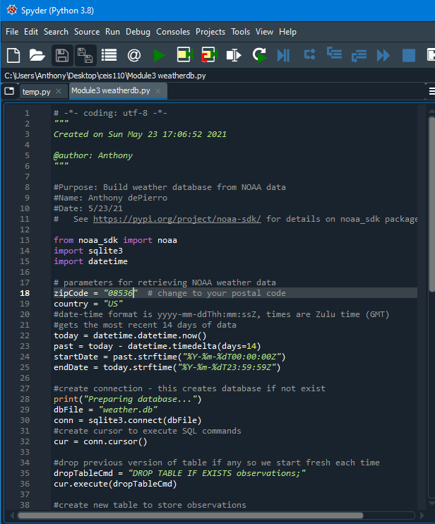
BuildWeatherDb.py Code
Screenshot of code in Spyder
Local zip code used for data analysis

Slide 11
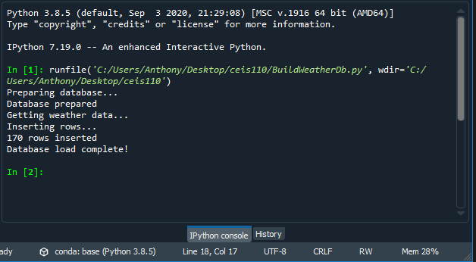
Python Console
Screenshot of program output in Python
console showing program executed successfully

Slide 12
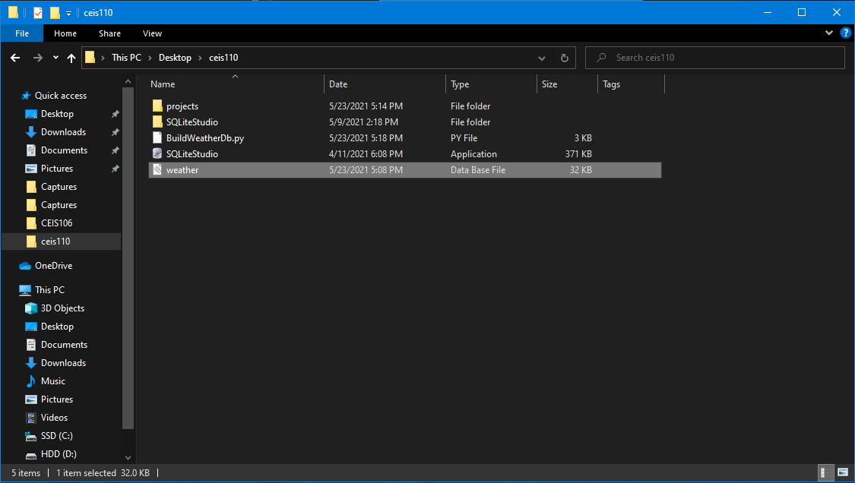
Weather.db File
Screenshot of Windows Explorer showing database file Weather.db was created

Slide 13
Mod 4- Querying the Database
Structured Query Language (SQL) is a programming language used for working with relational databases.
SQLiteStudio was used to query the database and view the results

Slide 14
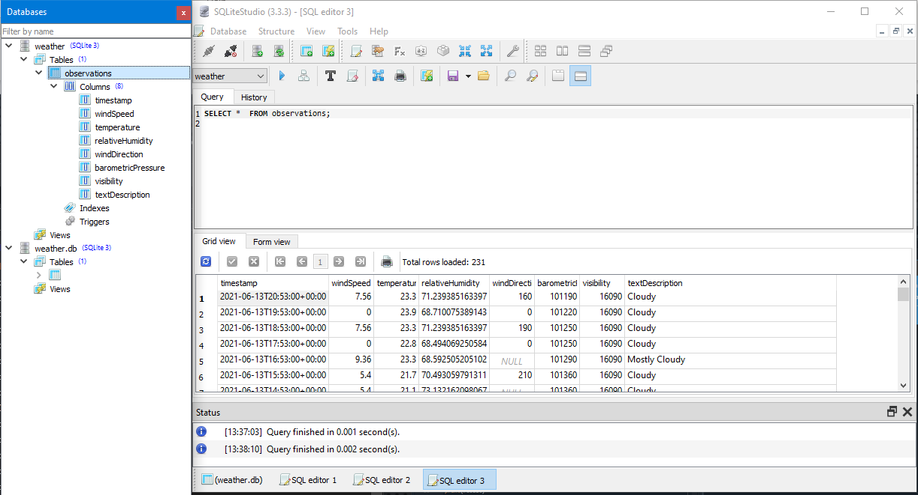
Query to retrieve all columns and all rows
Screenshot of SQL query command and results

Slide 15
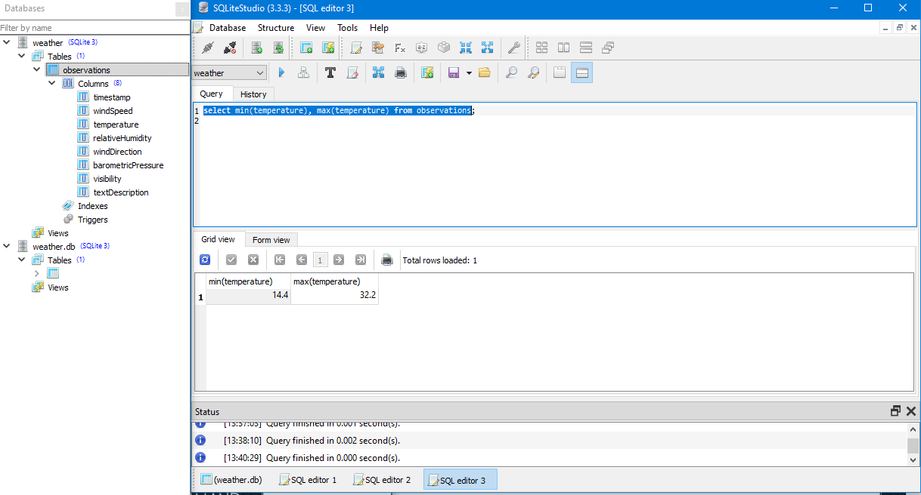
Query to retrieve lowest and highest temperatures
Screenshot of SQL query command and results (Celsius)

Slide 16
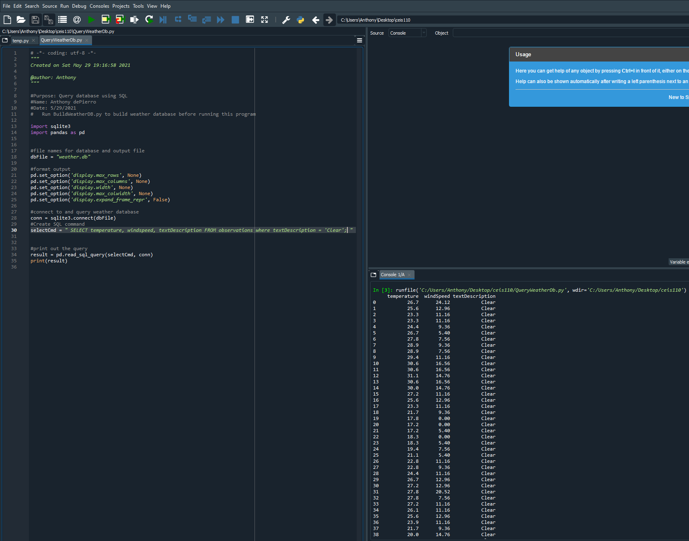
Query to retrieve all clear days
Screenshot of Python (Spyder) query command and results

Slide 17
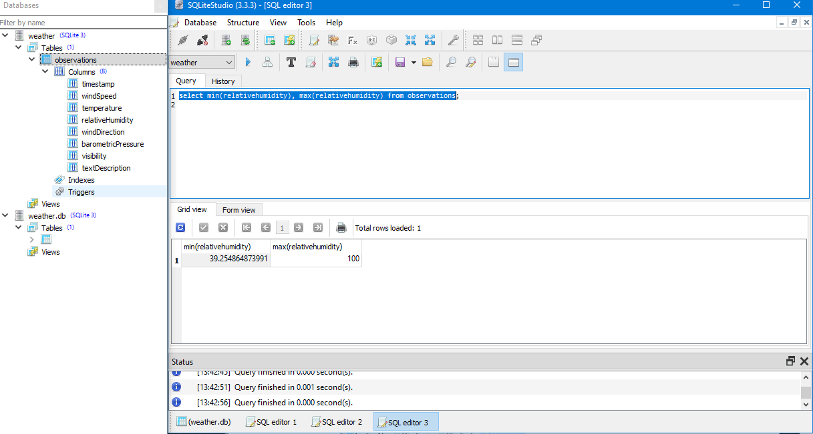
Query to retrieve lowest and highest relative humidity
Screenshot of SQL query command and results

Slide 18
Mod 5- Data Cleansing
Data was outputted from Python, to excel
Data was then cleansed to ensure it is complete, and valid to avoid errors in data

Slide 19
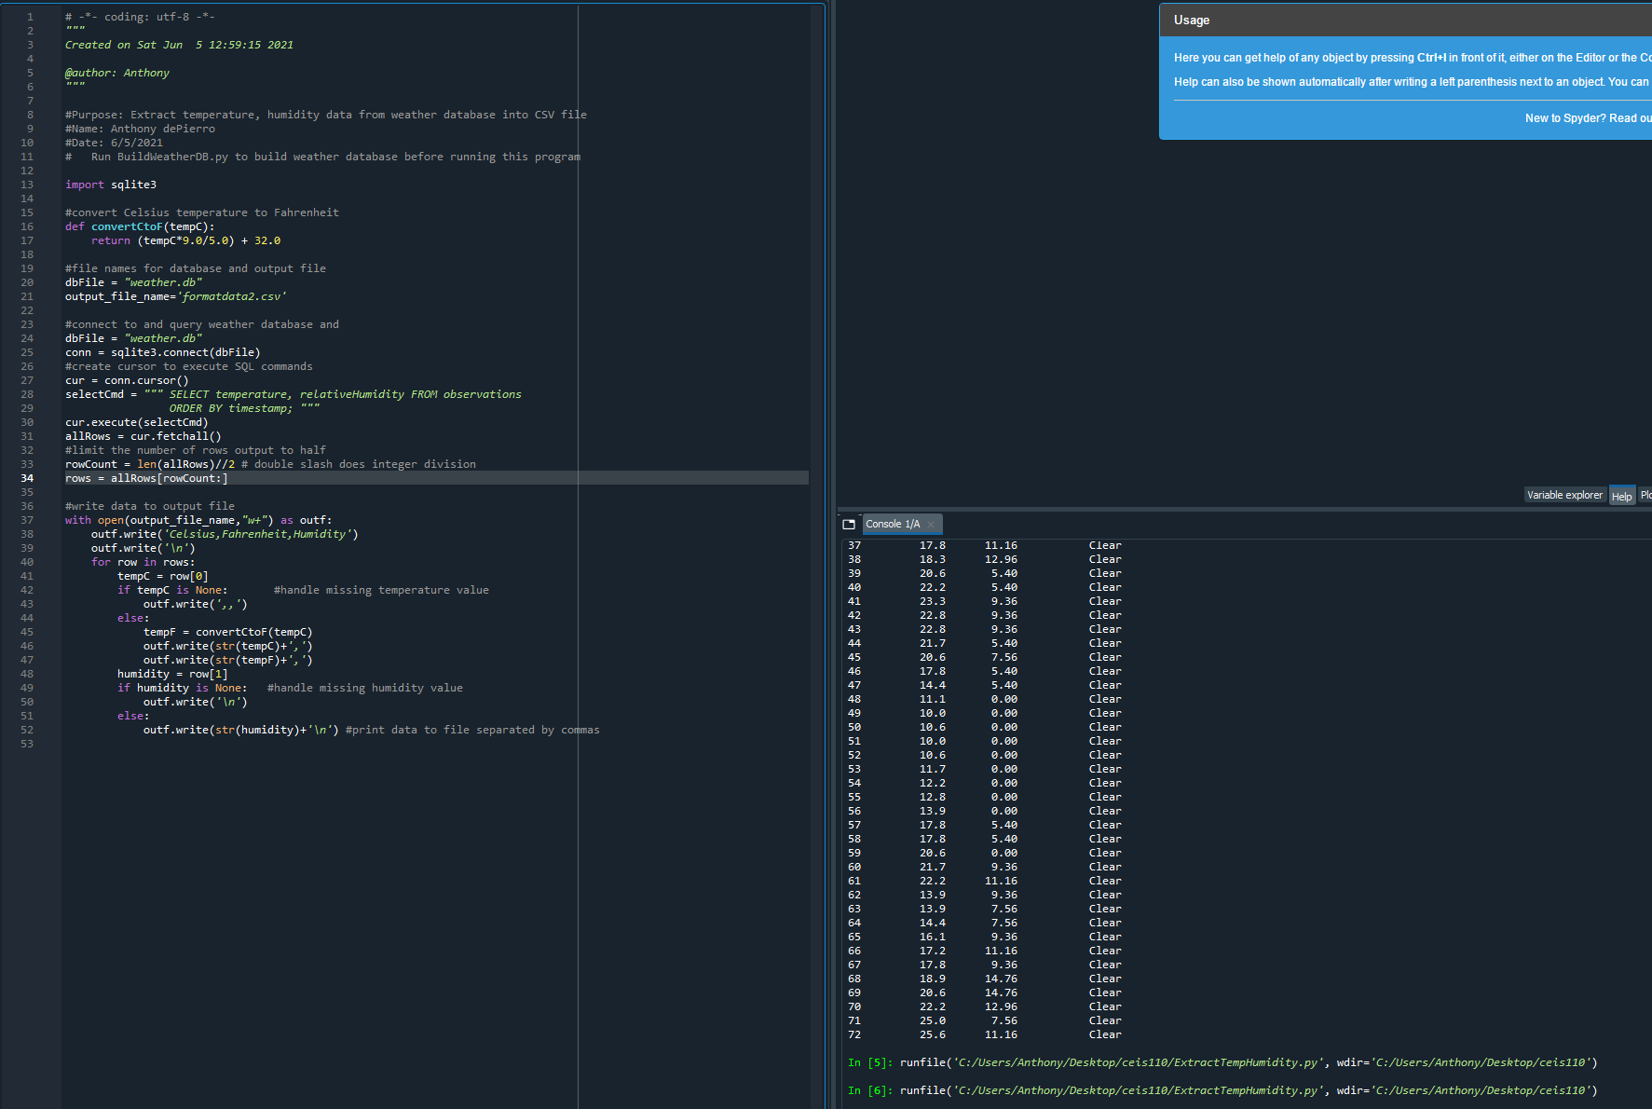
Python code
ExtractTempHumidity.py Python code to output data to excel

Slide 20
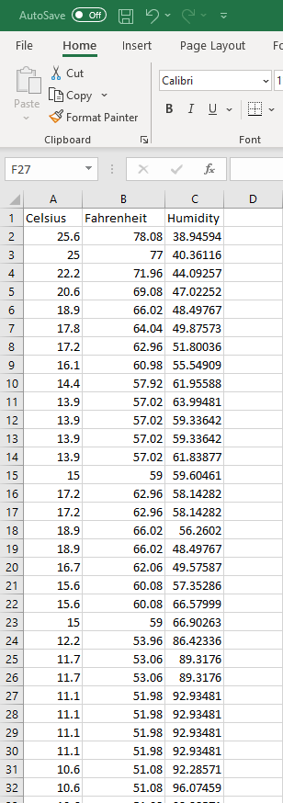
Retrieve and Convert Data to CSV Format
Formatdata file open in Excel showing 3 columns of data

Slide 21
Temperature and Humidity Chart
Excel chart based on temperature and humidity data from database

Slide 22
Mod 6- Data Analytics
Data was analyzed and displayed in various charts
Temperature and Humidity were compared in various ways

Slide 23
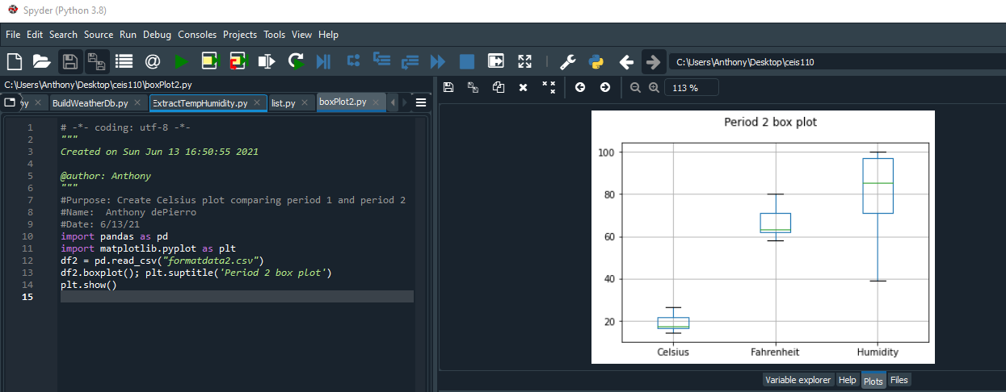
Box Plot
Box plot showing period 2 Celsious, Fahrenheit, and humidity

Slide 24
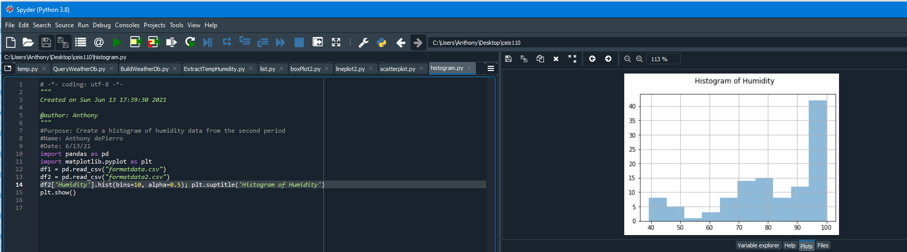
Histogram
Histogram showing humidity

Slide 25
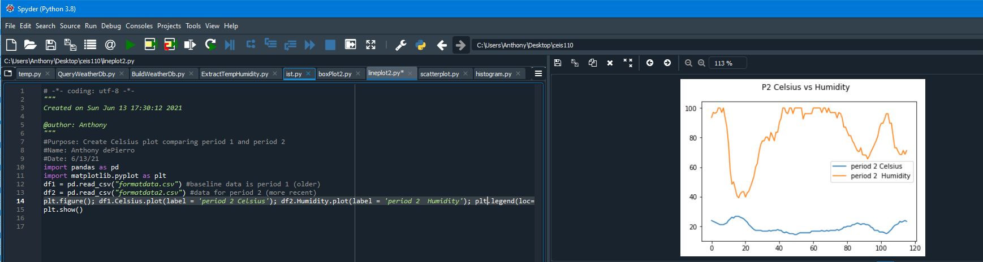
Analysis
Think of your own question and create a chart/graph to answer it
Your own question: How did the period 2 Temp in Celsius, compare to the period 2 humidity?
Answer supported by Chart:

Slide 26
Prediction
I expect the Temperature, and humidity to rise in the next few days. The Temperature and humidity has been a roller coaster, but ultimately, it has been on the rise.

Slide 27
Challenges
SQLite wasn’t running correctly. I had to wipe the program, and reinstall the application, as well as the databases
Databases weren’t syncing correctly with SQLite studio.
.CSV and .XLSX files weren’t being recognized by SQLite studio

Slide 28
Career Skills obtained
Database Development
Utlizing flowcharts
Programming utilizing python
Troubleshooting errors in the code and data cleansing
Utlizing SQLite studios
Navigating the various python and anaconda programs
Data analysis- reviewing charts and graphs to make predictions on data

Slide 29
Conclusion
This project covered fundamental topics of programming with data, by using data gathered from cloud service to perform data analytic operations
Building this project provided hands on learning opportunity to put into practice the topics covered in the course.

