Slide 1

NETW411:
Information Security and Mobile Devices
Anthony dePierro

Slide 2




Introduction
This class reviewed the concepts of data communication networks, cellular technology, and mobile technology. Security threats on mobile devices, mobile apps, and underlying wireless networks, as well as countermeasures to these threats, are discussed in detail.

Slide 3

Mod 2
Android Emulator

Slide 4
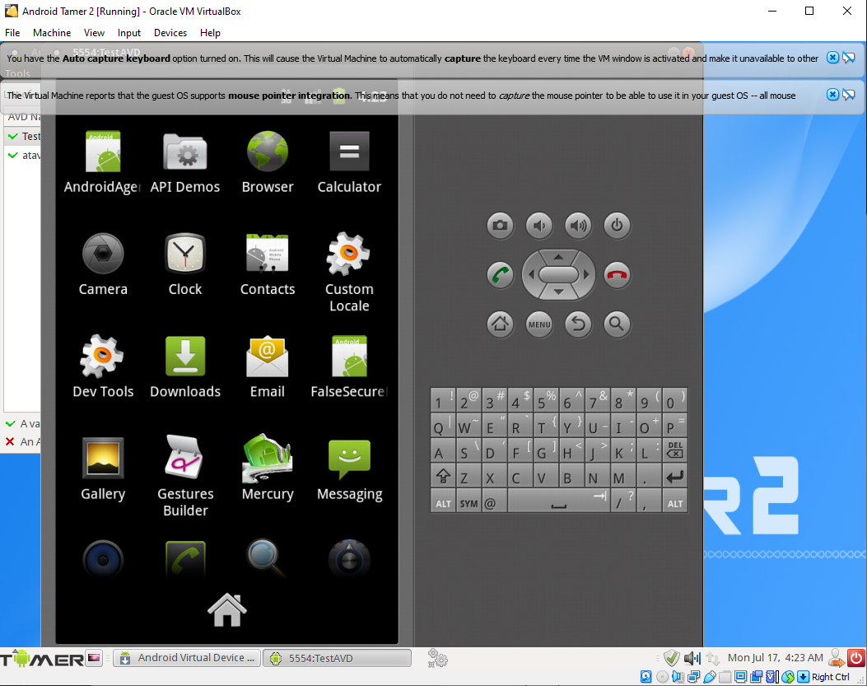
Accessing the Android Emulator
This screenshot shows the Android emulator phone screen with its apps.

Slide 5
What is Android SDK? What is it used for?
Answer: Android SDK stands for Android Software Developer Kit. It used to develop and build applications.
References:
1. https://www.edureka.co/blog/android-sdk-tutorial/#:~:text=The%20Android%20SDK%20(Software%20Development,goes%20as%20smoothly%20as%20possible.
2.

Slide 6
Mod 4
Android App Development

Slide 7
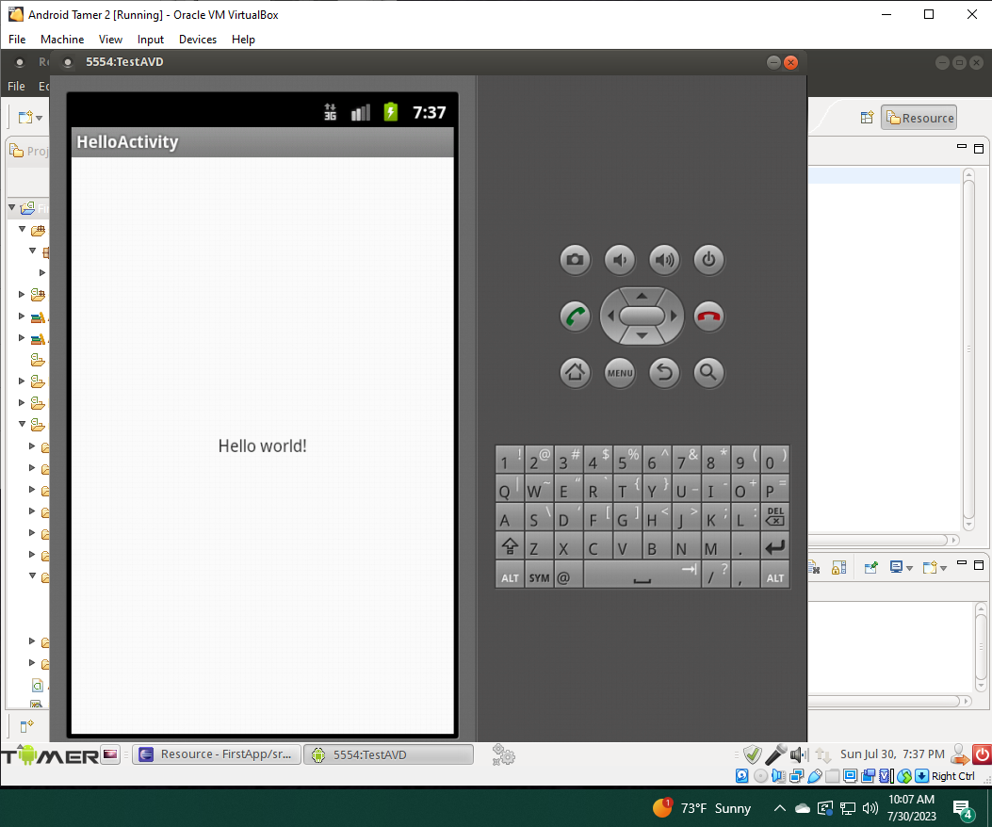
Using the Eclipse IDE
This screenshot shows the phone screen with the “Hello world!” message.

Slide 8
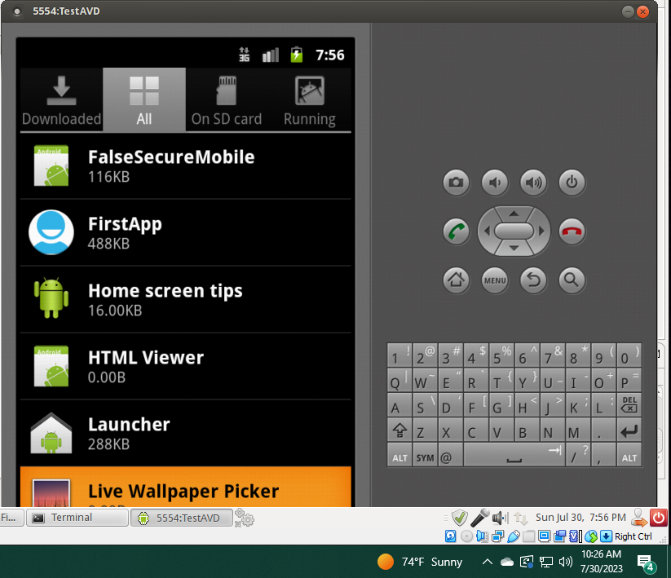
Creating Android Package File
This screenshot shows the phone screen with the new FirstApp app installed.

Slide 9
Mod 5
Reverse Engineering

Slide 10
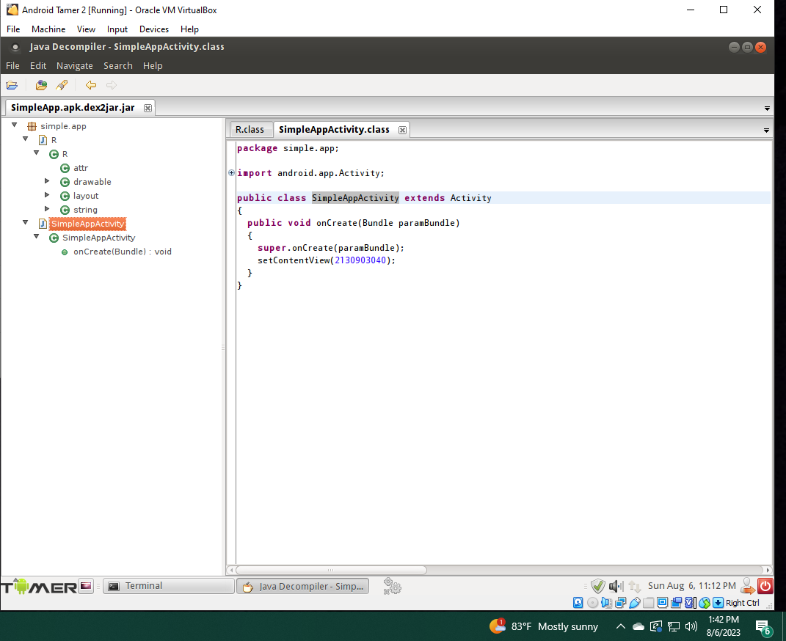
Reverse Engineering the SimpleApp App
This screenshot shows the Java Decompile tool window with SimpleApp source code.

Slide 11
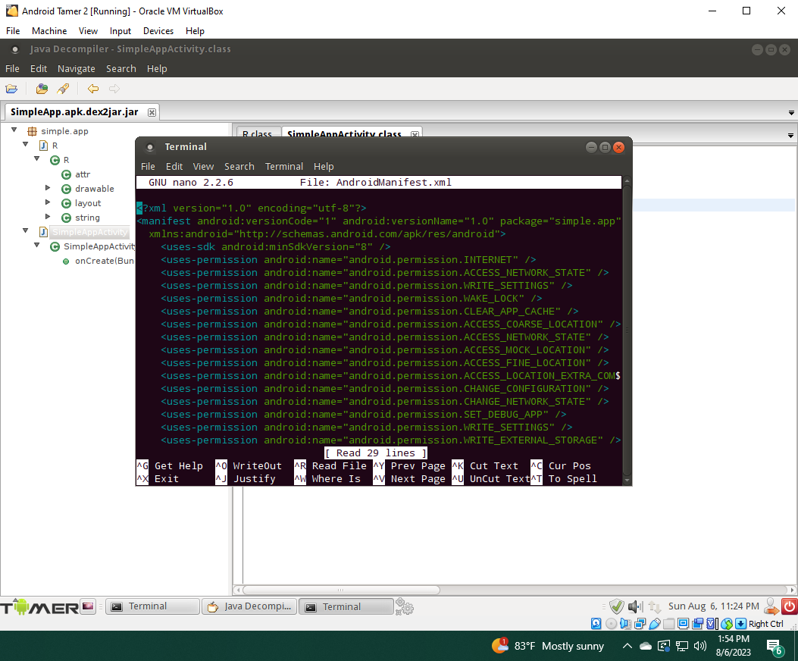
Reverse Engineering the SimpleApp App
This screenshot shows the content of the AndroidManifest.xml file.

Slide 12
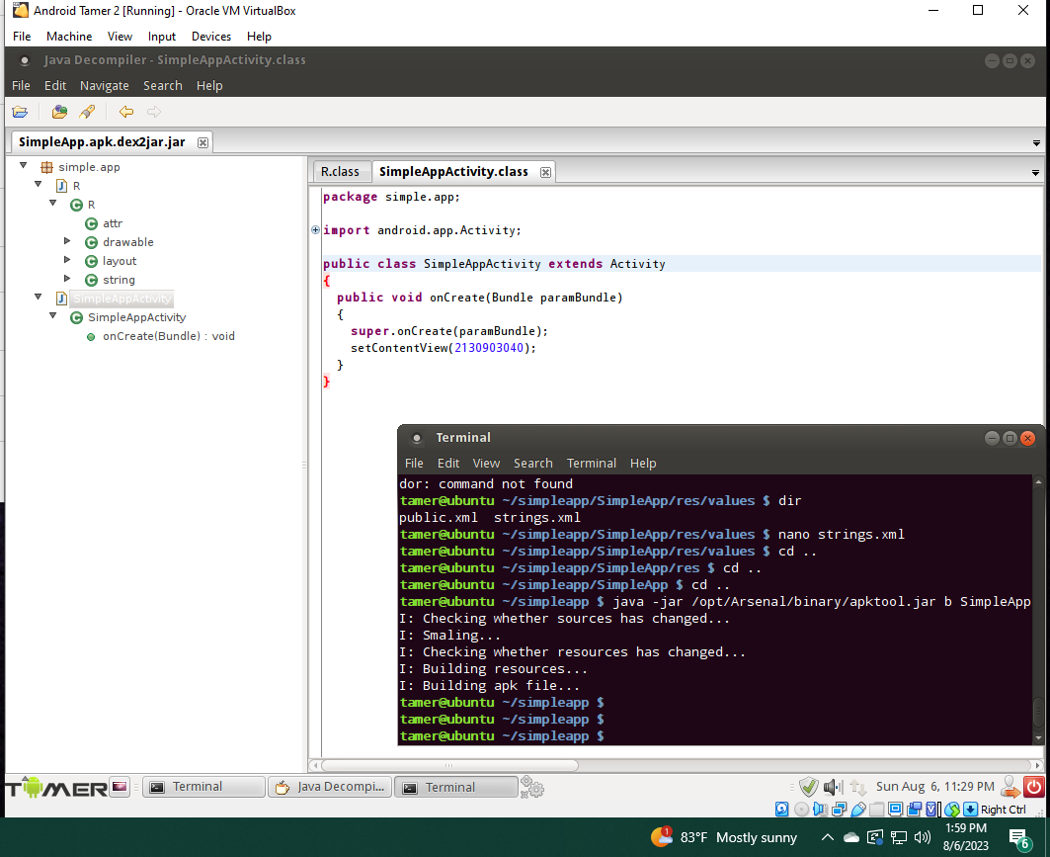
Reverse Engineering the SimpleApp App
This screenshot shows the recompiling process using apktool.

Slide 13
Mod 6
Web Traffic Analysis

Slide 14
Research Burp Suite online.
In the screenshot shown in Step 3, what does it mean when you select “Yes” to confirm the “Are you sure that you want to listen on all interfaces” message?
Answer: you are allowing Burp Suite's proxy to listen for and intercept network traffic on all available network interfaces on your system. This means that Burp Suite will capture and analyze HTTP/HTTPS traffic not only from your local machine but also from other devices and machines on your network that communicate through the specified interface.
References:
1. https://www.geeksforgeeks.org/what-is-burp-suite/
2.

Slide 15
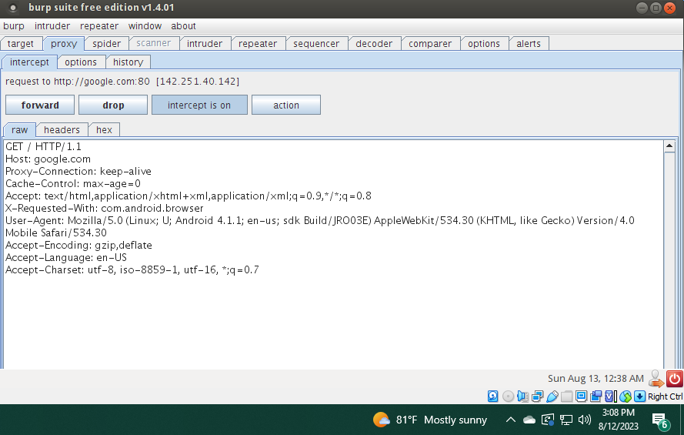
Using Burp Suite to Analyze Web Traffic
This screenshot should show the Burp Suite window with the Web header displayed.
Make sure to capture the data/time information in the bottom right corner of your computer screen.

Slide 16
Research the concept of “Web Headers.”
What is the role played by Web headers in a hacker’s attempt to mount a cyber attack?
Answer: They provide crucial information and opportunities for exploitation. They contain metadata about the request and response, including information about the client, server, and the data being exchanged.
References:
1. https://www.thehacker.recipes/web/config/http-headers
2.

Slide 17
Research the proxy software available for actual Android devices (not just an emulator).
Describe what it is and how it works.
Answer: One of the proxy software available for actual Android devices is "Packet Capture." Packet Capture is an Android app that allows users to capture and analyze network traffic passing through their device. It works by creating a local VPN (Virtual Private Network) service on the device, which intercepts and logs network packets as they pass through the network stack. The captured data can then be viewed and analyzed within the app, helping users diagnose network issues, monitor app behavior, and gain insights into the communication between their device and external servers.
References:
1. Packet Capture Mobile App
2. https://techwiser.com/wireshark-alternatives-for-android/

Slide 18

Challenges in the project
Emulator not stable
Application not showing in the phone menu
Linux commands were not 100% accurate

Slide 19
Career Skills Obtained
Mobile phone app development
Reverse Engineering apps
Mobile phone Security

Slide 20
Conclusion
I have learned many things from this course, including a better understanding of mobile network security.

Slide 21


References
https://www.edureka.co/blog/android-sdk-tutorial/#:~:text=The%20Android%20SDK%20(Software%20Development,goes%20as%20smoothly%20as%20possible.
https://www.geeksforgeeks.org/what-is-burp-suite/
https://www.thehacker.recipes/web/config/http-headers
Packet Capture Mobile App
https://techwiser.com/wireshark-alternatives-for-android/

