Slide 1
CEIS 106
Intro to Operating Systems
Anthony dePierro

Slide 2
Introduction
Detailed, and visual summary of what we learned in CEIS106

Slide 3
Module 1
Accessing Linux through Virtual Machine

Slide 4
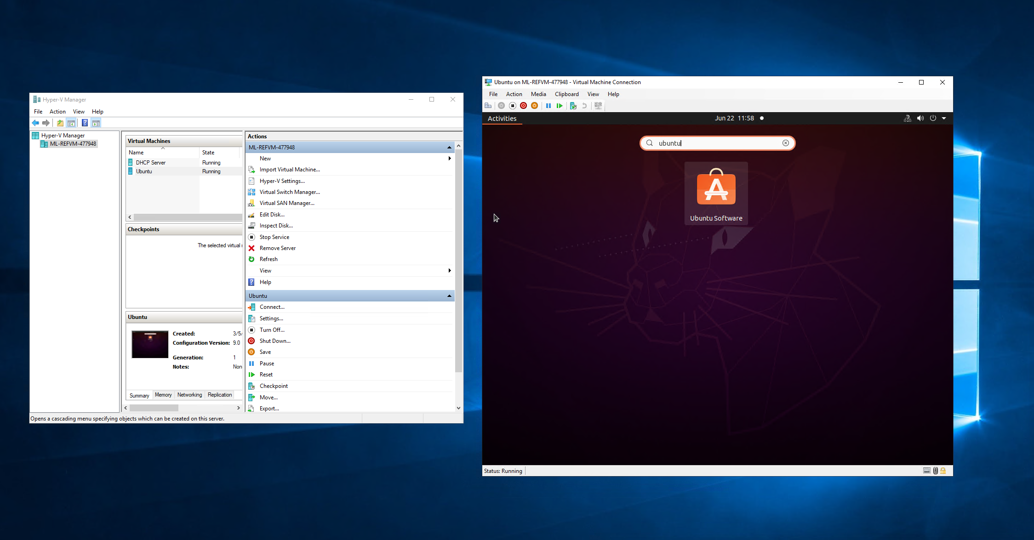
Accessing Linux through Virtual Machine
Mod 1
Accessing Linux through Microsoft Azure

Slide 5
Module 2
Linux File tree
Creating files and directories
Copying and removing Files and Directories
Locating files and directories

Slide 6
Navigate the Linux filesystem tree
Mod 2
1. What is the pwd command an acronym for? What about the cd command?
Answer here: print working directory, and cd is change directory
2. Explain the differences between a relative path and an absolute/full path in Linux.
Answer here: relative path is related to the pwd you are in. You would use the ‘cd (file name)’ command in the current pwd, where as absolute path would be cd /folder1/folder2/(file name) from Home (~)
Reference: Mod 2

Slide 7
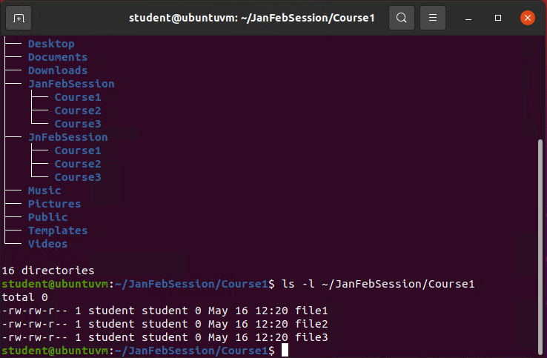
Create directories and files
Mod 2

Slide 8
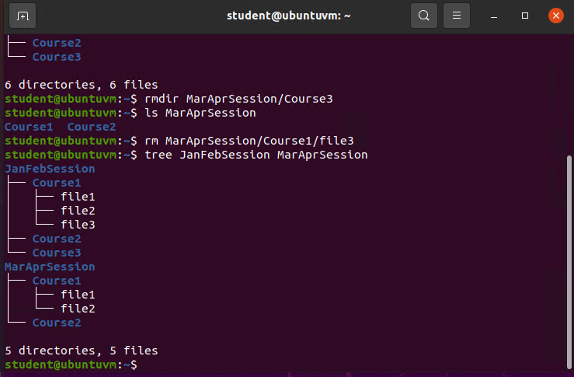
Copy and remove directories and files
Mod 2
Utilize the ‘rmdir’ command to remove directories
Utilize the ‘rm’command to remove files within a folder

Slide 9
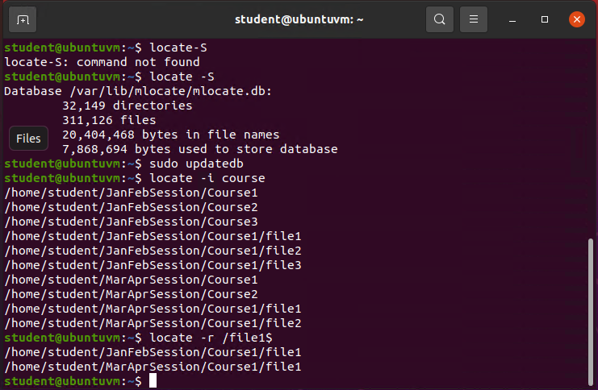
Locate directories and files
Mod 2
Using the ‘locate’ command to search directories

Slide 10
Module 3
Creating a shell script
Changing script file permissions
Setting PATH variables
Making the PATH variable permanent

Slide 11
Create a shell script
Mod 3
1. What are the file permissions of the script?
Answer here: read, write, and execute for the owner (7). Read and execute to for the others, and group (5). So 755
2. What’s the name of the user-defined variable in the script?
Answer here: text
3. Which redirection meta-character is used in the script? What does it do?
Answer here: >>, which appends the output redirection.

Slide 12
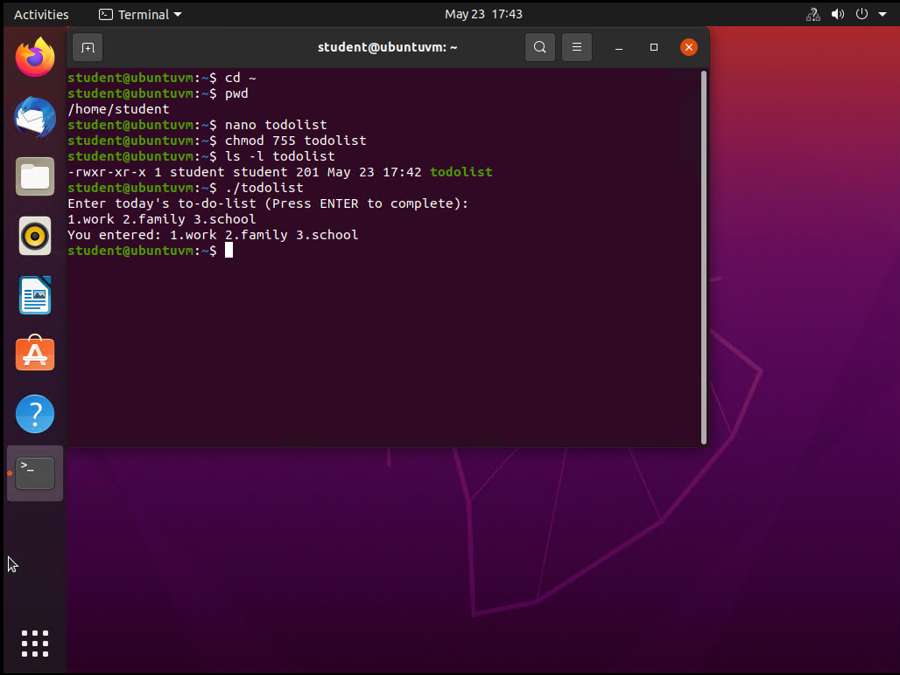
Change script file permissions
Mod 3
Utilizing the ‘chmod’ command to change script file permissions

Slide 13
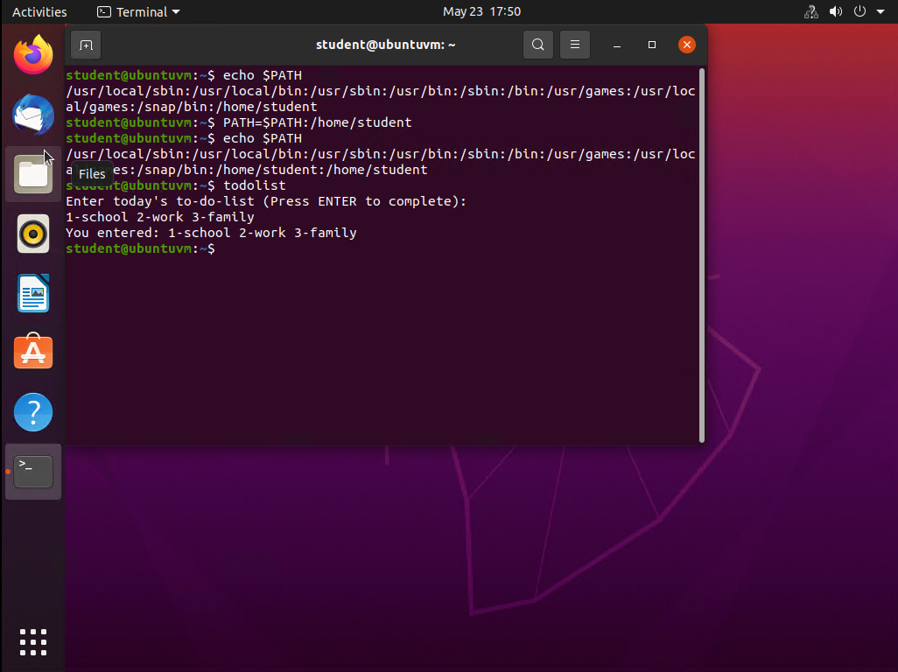
Set the PATH variable
Mod 3
Usting the ‘PATH=$PATH:’ command to set path variables.

Slide 14
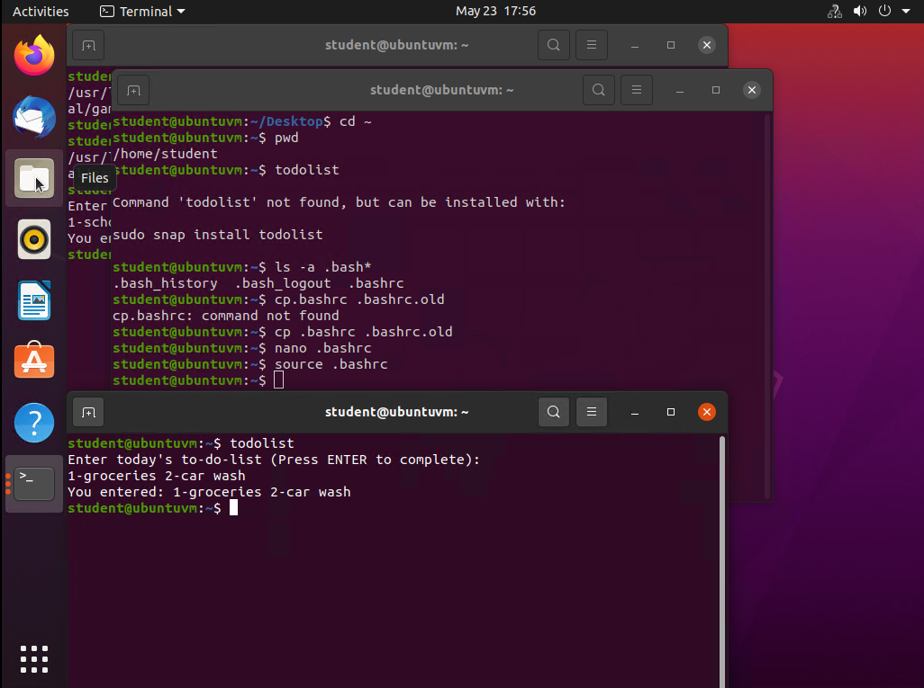
Make the PATH variable permanent
Mod 3

Slide 15
Module 4
Adding users and groups in CLI
Testing users and groups
Adding users in GUI (Graphical User Interface)
Removing users and groups

Slide 16
Add users and groups in CLI
Mod 4
1. What does the –m option in the useradd command do?
Answer here: -m creates a home folder for the new user.
2. What does the -3 option in the tail command do?
Answer here: 3 lines
3. Which line of the /etc/group file lists members of the “students” group? Copy it here.
Answer here: students:x:1002:student,mary

Slide 17
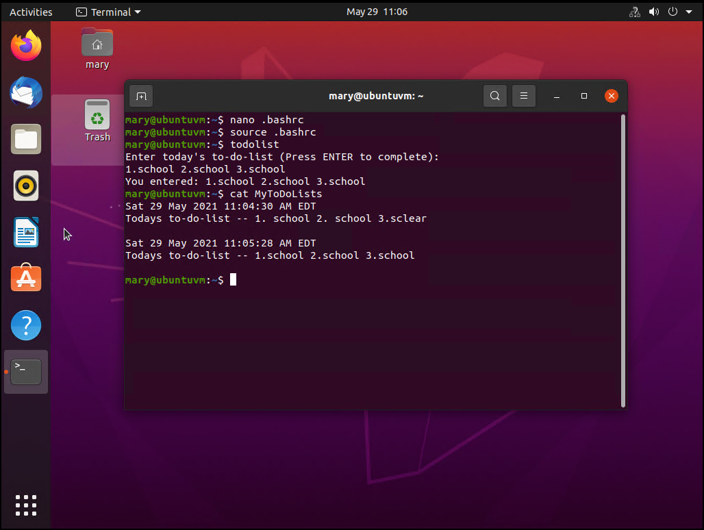
Test user and group settings
Mod 4

Slide 18
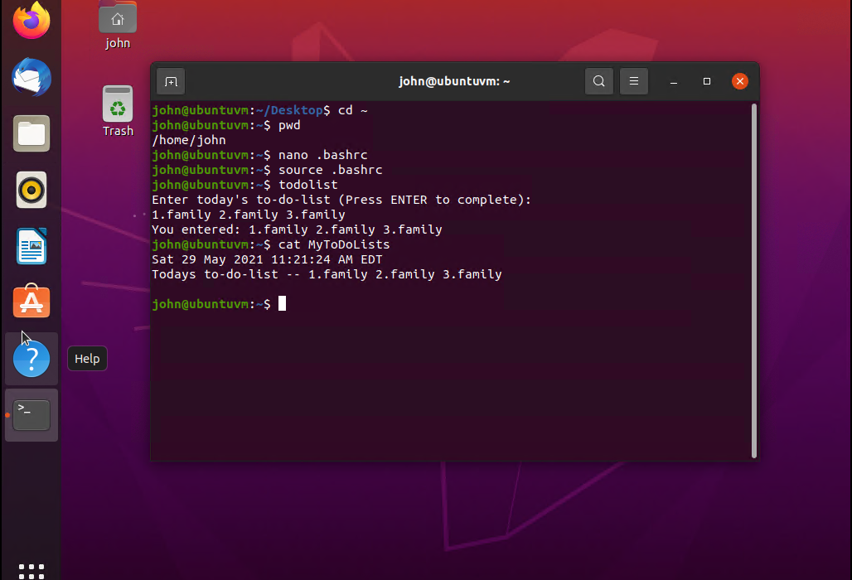
Add users in GUI
Mod 4

Slide 19
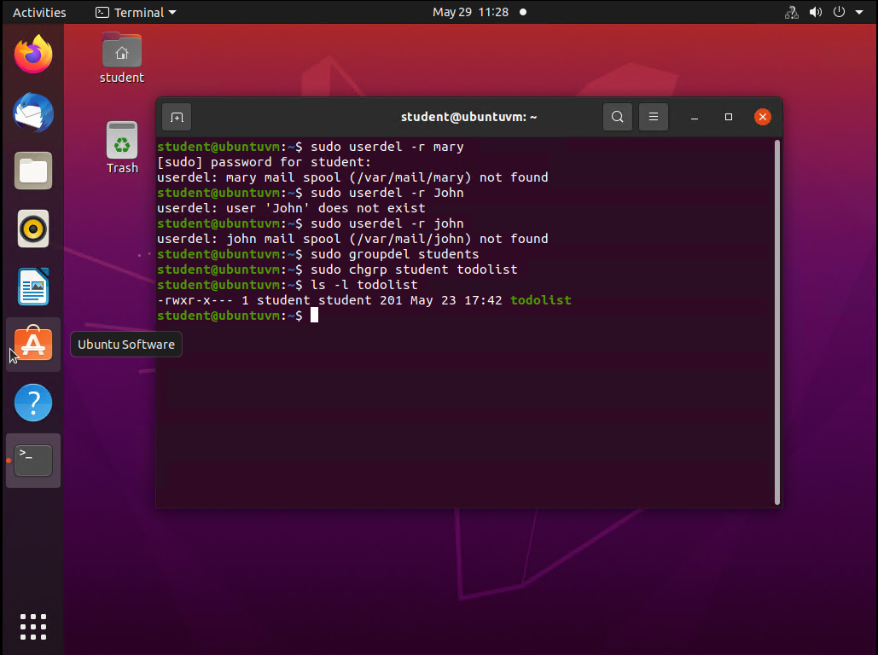

Remove users and groups
Mod 4
Utilize the ‘userdel’ command to remove users
Utilize the ‘groupdel’ command to remove groups

Slide 20
Module 5
Discover IP host configurations
Manage network interfaces
Use network utilities

Slide 21
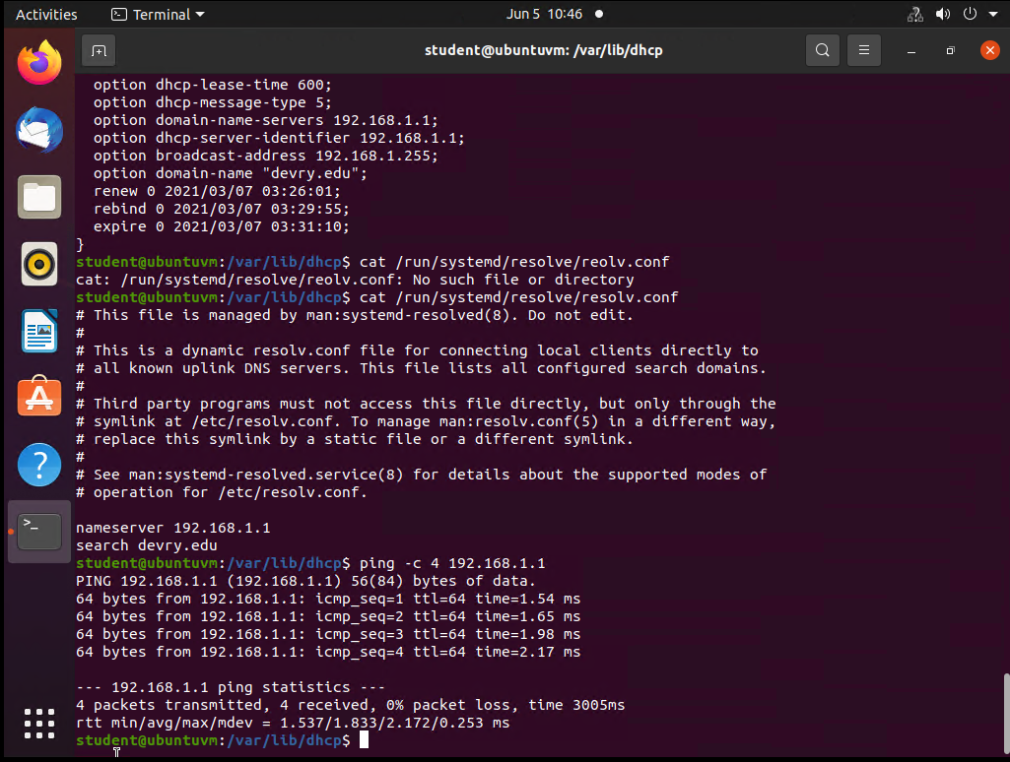
Discover host IP configurations
Mod 5
1. What is the IP address of your Ubuntu machine?
Answer here: 198.168.1.104
2. What is the IP address of its default gateway?
Answer here: 192.168.1.1
3. What is the IP address of its DHCP server?
Answer here: 192.168.1.1
4. What is the IP address of its DNS server?
Answer here: 192.168.1.1

Slide 22
Manage network interfaces
Mod 5
1. Which DHCP message is shown in the output of the sudo dhclient –v –r eth0 command? [hint: the message name is in uppercase.]
Answer here: DHCPRELEASE
2. Which four DHCP messages are shown in the output of the sudo dhclient –v eth0 command? [hint: the message names are in uppercase.]
Answer here: DHCPDISCOVER, DHCPOFFER, DHCPREQUEST, DHCPACK

Slide 23
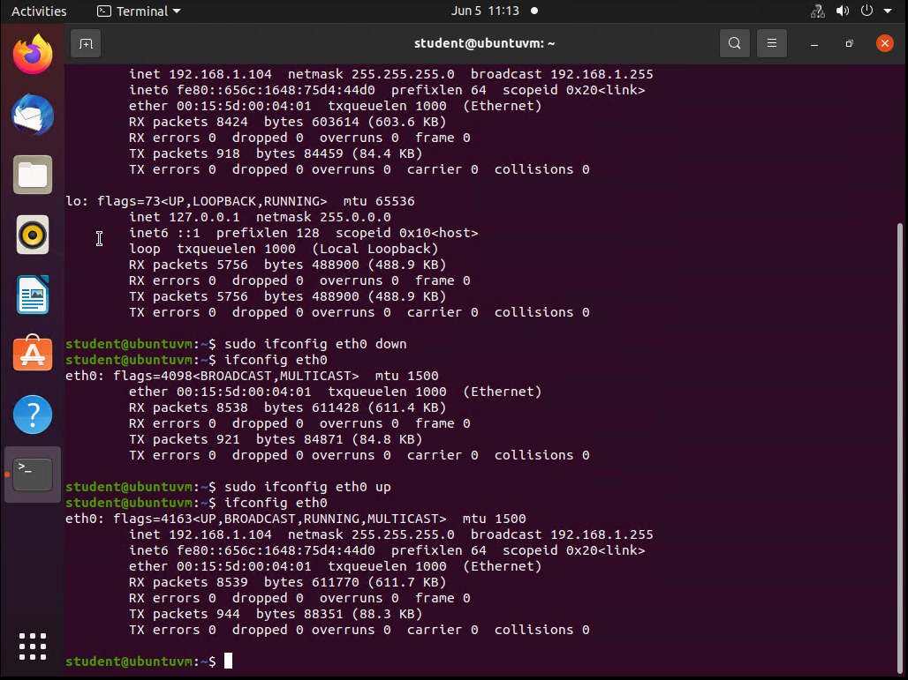
Use network utilities
Mod 5

Slide 24
Module 6
Monitor Linux processes
Monitor User activities
Monitor network bandwidth usage

Slide 25
Monitor Linux processes
Mod 6
1. What is the default action of the 15 SIGTERM kill signal?
Answer here: It terminates the process
2. In the System Monitor window, click on % CPU to sort the processes by CPU load. Which process shows the highest percentage of CPU usage?
Answer here: student

Slide 26
Monitor user activities
Mod 6
Issue the sudo action on command to turn on GNC accounting. Run the sudo updatedb command. Enter lastcomm updatedb to check if the updatedb command was executed before. Remember to turn off GNC accounting (sudo accton off) after answering the questions.
1. What flag value is displayed in the output?
Answer here: S
2. Why is the name of the user who ran the processes shown as root, not student?
Answer here: root is the only user account with permissions to modify.

Slide 27
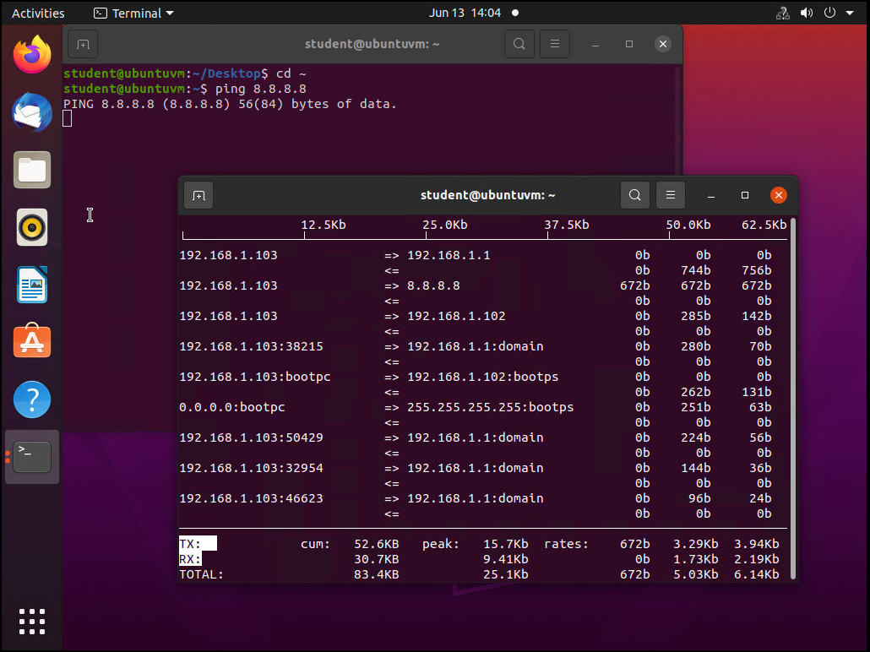
Monitor network bandwidth usage
Mod 6

Slide 28
Challenges
Remembering User passwords on Ubuntu
Spelling errors causing scripts not to run
Virtual Machine wouldn’t run Ubuntu properly

Slide 29
Career skills
Extensive knowledge of Linux Operating system
Using various commands to fulfill different functions
Adding and removing new users
Adding user permissions

Slide 30
Conclusion
This project covered fundamental topics of the Linux Operating system, using Ubuntu
Building this project provided hands on learning opportunity to put into practice the topics covered in the course.

