Slide 1
CEIS312
Artificial Intelligence and Machine Learning
Anthony dePierro

Slide 2
Introduction
Kaggle.com contains a variety of datasets for experimentation. One such dataset is the 80-cereals dataset. This dataset contains the consumer reports rating of several different cereals along with various data about the cereals. We will be predicting the consumer reports rating on the cereal based on the data given. This will be based on nutrition, and taste.

Slide 3
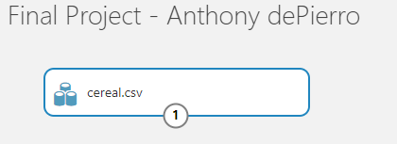
Uploading Dataset
Here we can see the Cereal.csv final was successfully uploaded to the canvas

Slide 4
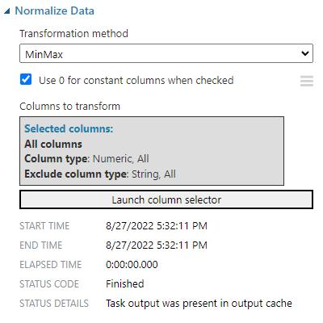
Data Preparation / Normalization
Data is normalized using MinMax. All Numeric columns were used, and all string columns were excluded

Slide 5
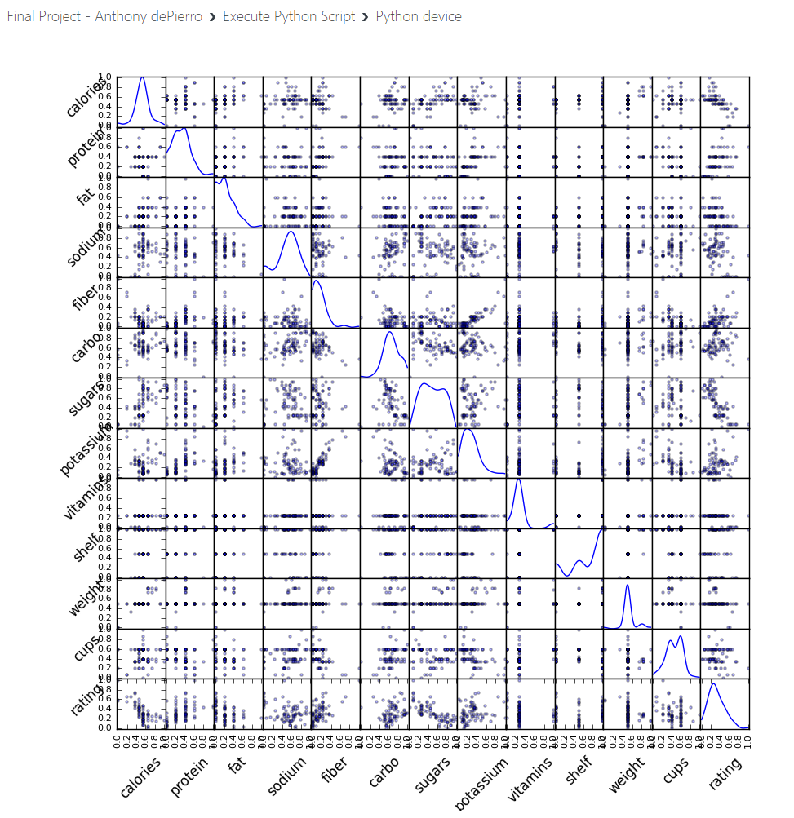
Executing Python Script
Python script was executed and produced a scatterplot of all the data

Slide 6
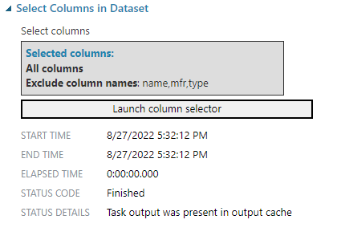
Selecting features
I further excluded all columns that included non-numeric data:
-Name
-Manufacturer
-type

Slide 7

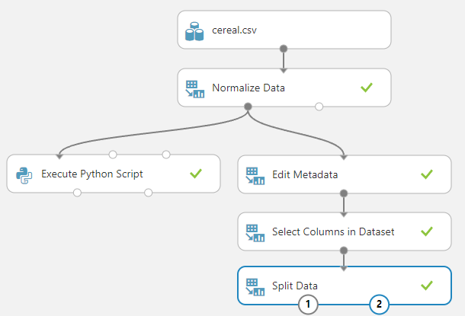

Splitting the data
Data is split into 2 datasets

Slide 8
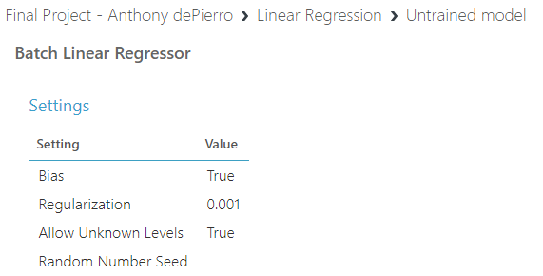
Linear Regression Model

Slide 9
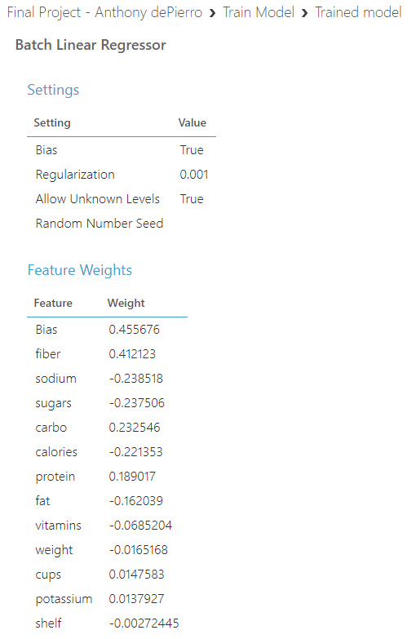
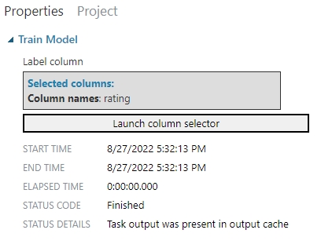
Training the Model
Trained the model using the Ratings column

Slide 10
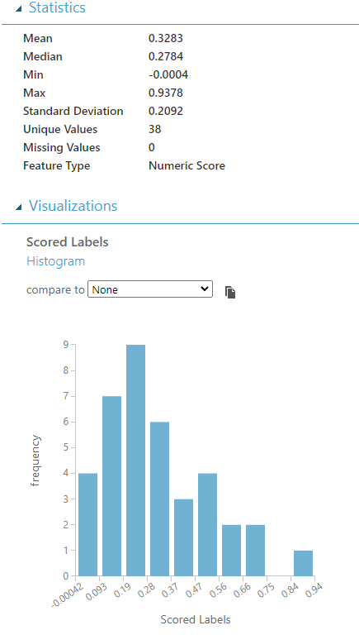
Scoring the Model
Data was scored

Slide 11
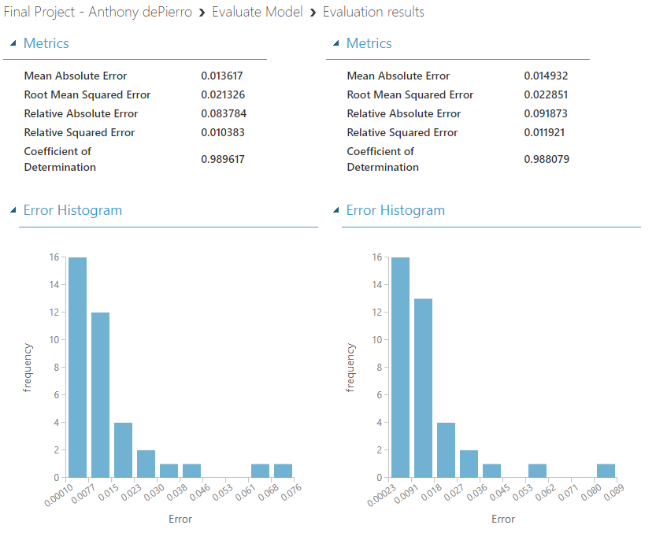
Evaluate the Model-Final results
Metrics on the right were my original results. In an effort improve, I changed some features of the experiment and succeeded, as seen on the left metrics.

Slide 12
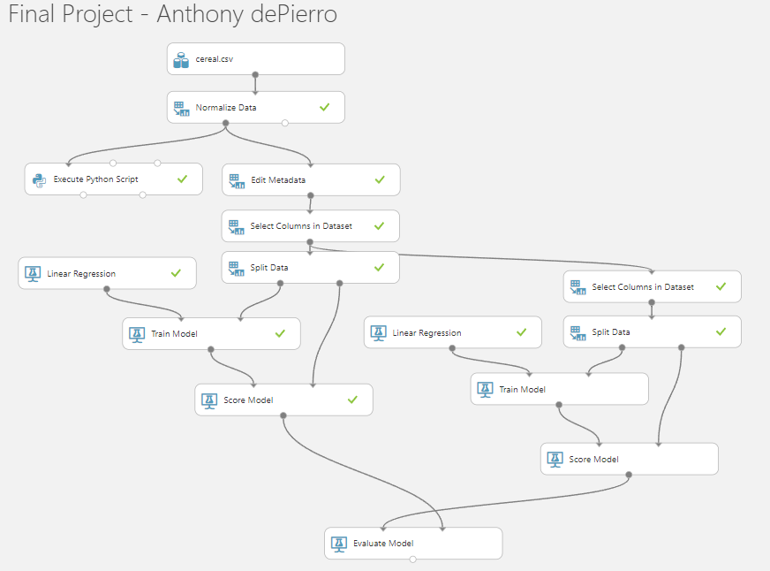
Full diagram

Slide 13
Iteration Process
I originally chose to exclude all data that did not have an integer, as I felt it did not need to be included
I chose to further remove shelf, weight, and cups because the data is not relevant.
While still using rating on the train model, I was able to achieve a higher R2 from 0.988079 to 0.989617!
I noticed vitamins were very influential. using vitamins in the train model caused the R2 to drop to 0.450771

Slide 14
Career Skills
Microsoft Machine Learning Studio
Evaluation of ML performance
Determining important features to influence outcomes

Slide 15
Challenges
Getting the R2 to fall above a .70
Permutation Feature Importance kept crashing the experiment
Trial and error until receiving desired results, or results that did not crash the experiment.

Slide 16
Conclusion
I have learned many things from this course, including a better understanding of Machine learning. This class has been very useful in learning how to create evaluate machine learning models and experiments.

