Slide 1
Converged Networks
NETW320

Slide 2
Introduction
This course examined foundations for current and emerging networks that deliver voice, data and video/imaging through various technologies. Topics include core switching, broadband and edge access, Internet protocol telephony, adding packet capabilities to circuit-switched networks, current generation of wireless mobile telecommunications technology, presence- enabled communications, security and troubleshooting. Telecommunications regulation and standards are discussed.
Ref: class Syllabus

Slide 3
mod2
Audio and Video Codecs

Slide 4
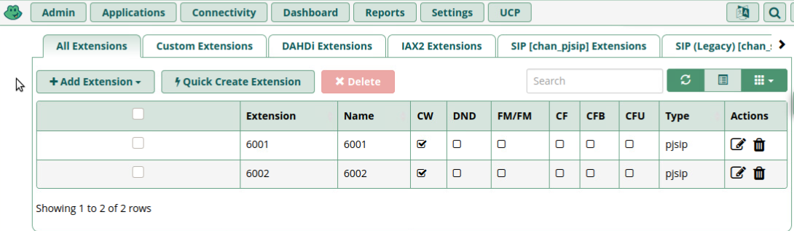
Create SIP Accounts
The screenshot shows the All Extension tab of the Asterisk Server A, with both extensions (6001 and 6002) being displayed.
SCREENSHOT HERE

Slide 5
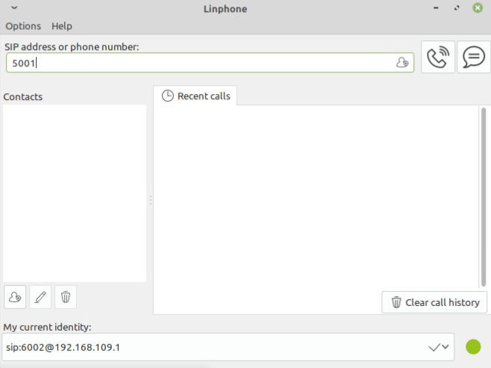
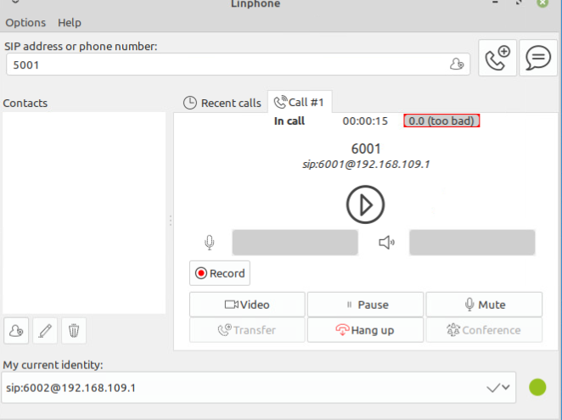
Register SIP Clients
This screenshot should show the Linphone window, with sip:6002@192.168.109.1 being displayed in the My current identity field.
This screenshot should show the Linphone window with the in call status and timer xx:xx:xx information.

Slide 6
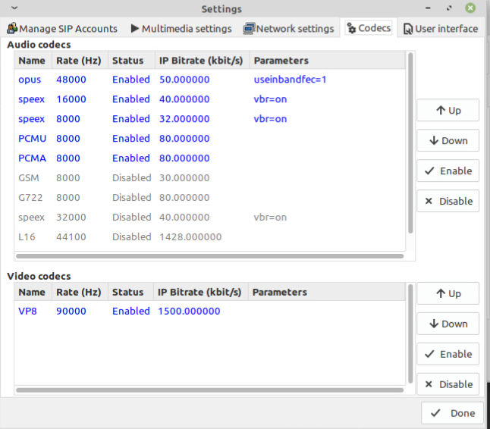
Audio and Video Codecs
The screenshot shows the Settings window of the Linphone, showing the audio codecs and video codecs.
Among the audio codecs enabled for the Linphone, which one requires the most bandwidth per call? Which one requires the least bandwidth per call?
Answer: most = PCMU/PCMA
Least = speex
Which video codec does the Linphone use? How much bandwidth would such a video session consume?
Answer:1500.00000 kbits/s

Slide 7
MOD3
Real Time Protocol (RTP)

Slide 8
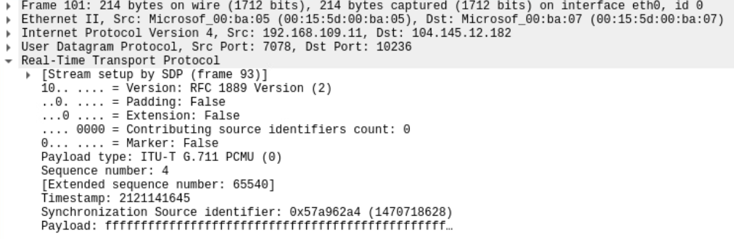
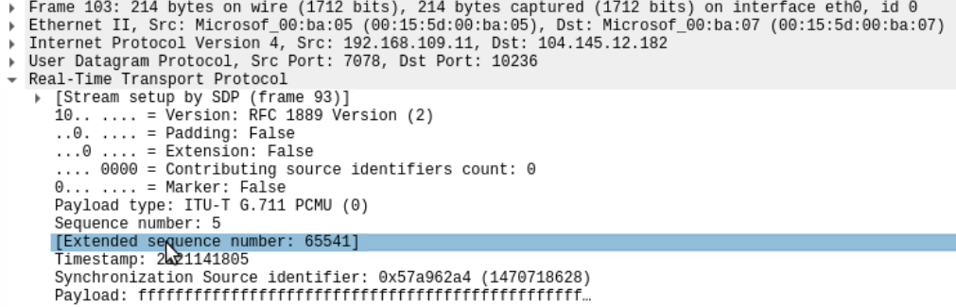
RTP Packet Payload Size
These screenshots should show the Tree View section of two consecutive RTP packets (the difference between their sequence numbers is 1), respectively. Make sure to capture the payload type, sequence number, and timestamp information.

Slide 9
RTP Packet Payload Size
1. If each increment of the RTP timestamp clock (i.e., one unit) represents 1/8,000 of a second, how many seconds or milliseconds of conversation are carried in each RTP packet? ___0.02___
2. Given the G. 711 codec bit rate as 64,000 bits per second, the payload size in seconds or milliseconds calculated above can also be represented in __1280__ bits or _160___ bytes.
3. Subtract from the Total length above: 20 bytes for IP header, 8 bits for UDP header, and 12 bytes for RTP header.
Payload length (in bytes) = Total length – 20 – 8 – 12 = __160_______
4. Does the payload length in bytes match the payload size in bytes in Step 11?
Answer: yes

Slide 10
MOD4
Session Initiation Protocol (SIP)

Slide 11
SIP Messages
The INVITE – 200 OK – ACK message sequence you observed in Steps 2, 5, and 6 is the three-way handshake used to establish an SIP session. The following values are used to uniquely identify this call:
Tag value (the value that follows the From: field) from Step 2: sip:6001@192.168.109.1;tag=uP~KF1g7k
Tag value (the value that follows the To: field) from Step 4: sip:6002@192.168.109.1;tag=uP~KF1g7k
Call-ID value from steps 2, 3, 4, 5, and 6: odu0JQ4vdM
Do the tag values and Call-ID value in the BYE – 200 OK – ACK sequence match?
Answer: yes

Slide 12
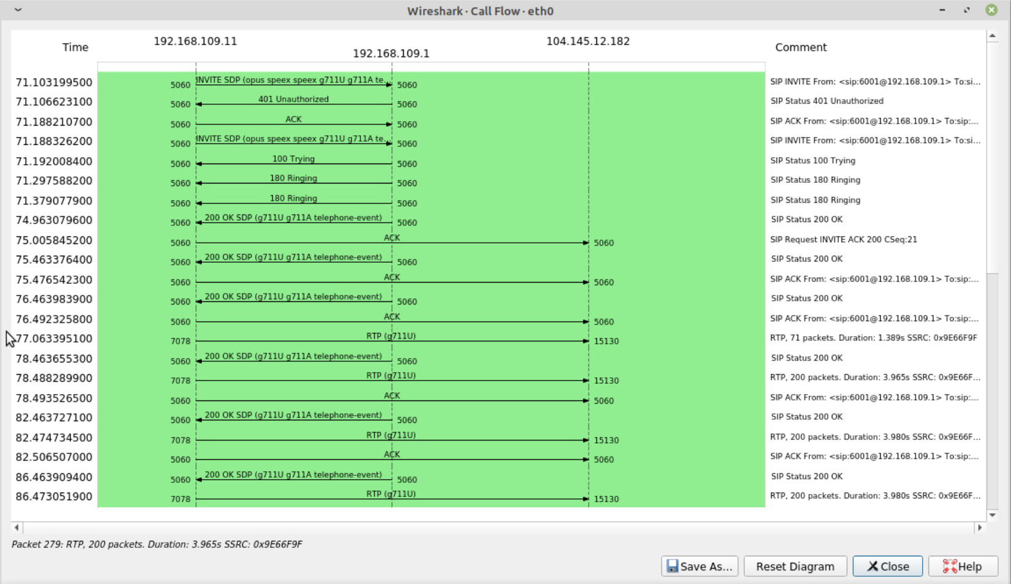
Protocol Sequence Diagram
The protocol sequence diagram shows a summary of messages exchanged among the SIP clients and SIP server during the SIP session setup and tear-down process.

Slide 13
MOD5
RTP Security

Slide 14
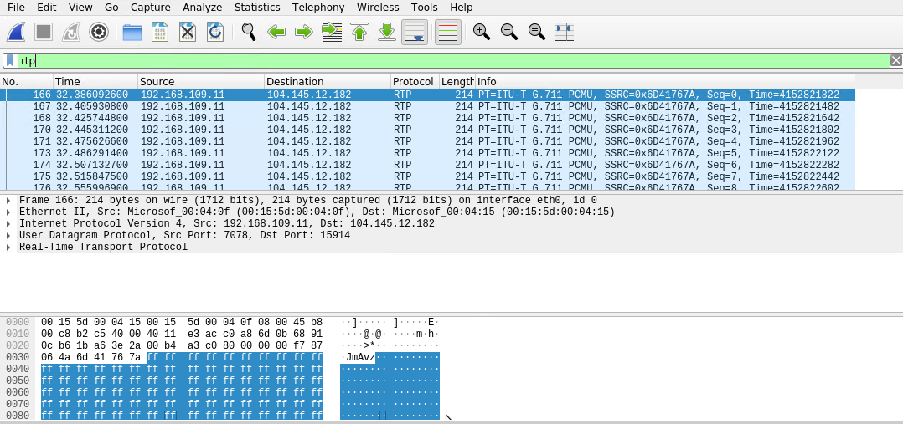
Secure Real-time Transport Protocol (SRTP)
This screenshot shows the Wireshark Packet View window, with the encrypted RTP or SRTP packets.

Slide 15
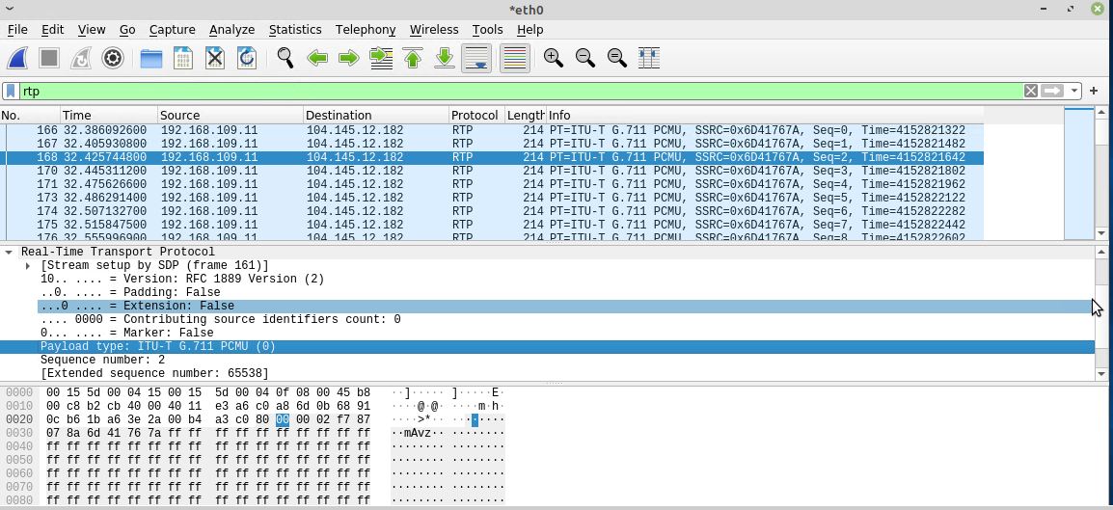
Secure Real-time Transport Protocol (SRTP)
This screenshot shows the Wireshark Tree View window, with the encrypted payload of a SRTP packet.

Slide 16
MOD6
SIP Security

Slide 17
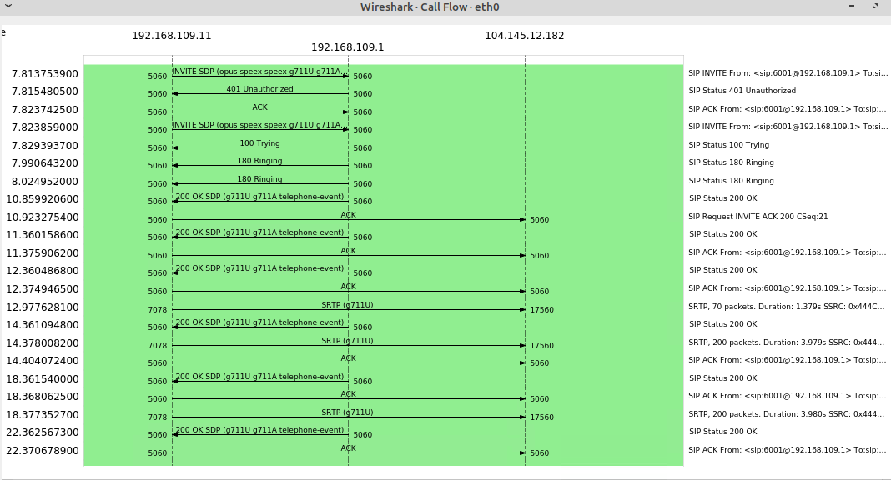
RTP Stream Decryption
This screenshot should show the protocol sequence diagram of SIP flows.
SCREENSHOT HERE

Slide 18
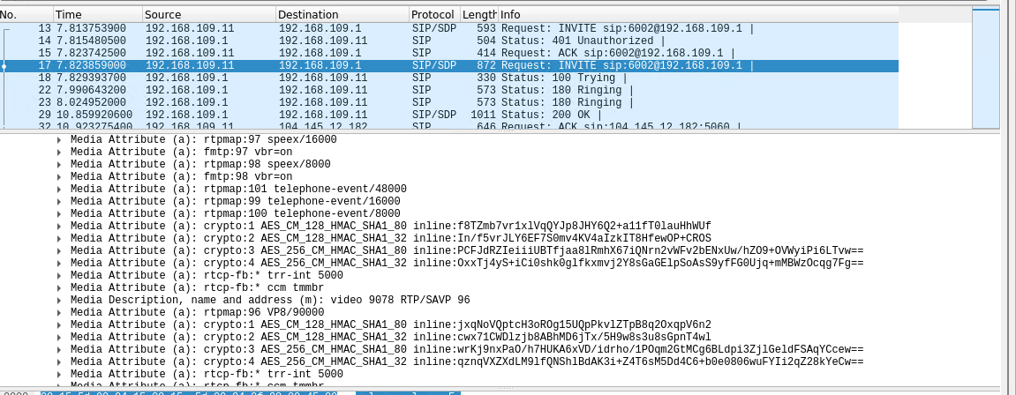
RTP Stream Decryption
This screenshot should include the Wireshark Tree View section, showing the two groups/sets of crypto: entries.
SCREENSHOT HERE

Slide 19
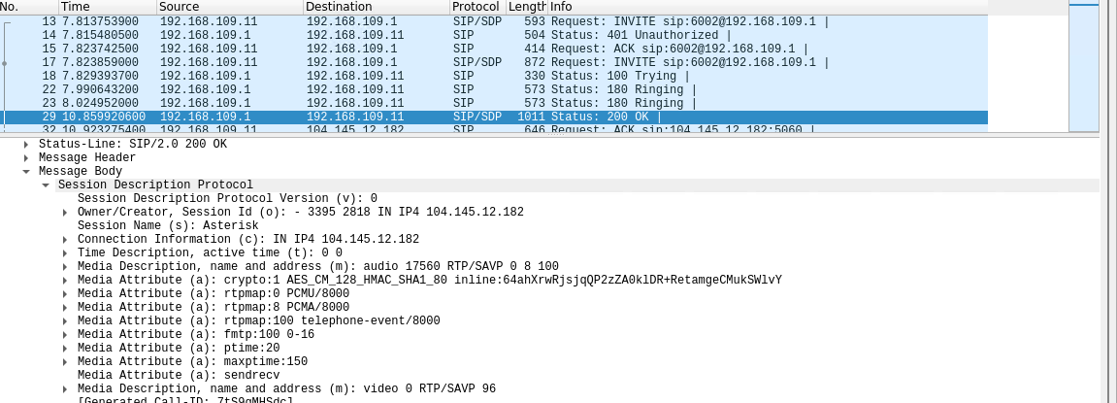
RTP Stream Decryption
This screenshot should include the Wireshark Tree View section, showing the single crypto: entry used to encrypt messages from Asterisk Server to SIP Client 1.
SCREENSHOT HERE
In the crypo: entry name, AES_CM_128_HMAC_SHA1_80, what encryption algorithm, authentication method, and hashing algorithm could you identify?
Answer:
Encryption Algorithm: AES
Authentication Method: HMAC
Hashing Algorithm: SHA1

Slide 20
Challenges
Module would not load
VM crashing
VM errors

Slide 21
Career Skills
SIP phones
CCNP
Voice, Data, and video/imaging transfer

Slide 22
conclusion
I have learned many things from this course, including a better understanding of Converged Networks.

