Slide 1


Fundamentals of Cloud Computing
NETW211

Slide 2
Introduction
Detailed, and visual summary of what we learned in NETW211.

Slide 3
Mod 2
Connecting to the EC2 instance, and Terminating the Instance

Slide 4
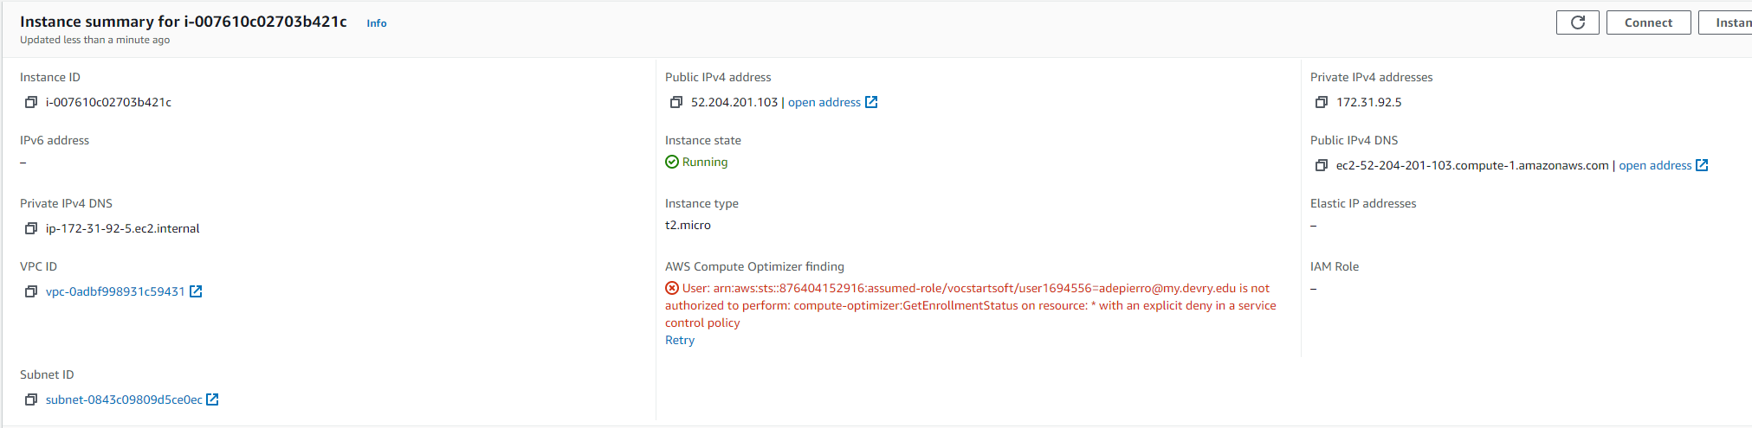
Launching an EC2 instance
This screenshot shows the instance summary page with the information about the instance.

Slide 5
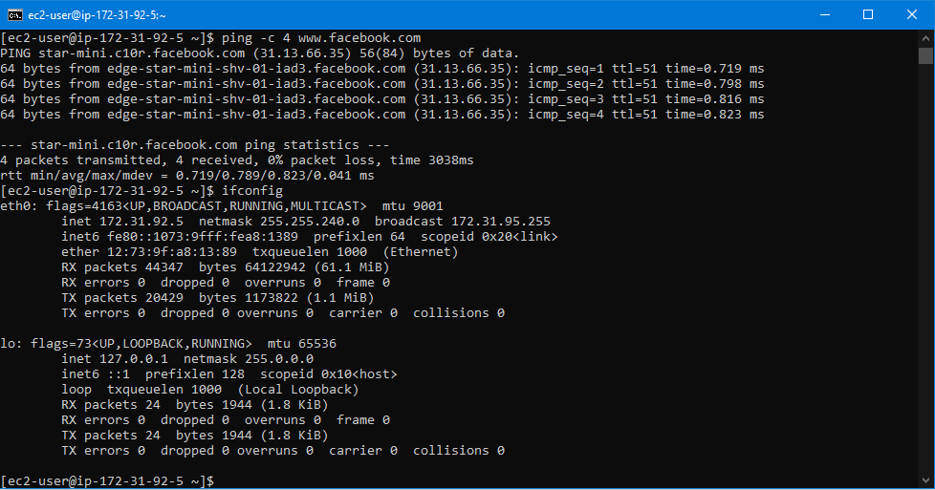
Connecting to the instance
This screenshot shows the Command Prompt window with the instance’s IPv4 address being displayed.

Slide 6

Terminating the instance
This screenshot shows the Instances page with the instance name and its state as terminated.

Slide 7
Mod 3
VPC’s and subnets

Slide 8
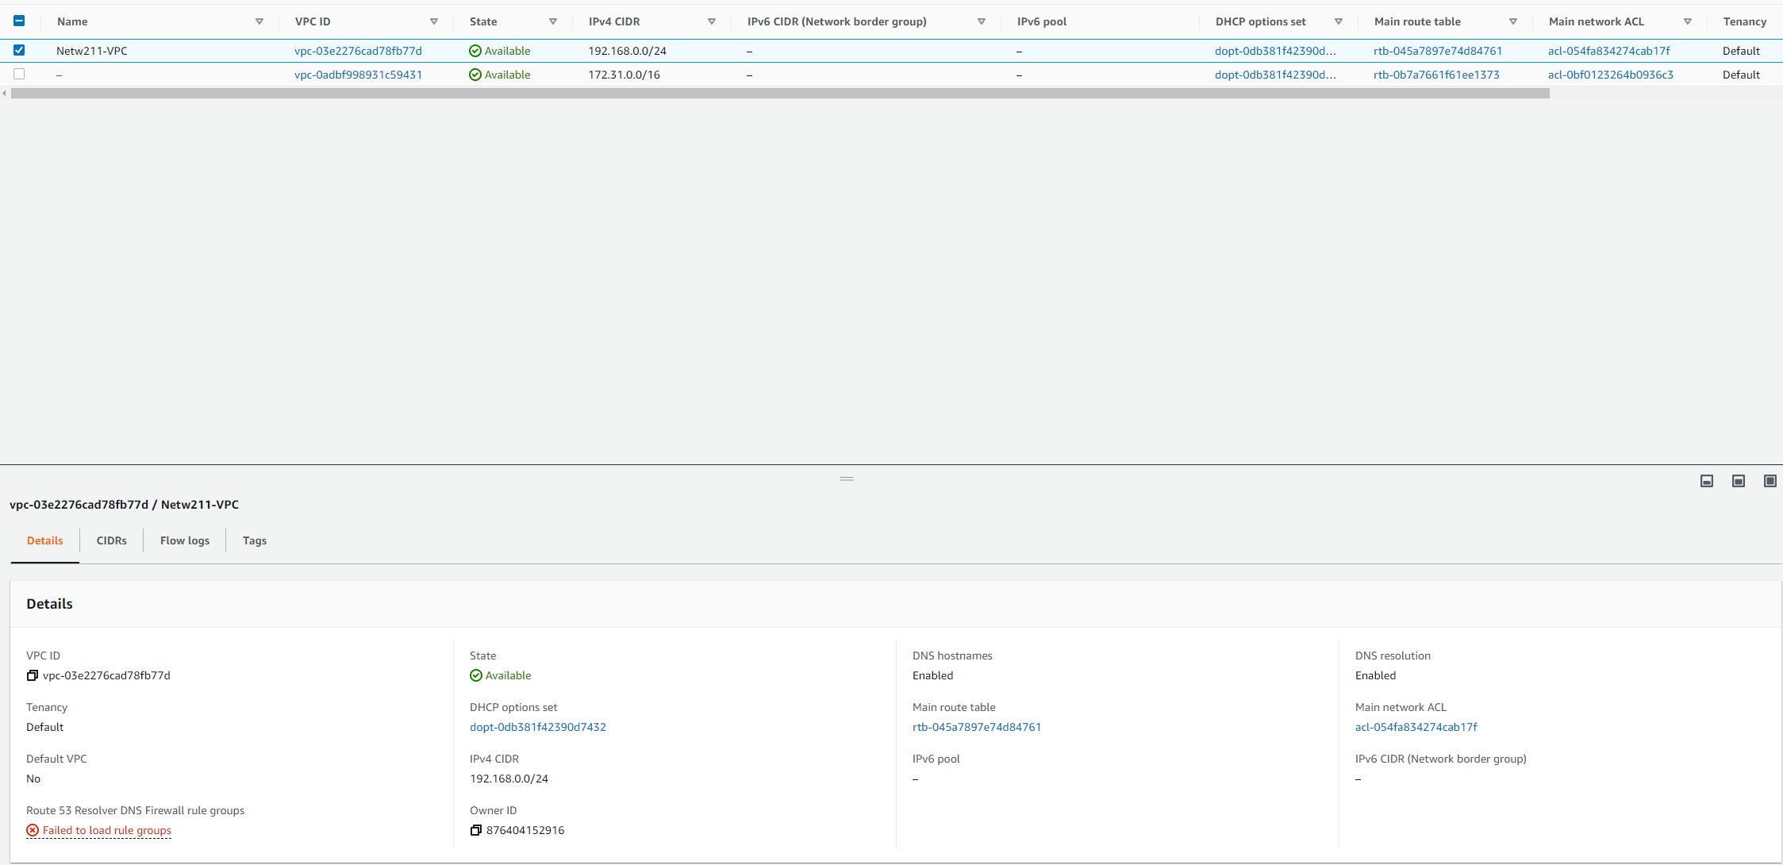
Launching a VPC with a single subnet
This screenshot shows the dashboard with the information about the VPC.

Slide 9
Questions
1. With a /26 network prefix, how many usable IPv4 addresses are there? Why is the number of available IPv4 addresses HERE shown as 59?
Answer here: 64. Aws uses 5 of the ip’s.
2. What’s the role of an Internet Gateway?
Answer here: to allow communication between your VPC and the internet.
References:
1.
2.

Slide 10
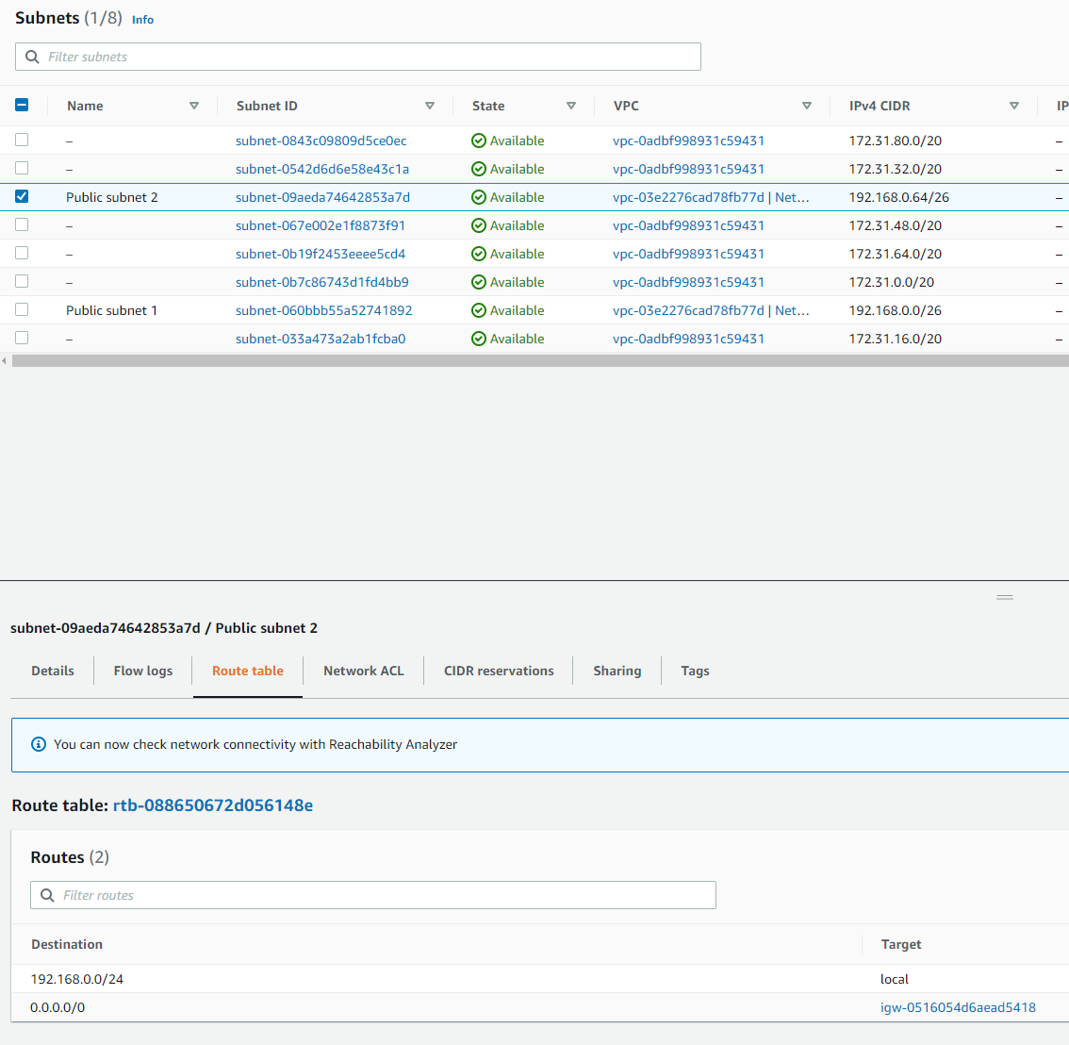
Adding another subnet
This screenshot shows the dashboard with two subnets and the route table of public subnet 2.

Slide 11
Mod 4
Launching and testing an EC2

Slide 12
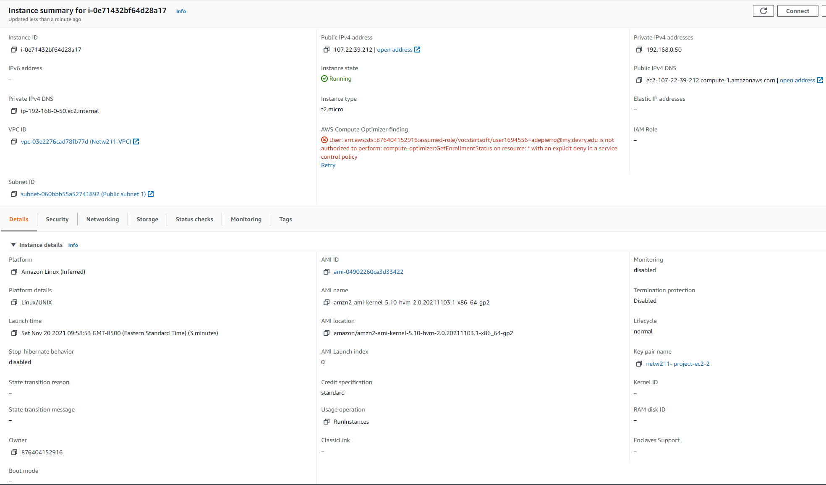
Launching an EC2 instance
This screenshot shows the Details section of the EC2 instance.

Slide 13
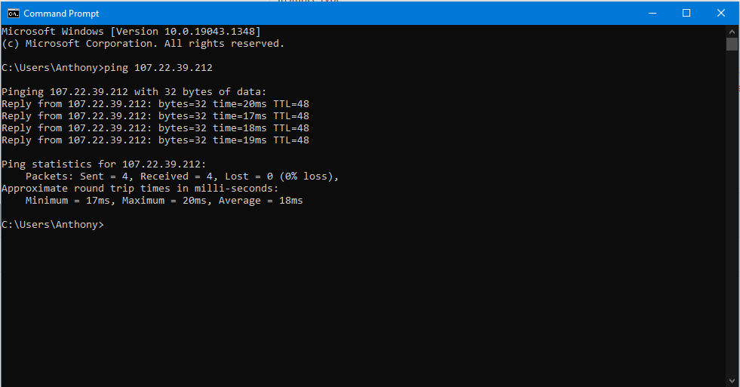
Setting up a security group
This screenshot shows the successful ping from your computer to the instance in the cloud.

Slide 14
Mod5
Configuring AWS bucket service

Slide 15
Question
What does the default encryption do?
Answer here: With Amazon S3 default encryption, you can set the default encryption behavior for an S3 bucket so that all new objects are encrypted when they are stored in the bucket. The objects are encrypted using server-side encryption with either Amazon S3-managed keys (SSE-S3) or AWS KMS keys stored in AWS Key Management Service (AWS KMS) (SSE-KMS).
References:
1. https://docs.aws.amazon.com/AmazonS3/latest/userguide/bucket-encryption.html
2.

Slide 16
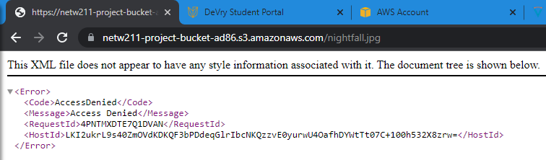
Uploading a file
This screenshot shows the Access Denied error message in a browser window.

Slide 17
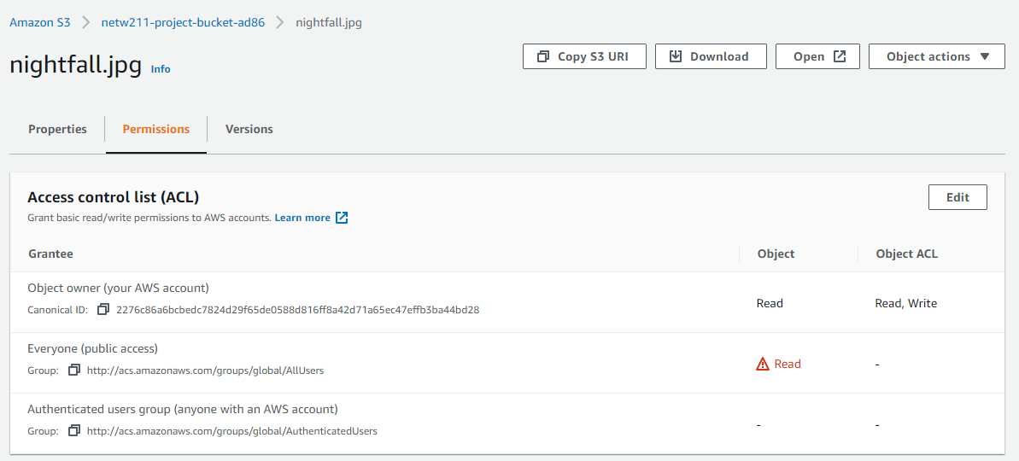
Changing permissions
This screenshot shows the permissions or access control list (ACL) information of the uploaded file.

Slide 18
Mod6
Utilizing CloudWatch to monitor EC2

Slide 19
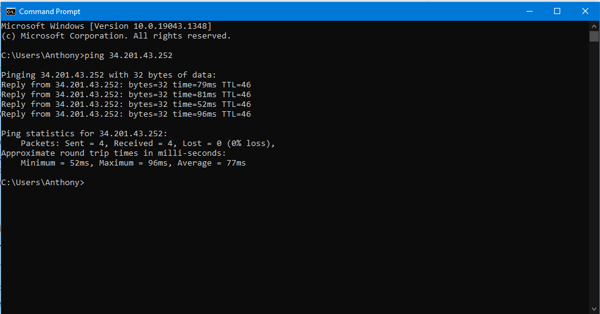
Launching an EC2 instance
This screenshot shows the successful ping from your local computer to the EC2 instance.

Slide 20
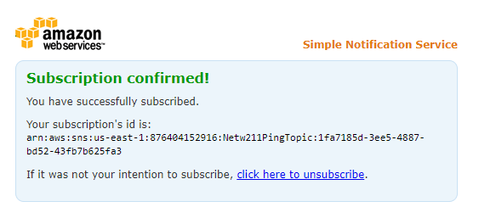
Setting up SNS notification and subscription
This screenshot shows the browser window with the “Subscription confirmed!” message (not the email!).

Slide 21
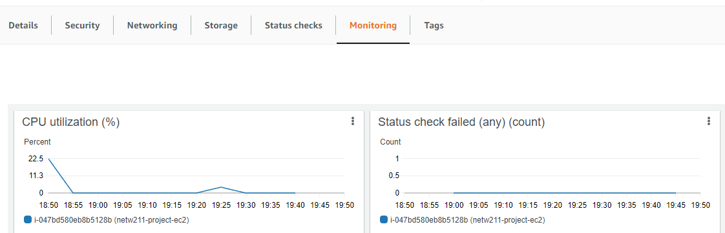
Setting up a CloudWatch alarm
This screenshot shows the EC2 dashboard with several CloudWatch metrics.

Slide 22
Challenges
Connecting to the AWS student profile
Pinging the EC2 IP address while using CloudWatch was not showing any CPU utilization (mod6)

Slide 23
Career Skills
Configuring and launching EC2 instances
Configuring an AWS bucket
Utilizing CloudWatch
Setting up alerts in CloudWatch

Slide 24
Conclusion
This project covered the fundamentals of cloud computing using Amazons AWS.
Building this project provided hands on practice to the topics covered in this course.

