Slide 1
CEIS101 Course Project
Anthony dePierro

Slide 2
Introduction
Explored IoT concepts by creating a home automation systems
LED lights
Motion sensor
Light sensor
Water sensor
DHT sensor

Slide 3
Design project on tinkercad
LED light design
Light wiring design
Design coding

Slide 4
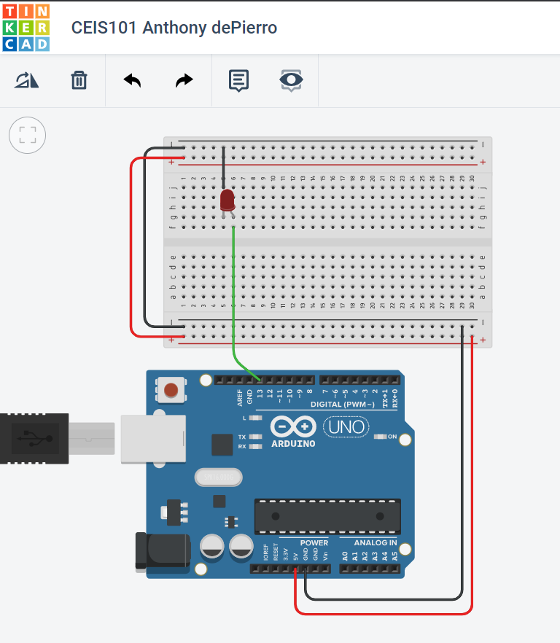
Circuit on Tinkercad

Slide 5
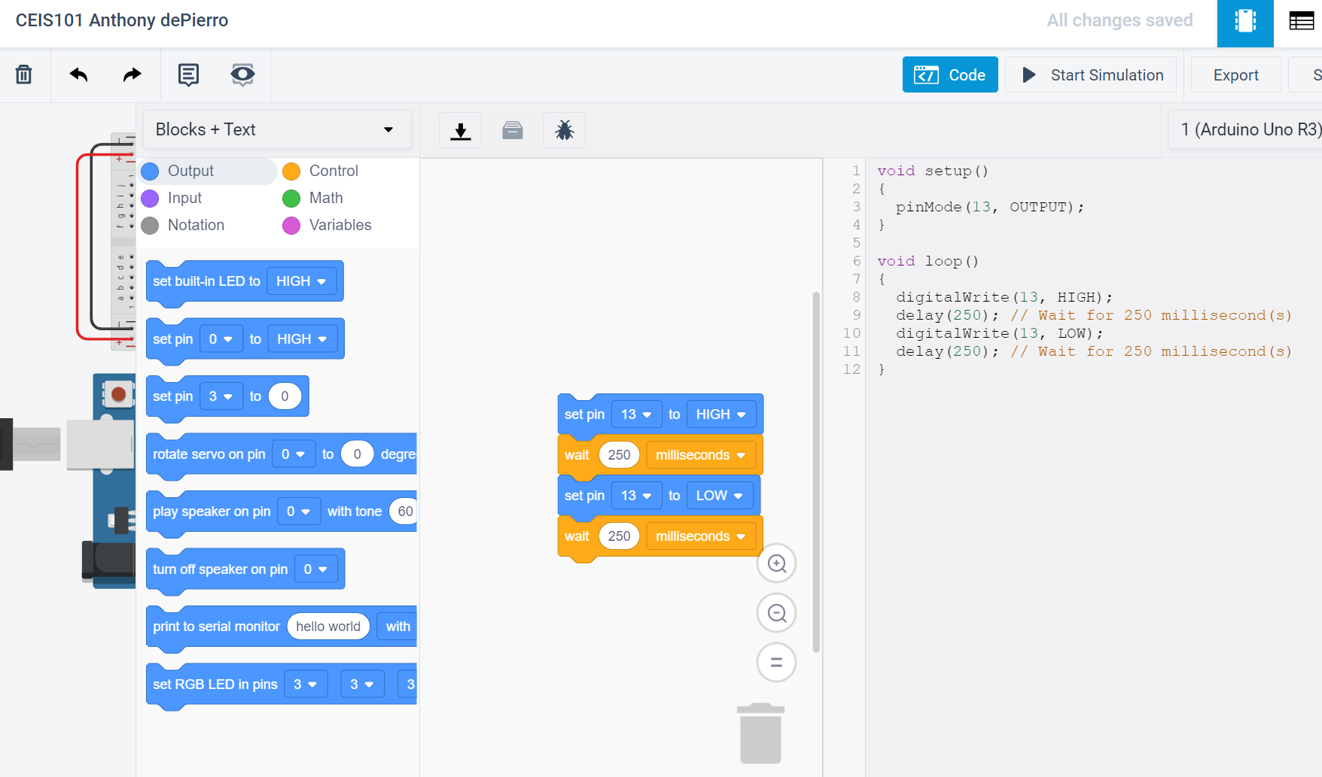
Code

Slide 6
Built IoT project using tinkercad design
Used Arduino Mega board
Used a red LED component
Used wires
Displayed functionality using serial monitor

Slide 7
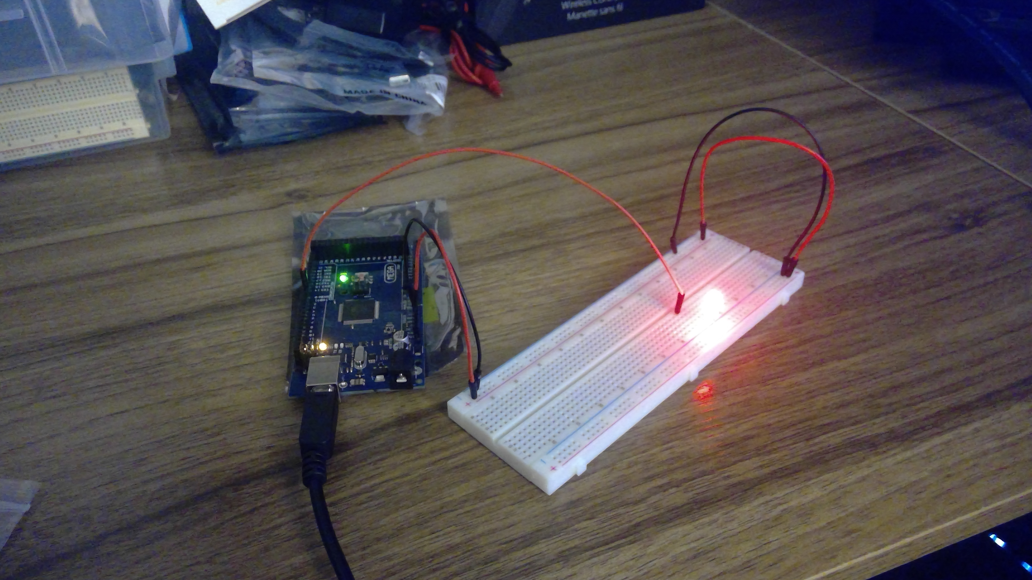
Circuit with red LED on

Slide 8
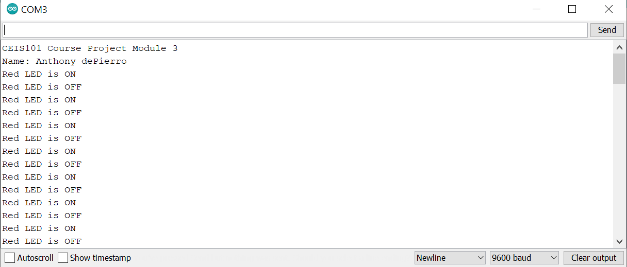
Serial Monitor

Slide 9
Open door alarm
Wired 2 LEDs to display door open
Wired an active buzzer
Coding
Verified functionality utilizing serial monitor

Slide 10
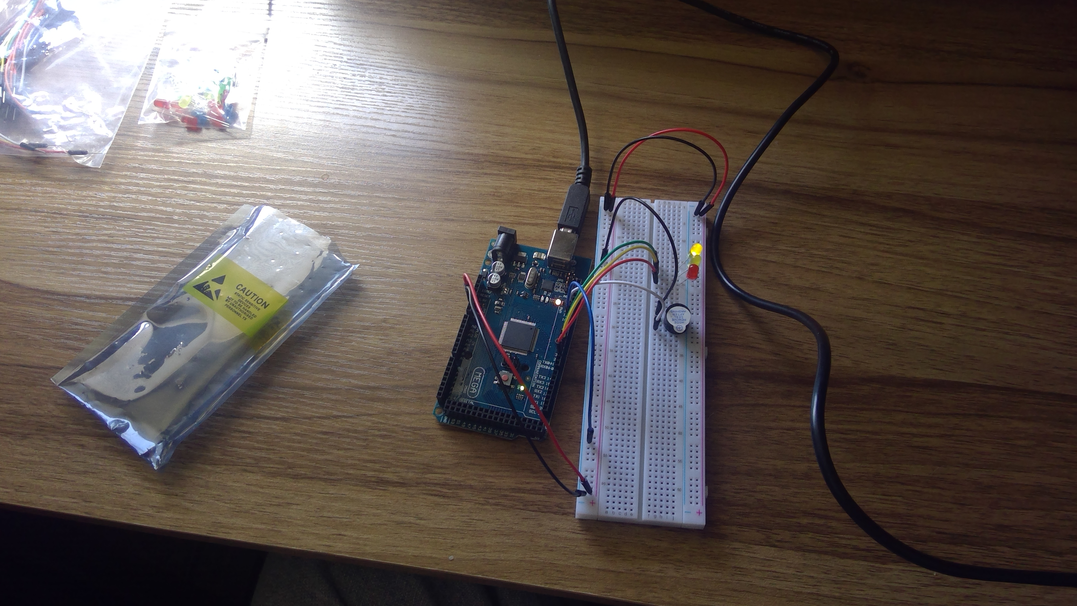
Circuit of door closed with Green LED ON

Slide 11
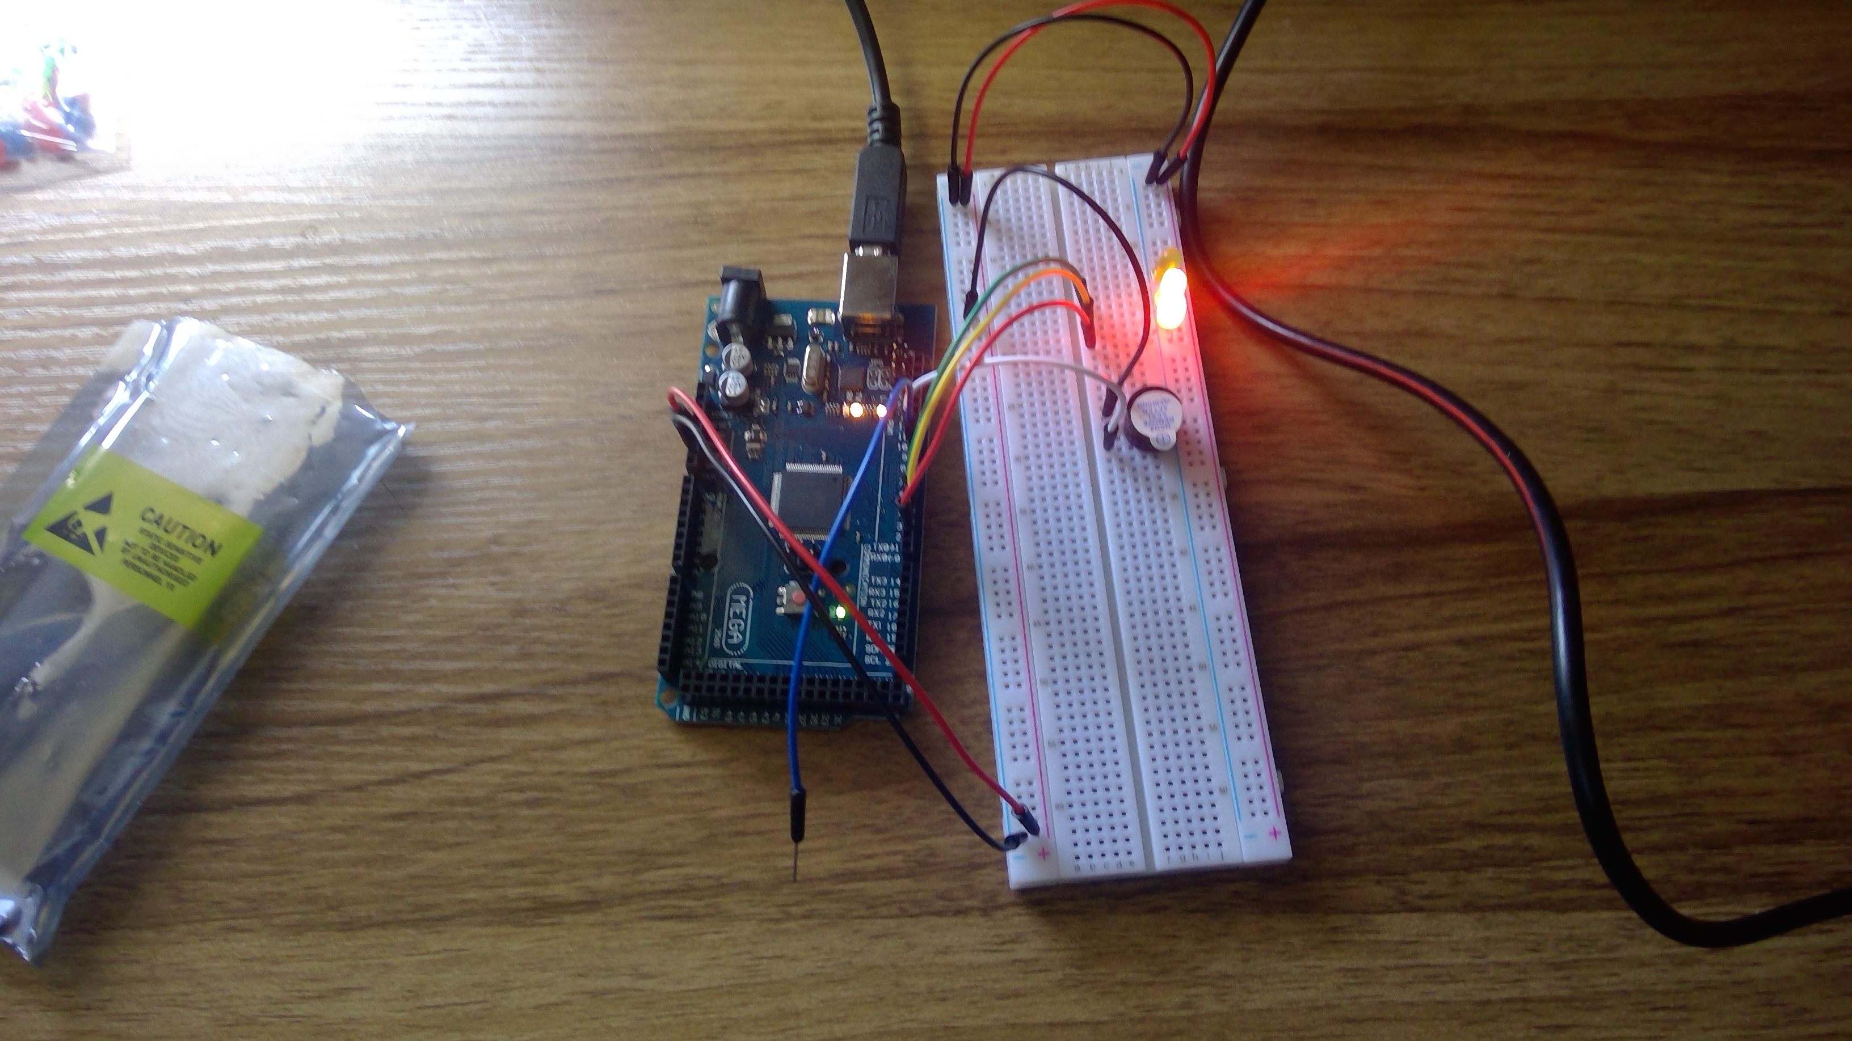
Circuit of door open with Green LED OFF/Red on

Slide 12
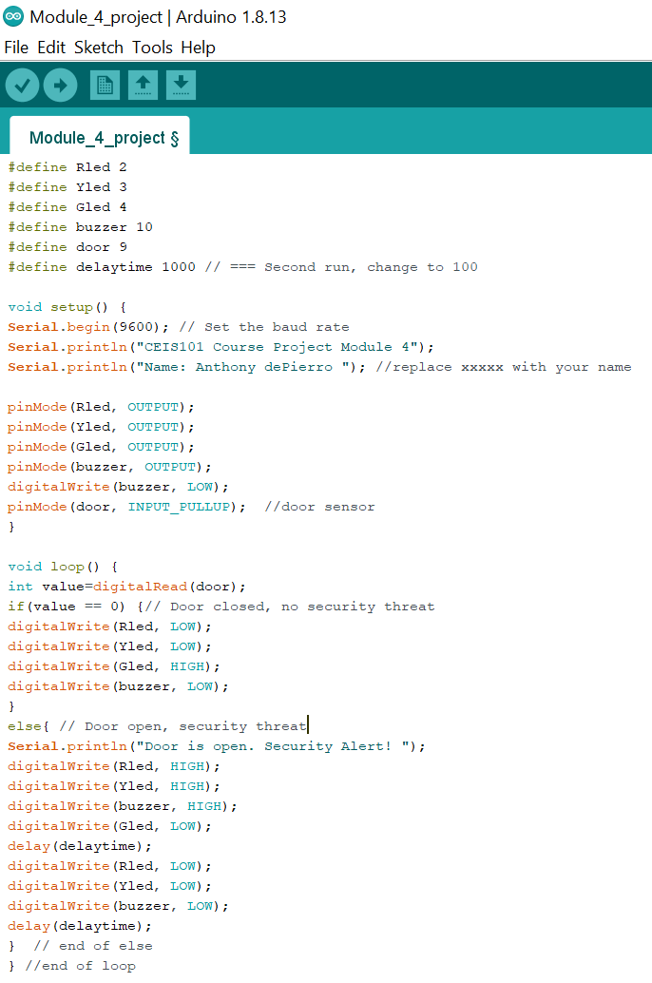
Arduino Code

Slide 13
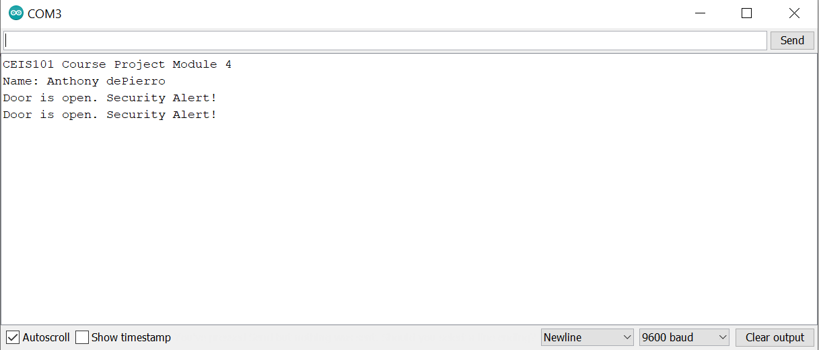
Serial Monitor

Slide 14
The Addition of a distance sensor
Added distance sensor to Home IoT
Added yellow LED
Coded for LED to react to distance
Coded active buzzer to react to distance
>12 inches=Green LED
<12 inches/>6 inches=Yellow LED
<6 inches = Red LED

Slide 15
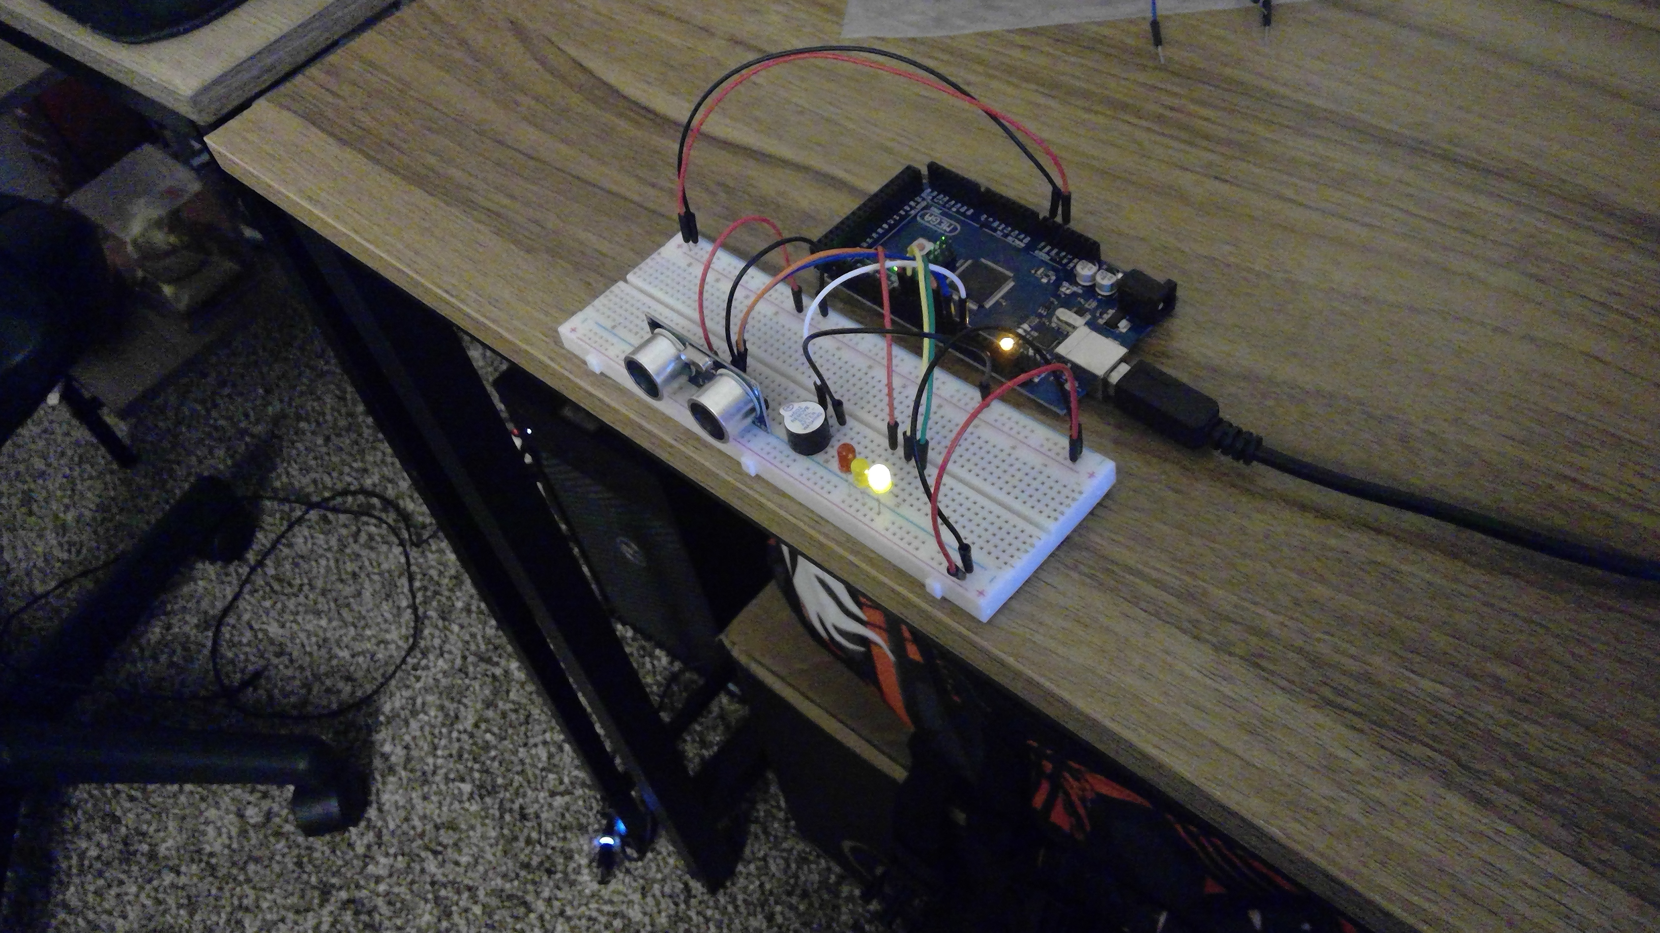
Circuit with green LED on

Slide 16
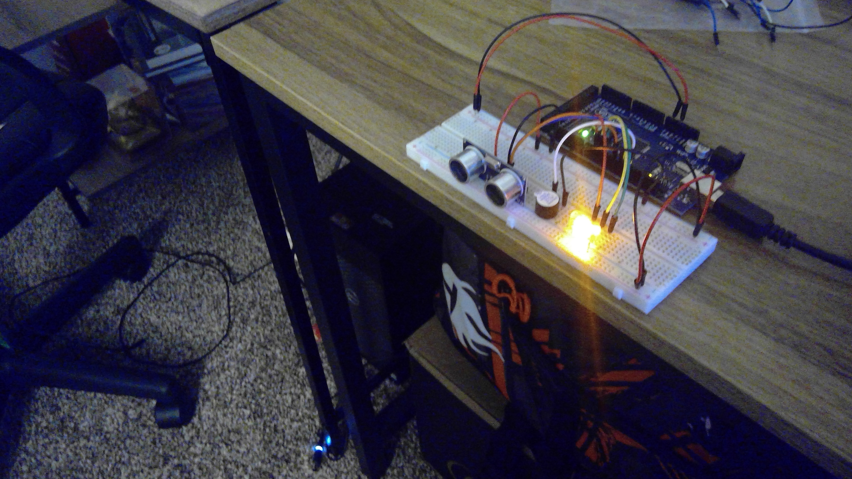
Circuit with yellow LED on

Slide 17
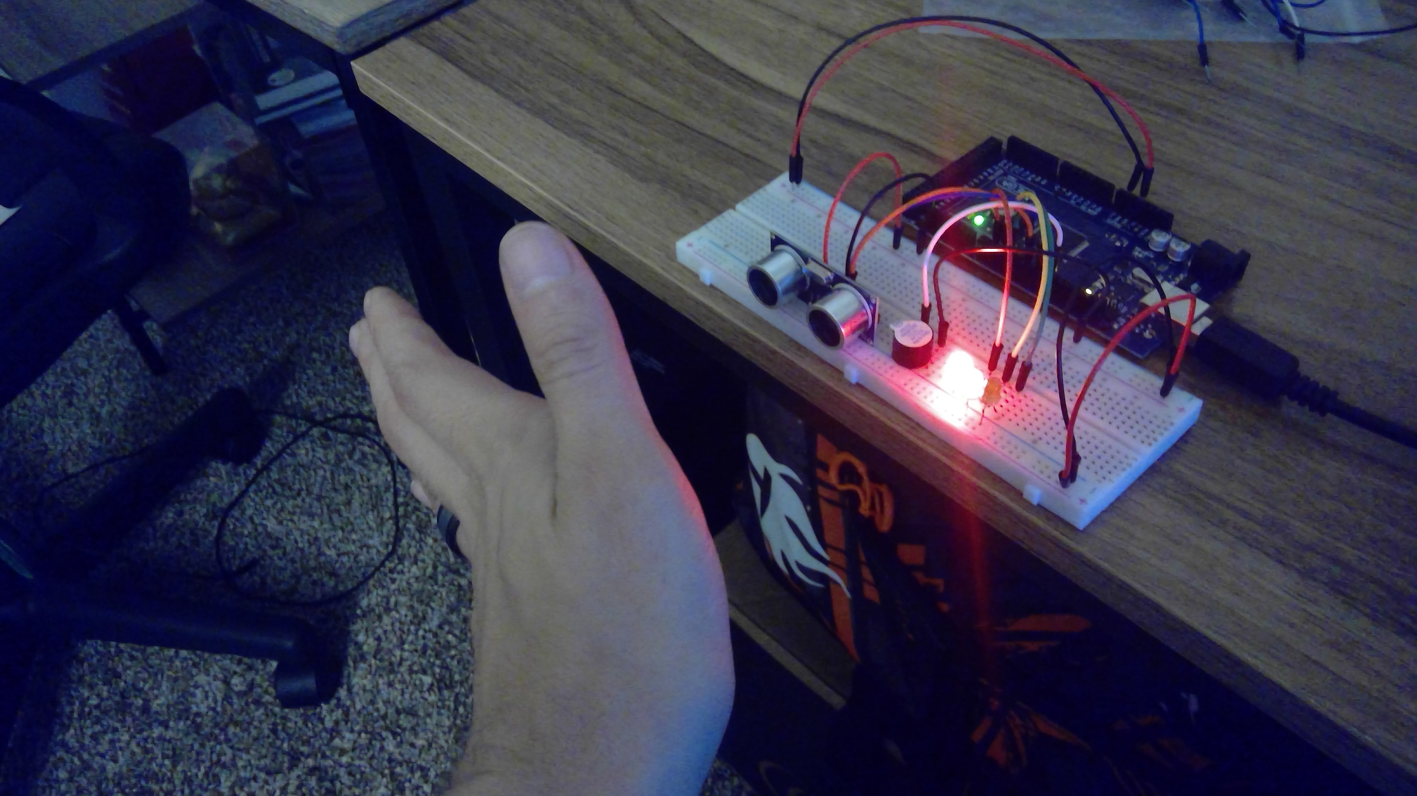
Circuit with red LED on

Slide 18
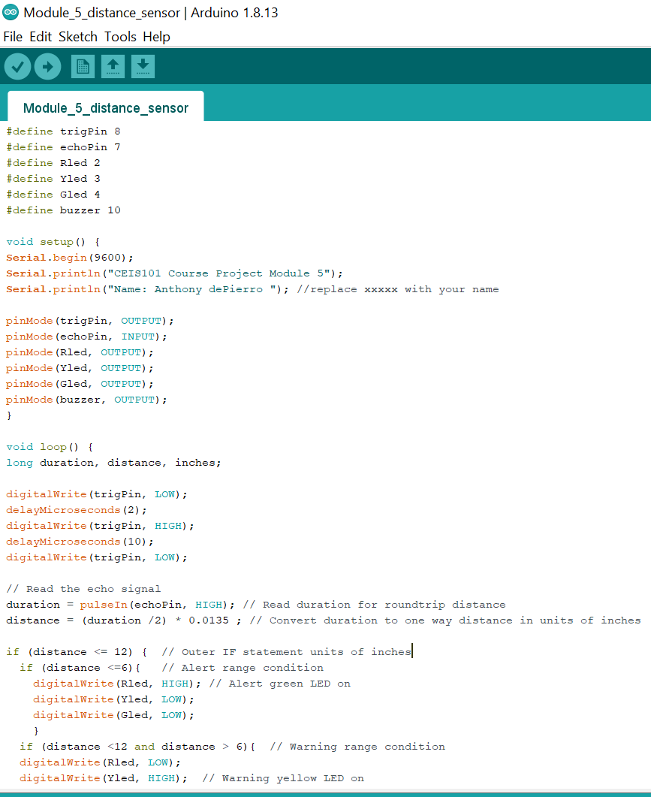
Arduino Code

Slide 19
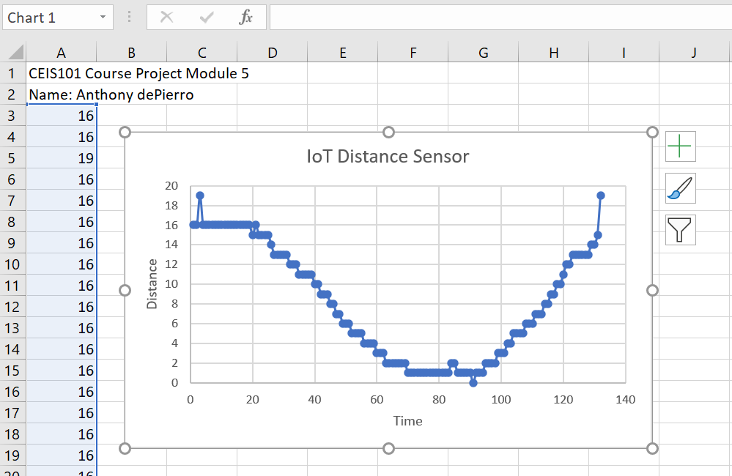
Plot of data

Slide 20
Light Sensor
Added Photo resisiter
Added Blue Led

Slide 21
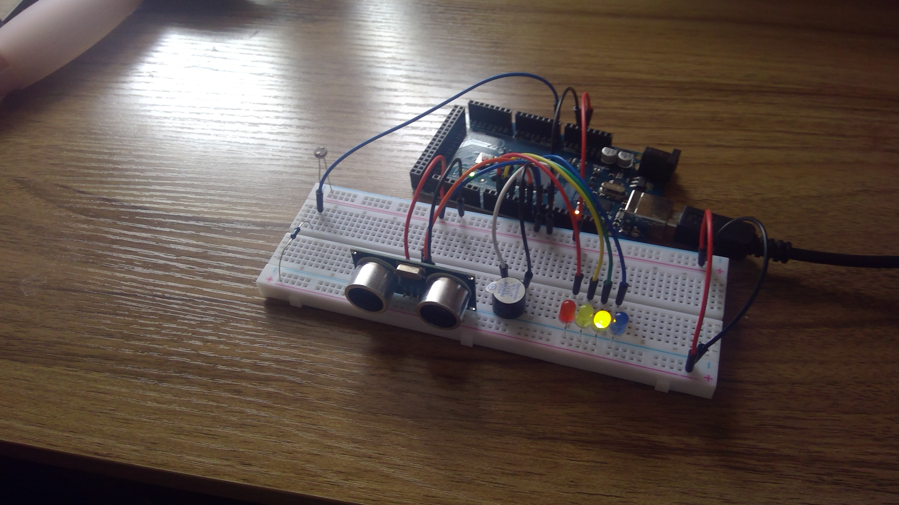
Circuit with automated LED off

Slide 22
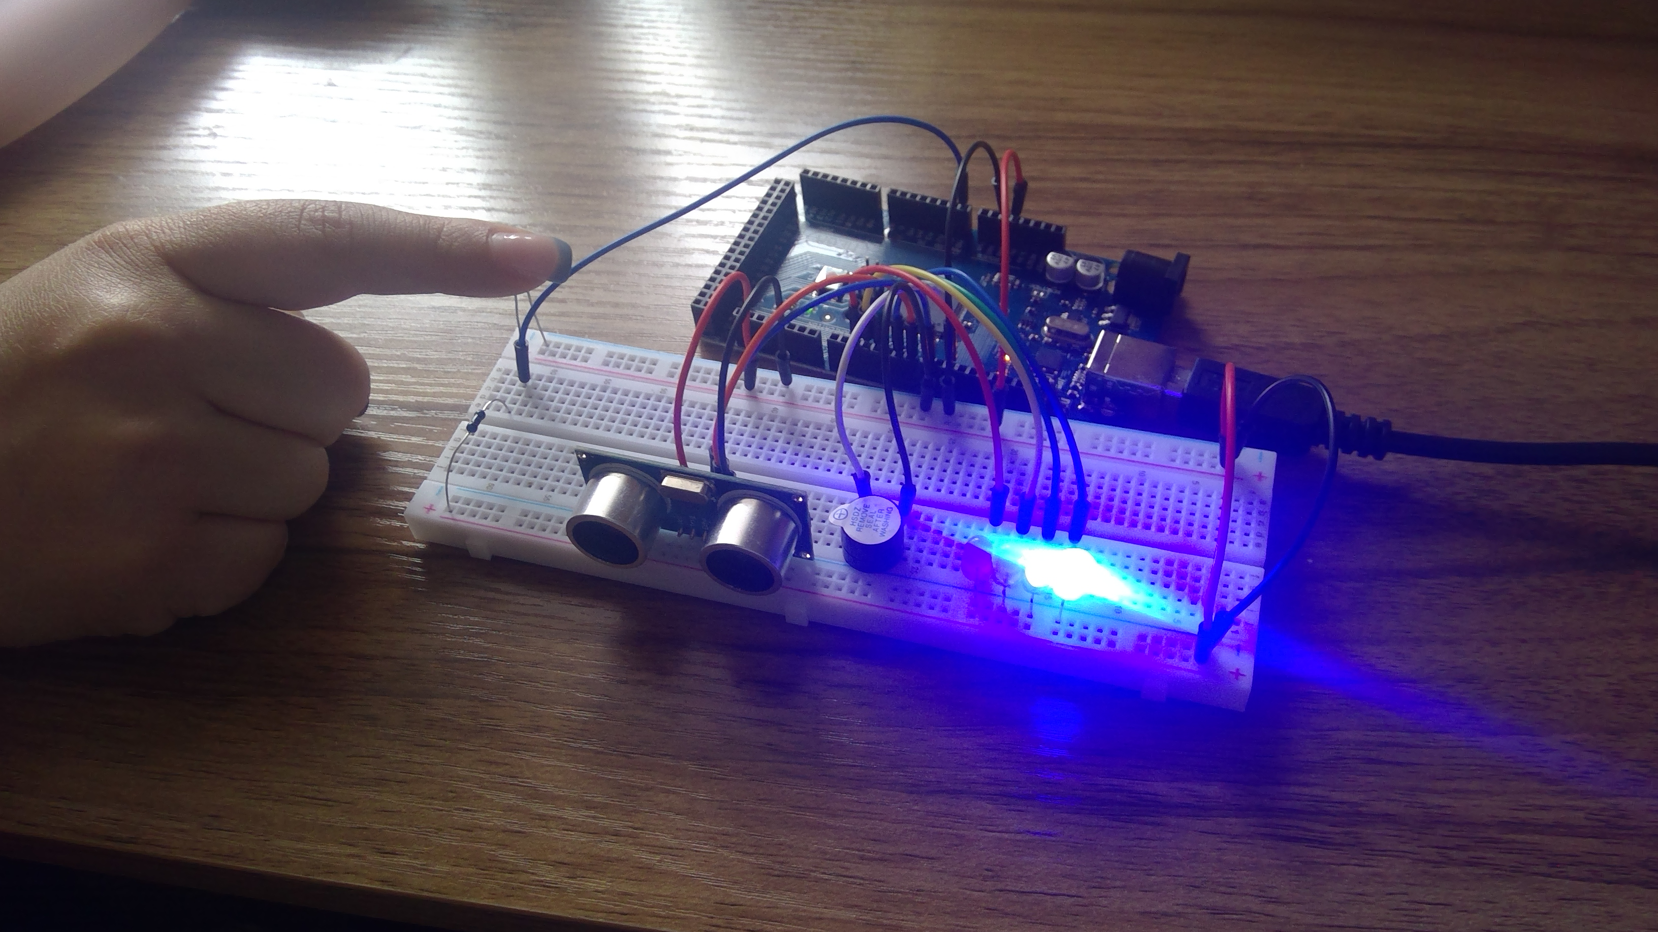
Circuit with automated LED on

Slide 23
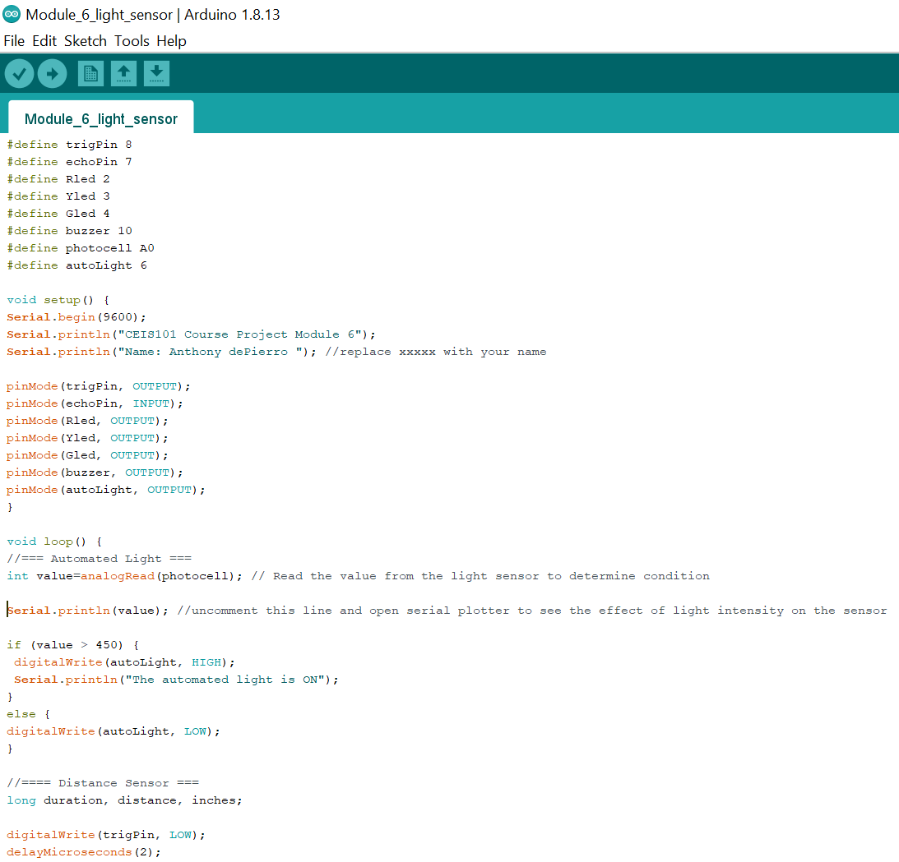
Arduino Code

Slide 24
DHT and Water sensor challenge
Added water sensor
Added LED to signal when water is present
Added DHT sensor
Monitored Humidity and Temperature using Serial Monitor

Slide 25
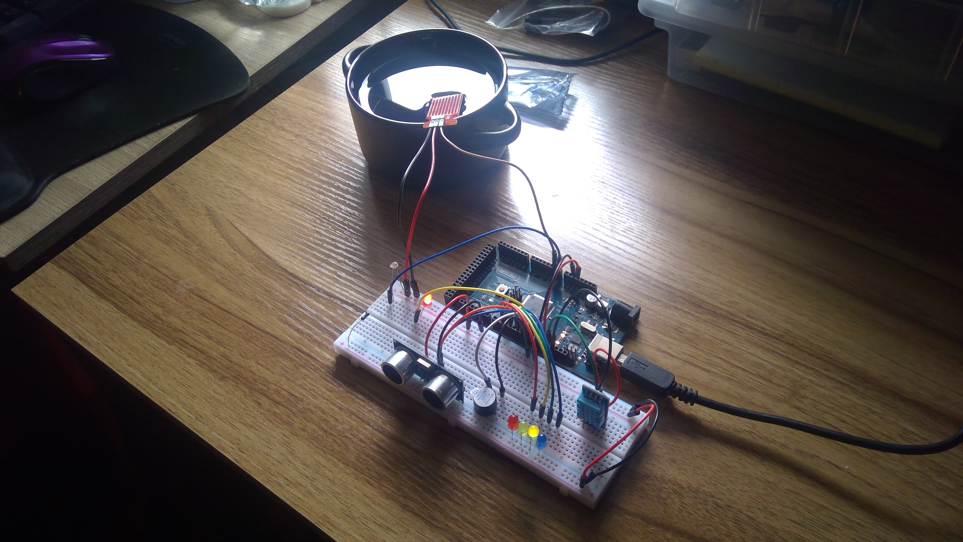
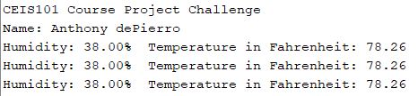
DHT/WATER SENSOR CHALLENGE
**RED LED alerts that water is present**

Slide 26
Challenges
Bad Green LED. Would not stay on. Swapped to a new LED-FIXED
Had trouble configuring the water sensor-FIXED

Slide 27
Career Skills
IoT skills by working with Arduino
Prototyping skills by working with Tinkercad
Wiring skills
Industry standard with wiring colors
Different sensors and their functionality

Slide 28
Conclusion
Learned how to wire components
Began to learn how to read code
Learned how components worked together
Challenged myself to configure DHT and water sensors

